Slide 1
SPACE PROJECT Communication Satellite Project (Solidaridad Mexican Satellite)
Salvador Landeros, Miguel Calvo, Ramón Martínez

Slide 2
Scope
Topic 1: Mission Objectives
Topic 2: General Requirements
Topic 3: Payload solution
Topic 4: Subsystems solution
Topic 5: Integration and tests
Topic 6: Launch
Topic 7: Earth segment solution
Topic 8: Training and operations

Slide 3
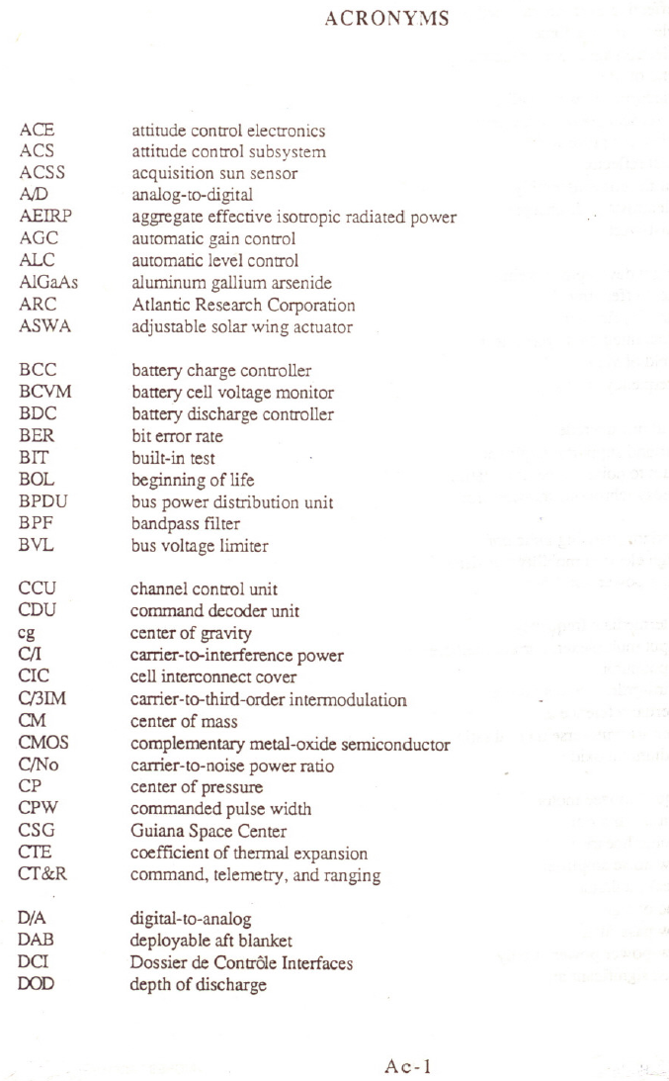

Slide 4
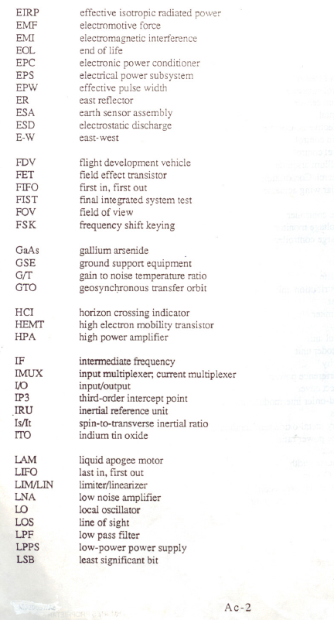

Slide 5
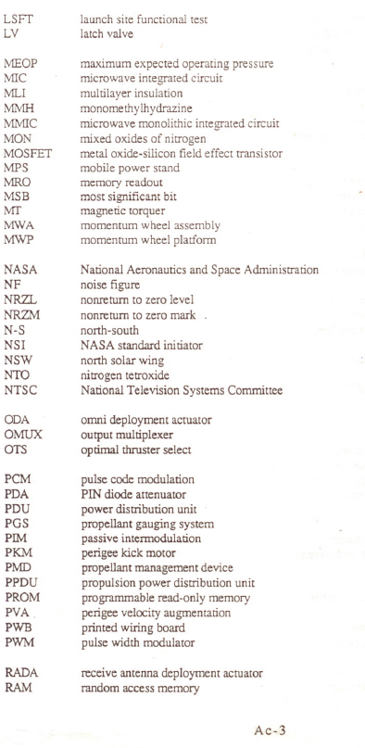

Slide 6
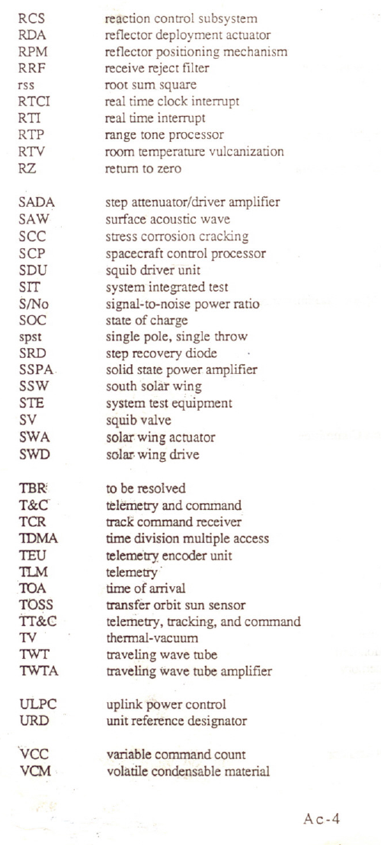

Slide 7
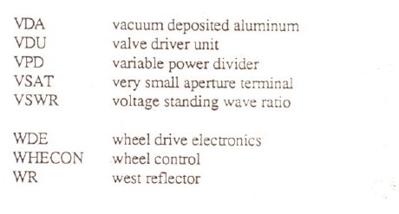

Slide 8
Topic1: Mission objectives
General objective
To provide telecommunications solutions in Mexico,USA and LatinAmerica
Specific objectives
To offer C, Ku and L band services(FSS, DBS, Mobil)

Slide 9
Space Mission Architecture
Subject
Mission and Ground Element
Orbit
Mission
Concept
Space Element
Payload
Bus
Launch Element

Slide 10
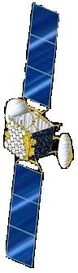
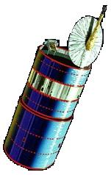
Position and neighboring of the Solidaridad Satellites
SOLIDARIDAD 2
SOLIDARIDAD 1
MORELOS II
ANIK E1
ANIK C3
ANIK E2
ANIK C1
GSTAR 2
GSTAR 1
111.1°
114.9°
113.0°
107.3°
109.2°
115.8°
118.7°
105°
121.0°
West Longitud

Slide 11
Spacecraft
Stabilization
Transfer/drift orbit | Stable spinner
Geosynchronous | 3-axis body stabilized
Stationkeeping performance | Limit, deg | Correction Interval (Nominal), Days
North – south | ±0.05 | >14
East – west | ±0.05 | >14
Mission/design life | 14 yr
Weight | < 3000 kg

Slide 12
Topic 2: General requirements

Slide 13
Communications
The Satellite Communications subsystem shall include all necessary antennas and microwave transponder hardware to receive, amplify and transmit microwave signals within the Ku–band services areas, the C–band services areas and the L–band services areas.
This subsystem shall comprise 16 linearised 14/12 GHz transponders(54 MHz bandwith), 18, 6/4 GHz transponders(12, 36 MHz bandwith and 6, 72 MHz bandwidth) and one 1.6/1.5 GHz transponder of 31 MHz bandwith

Slide 14
Communications(Cont)
The transponders shall be capable of being operated in either single carrier or multicarrier per transponder modes including:
Single carrier or two-carrier FM television.
Single carrier FM television mixed with a number of narrowband SCPC carriers or a wideband digital carriers.
Multicarriers such as FM/FDM
SCPC/ FM/ FDMA
SCPC/ PSK/ FDMA
TDM/ PSK/ TDMA
CDMA

Slide 15
Frequency Bands
The subsystem shall receive and transmit in the following frequency bands:
Frequency Band | Receive |  |  | Transmit
C Ku L | 5.925 14.0 1626.5 | to to to | 6.425 GHz 14.5 GHz 1660.5 MHz | 3.7 11.7 1525 | to to to | 4.2 GHz 12.2 GHz 1559 MHz

Slide 16
Polarization C band
Transponder | Receive Polarization | Transmit Polarization
1-12(Narrow Band) 1-6(Wide Band) | Horizontal Vertical | Vertical Horizontal

Slide 17
Polarization Ku band
Transponder | Receive Polarization | Transmit Polarization
1-8 9-16 | Vertical Horizontal | Horizontal Vertical

Slide 18
Polarization L band
Transponder | Receive polarization | Transmit polarization
1 | Right-hand circular | Right-hand circular

Slide 19
Communications
 | C Band (36 MHz) | C Band (72 MHz) | Ku Band (54 MHz)
EIRP (dBW) (EOC) | R1: 37.0 R2: 36.2 R3: 36.6 | R1:40.1 | R4:47.0 R5:46.40
Capacity(transponders) | 12 | 6 | 16
Principal cities, USA | Los Angeles San Antonio Miami | Los Angeles and San Antonio | Los Angeles, New York, Miami, Houston, Dallas and San Francisco
Latin America | Mexico, Argentina, Chile Venezuela, Colombia and Central America | Mexico, Belice and Guatemala | Mexico, Guatemala, Belice and Cuba
G/T /(dB/°K) EOC | R1=2.5 R2=-0.5 R3=1 | R1: 2.0 | R4: 2.2 R5: 2.5

Slide 20
Communications (Cont.)
Solidaridad 1 | C Band (36 MHz) | C Band (72 MHz) | Ku Band (54 MHz)
Saturation density flux | R1 : -92.0 R2 : -92.0 R3 : -89.0 | R1 : -89.0 | R4 : -95.0 R5 : -95.0
Redundancy | 14 SSPAs for 12 channels | 8 SSPAs for 6 channels | 20 TWTAs for 16 channels
Amplifiers Power | SSPA of 10 and 16 Watts | SSPA of 14.4 Watts | TWTA of 45 Watts
Input attenuation range | 0 to 14 dB in 2dB steps | 0 to 14 dB in 2dB steps | 0 to 22 in 2 dB steps
Degrees of tolerance in the stationkeeping | ±0.05º N-S ±0.05º E-W | - | -
Fuel at december 1st, 1998 |  | 271.821
Operation Life: 14 years |  | Start Operation: January,1994

Slide 21
Communications(Cont)
The tenderer shall provide detailed calculations of predicted EIRP, including justification for all assumed output RF losses and degradations to cater for RF variations over temperature and spacecraft life. Predicted worst-case end-of- life EIRP performance shall include a minimum margin of 0.5 dB relative to these specifications.
In calculating G/T values, a spacecraft antenna noise temperature of 290º K shall be assumed, all noise services generated within the spacecraft shall be included, and a minimum margin of 0.5 dB relative to especifications under worst-case predicted end-of-life conditions shall be included.
The SFD at any selected gain step shall not vary more than ±0.5 dB over any 24 hour period and ±2 dB over the spacecraft service life.

Slide 22
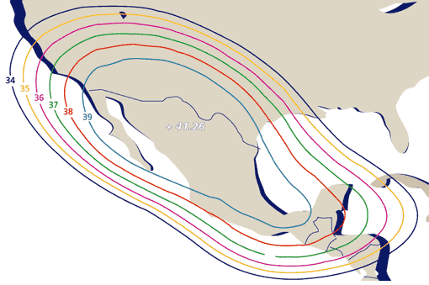
Solidaridad C1 Band
+ 41.26

Slide 23
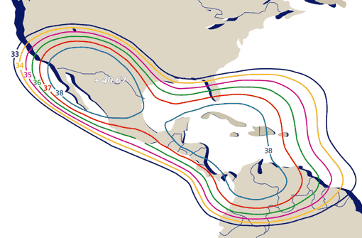
Solidaridad C2 Band
+ 40.67

Slide 24
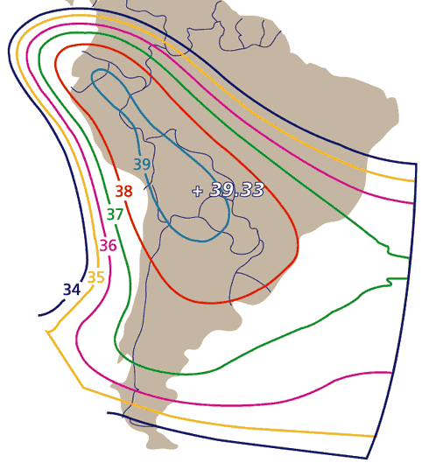
Solidaridad C3 Band

Slide 25
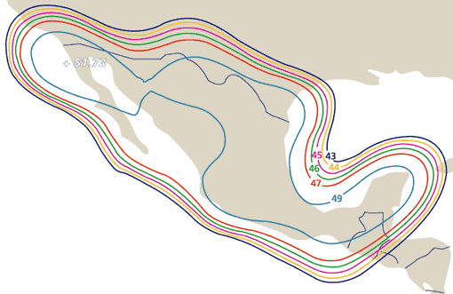
Solidaridad Ku4 Band
+ 51.73

Slide 26
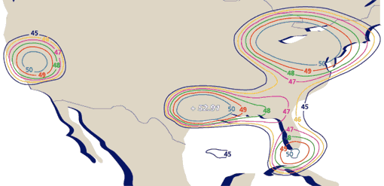
Solidaridad Ku5 Band
+ 52.91

Slide 27
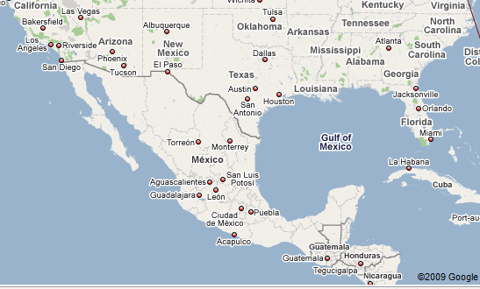
Solidaridad Satellite Region 6 (R6) “L” Band
PIRE: 46.0 dBW

Slide 28
C – Band Repeater
Coverage:
 | R1 | Mexico, US southern border and Central America northern part.
 | R2 | R1 + Southern Florida, the Caribbean, Central America, Colombia and Venezuela.
 | R3 | Most of the remaining parts of south America with the exception of Brazil.
Life: | 15 years
EIRP: | R1: 37dBw, R2: 36dBw, R3: 36dBw 40dBw
No. Channels: | 18
Amplifiers: | TWT’s or SSPA’s 14 for 12 8 for 6
3 for 2 C Band receivers 16 for 12 C Band Channel Control Units 8 for 6 C Band Channel Control Units 18 Input Multiplexers 18 Output Multiplexers

Slide 29
Ku Band Repeater
Coverage:
 | R4 | Mexico, Los Angeles and San Antonio.
 | R5 | Major United States cities and parts of Canada and Cuba.
Life: | 15 years
EIRP: | R4: 47dBw, R5: 46dBw
No.Channels: | 16
TWT’s: | 20 for 16 Ku band
5 for 3 Ku band receivers 10 for 8 Band channels Control Units 10 for 8 Band channels Control Units 16 Channel Input Multiplexers 16 Channel Output Multiplexers

Slide 30
L band repeater
-Coverage: México and territorial waters
-Life: 15 years
-Number of channels: 7 sub-bands
-PIRE: 45 dBw
-Amplifiers: 6(4 operating, 2 redundant)
-Antennas: Diplexed phased array

Slide 31
Telemetry, Tracking and Command(TTC)
The TTC subsystem shall provide the capabilitiy to monitor and control the spacecraft so that it meets all performance requirements and shall be suitable for controlling the spacecraft during periods of attitude instability for any attitude and attitude rate that is theoretically achievable by the spacecraft.
The TTC system shall not prevent the spacecraft being launched as co-passenger with another spacecraft using C band telemetry and command frequencies at similar signal levels. As a minimum it is requiered to have one TTC channel available in transfer orbit on a full time basis up untill apogee motor fire or until the two spacecraft can be spatially isolated by the TTC earth station antennas

Slide 32
TTC(Cont)
Command requirements
The probability of successfully executing a command shall be at least 99.98% for single entry attemt under all nominal transfer orbit and on-station operating conditions.
The command subsystem shall serve as an uplink receiver for ranging signals.
The command subsystem shall consist of redundant command receivers operating at the same frequency and redundant decoders, all of which shall be active whenever the electrical power bus is supplying power.
The command subsystem shall operate at C band

Slide 33
TTC(Cont)
Telemetry requirements
The telemetry subsystem shall collect and transmit data pertaining to all spacecraft subsystems in quantities, accuracies and at time intervals sufficient to determine spacecraft performances, to identify the necessity to take corrective action and to enable analysis of failures.
The telemetry subsystem shall also provide a downlink capability for ranging system.
The Telemetry system shall comprise, as a minimum, two fully redundant subsystems, each operating at the same frequency.
The Telemetry subsystem shall operate at C band.

Slide 34
TTC(Cont)
Both the command and telemetry subsystems shall interface with the omnidirectional antenna for transfer orbit an on-station backup capability. Both subsystems shall also interface with the high gain communications antenna for normal on-station operations.
The TTC subsystem shall provide a facility to carry out ranging for spacecraft orbit determination operations.

Slide 35
Attitude Subsystem
The tenderer shall provide a full description of the proposed spacecraft attitude determination and control subsystem including analysis of spacecraft dynamic stability and attitude subsystem performance during all operational phases. Any included contingencies and margins(eg, for qualification testing) shall be identified.
The design of all sensors shall minimise the effects of seasonal, thermal, optical, RF and diurnal variations.
The design of the attitude determination of the nominal thrust axis of the apogee motor can be determinated, through appropriate ground processing, to an accuracy of 1.2 degrees, after no more then one half hour of continuous observation, and to an accuracy of 0.5 degrees, after no more than two hours of observation, either continuous or cumulativa

Slide 36
Electrical Subsystem
The electrical subsystem shall generate, store, condition and distribute the electrical power required for all spacecraft loads to fulfill the mission requirements during all mission phases and expected modes of operation. The subsystem shall consist of:
Solar arrays as primary power source
Batteries for energy storage as secondary power source
Power control, conditioning and protection circuits
No single part failure in the power subsystem shall prevent the subsystem from satisfying the load requirements.
No single part or insulation system failure in the spacecraft shall open or short a main electrical power bus.

Slide 37
Electrical Subsystem (Cont.)
TWTAs shall be automatically disconnected from the power bus if an undervoltage condition develops on the power bus. In order to ensure the ability to exercise command control of the spacecraft, the TC&R susystem and all other housekeeping loads, as a minimum, shall continue to meet all performance requirements at a bus voltage 10% less than the TWTA undervoltage conditions, it is required that essential loads are kept operational for as long as practicable, and that non-essential loads ie. loads not needed to re-acquire spacecraft function after a temporary failure are disconnected. After any zero bus voltage condition, the TC&R equipment shall recover automatically in a safe configuration with unimpaired performance.
The tenderer shall provide a full description of the proposed spacecraft power subsystem inlcuding a detailed power budget for the spacecraft , showing actual or apportioned power requirements for each unit subsystem under steady-state and transient conditions and identifying any included contingencies and margins.

Slide 38
Electrical Subsystem (Cont.)
Solar Array
The primary on-board electric power source shall consist of n-on-p silicon solar cells with fused silica (or equivalent) cover slides having adequate ultraviolet filtering. The active area of each solar cell shall be fully covered by either the cover slide or other suitable material to provide radiation protection. The ungrounded ends of the strings shall be isolated from the bus by diodes. Adequate measures shall be taken to allow for the safe dissipation of excess solar array power. Telemetry associated with the solar array shall permit accurate determination of solar array output power to within 1% or better.
At the end of the spacecraft service life, the usable power output of the main array under the worst-case condition in sunligth shall be 5% greater than the maximum load requirement, the tenderer shall assume all transponders to be operational throughout the spacecraft lifetime with 6 narrow band and 3 wideband C band transponders and eight Ku band transponders operating at 2.5 dB output backoff, the L band system operating at the drive levels and all other transponders saturated. In sizing the solar array, array degradation shall be predicted using the space radiation environment specification, and nominal end of life predicted array temperatures.

Slide 39
Electrical Subsystem (Cont.)
The tenderer shall provide a detailed account of all array degradation factors together with a solar array power profile covering the life of spacecraft. These shall include, but are not limited to:
Radiation degradation (including detailed calculations and measurement data)
Optical transmission loss
Seasonal declination intensity
Measurement accuracy (standard cell calibration, etc.)
Diode and harness losses
Fabrication and process losses
Temperature effects
Mismatch losses
Thermal cycling losses

Slide 40
Electrical Subsystem (Cont.)
Batteries
The secondary power source for supplying all power during eclipse and supplementary power prior to arrival on-station shall be either nickel-cadmium or nickel-hydrogen batteries.
The battery system shall comprise at least two batteries, with reconditioning capability, unless the tenderer can demonstrate that alternative battery configurations without reconditioning can meet mission requirements.
Adequate battery capacity shall be available to provide full satellite performance through all eclipses during spacecraft service life.
The tenderer shall demonstrate that the battery subsystem proposed is full compatible with the mission requirements and shall select battery characteristics incluing number of cells, number of battery packs, battery temperature, depth of discharge, charging rates, etc, to ensure that the spacecraft meets specification under worst-case conditionsover the service life. As a guideline, the maximum depth of discharge on NiCd cells should be less than 50% and on NiH2 cells, less than 60%. Higher depths of discharge must be justified.

Slide 41
Electrical Subsystem (Cont.)
The battery subsystem design shall be such that full mission capability over the spacecraft service life is retained with any single cell short circuit or open circuit. If Nickel-Cadmium battery cells are used, the contractor may consider only short circuit cell failure modes in this design, provided he can demonstrate that the battery design and operating procedures preclude open circuit failures.
The battery subsystem shall include a constant current charging system which can adequately recharge the batteries between eclipses. Individual battery reconditioning circuitry shall be provided. Circuitry for automatic end of charge control shall be provided, which preferably shall be based on a selectable set of battery voltage/temperature limits or pressure limits. However, the tenderer should feel free to propose alternative end of charge determination schemes. The spacecraft design shall allow for removaland replacement of batteries whitout affecting the acceptance status of other equipment on the spacecraft.
Telemetry associated with the battery subsystem shall permit accurate determination of battery characteristics and operation (temperature, overall battery voltage, etc.). Individual cell voltage monitoring shall be provided.

Slide 42
Electrical Subsystem (Cont.)
Power Conditioning, Control and Distribution
The power conditioning, control and distribution electronics shall transfer electrical power between the solar array, batteries and all spacecraft loads in manner which is compatible with the electrical inteface of the spacecraft loads, the solar array and the batteries.
The design of all electronic circuits shall be such as to provide appropriate control loop stability margins and adequate thermal and electrical derating under critical conditions. The tenderer shall state the respective stability margins and derating characteristics to be adopted in his spacecraft design.
Protection provisioning shall be included to prevent a failure in a load from permanently degrading the power subsystem performance.
It shall be possible to override by telecommands any automatic changeover or fault isolation provision. Appropriate measures shall be taken to prevent conducted or radiated electromagnetic interference from degrading spacecraft performance.
It shall not be possible to simultaneously disconnect all batteries from the spacecraft power bus.

Slide 43
Propulsion
The propulsion subsystem shall be an integrated, storable bipropellant design to performs orbital insertion, attitude control and station keeping functions by providing the necessary translational impulse and moment in all three axes. The subsystem shall be designed, and the bipropellant supply sized, for an operational liftime equal to or greater than the spacecraft service liftime.
An analysis of the bipropellant requirements of the spacecraft for all phases of the mission shall be performed to demostrate the adequancy of the propellant load provided.
The contractor shall provide details of the performance prediction techniques to predict fuel life and assess remaining fuel on board accounting for pressure, temperature, pressurant solubility, tank expansion and initial conditions.

Slide 44
Thermal
The tenderer shall provide a full description of the spacecraft thermal control subsystem. The spacecraft shall be constructed to maitain all equipment and structure within design temperature ranges under all expected conditions of prelaunch, launch transfer orbit and geostationary orbit environments and operations modes.
For each unit of the spacecraft, the thermal control subsystem shall be designed to provide adequate margins between the temperature extremes expected in flight(based on worst case environmental conditions and operating modes) and the temperature range used for unit level acceptance testing. The worst case temperature extremes shall take into account degradation effects of the thermal control items specially low solar absorptance radiator surfaces and heat pipes

Slide 45
Thermal(Cont)
During qualification and system level protoflight tests, satisfactory performance shall be demonstrated at 10º C above and 10º C below predicted in-orbit temperatures. For acceptance-level tests, the margin shall be 5º C.
Provisions shall be made to obtain sufficient data at adequate sampling rates for monitoring the thermal control subsystem performance, temperatures of spacecraft units, heater operation, and for performing failure analysis if nedded. Temperature sensors shall be designed to provide adequate resolutions in the desired ranges, which shall be approved by the operator

Slide 46
Structural
The spacecraft structure shall provide the mechanical support for other subsystems in a configuration meeting the system requirements of thermal control, mass properties, alignment, launch vehicle interface, and assembly, integration and test. The design shall be based on an envelope of the environments, safety and fracture mechanics requirements specified by the selected launch vehicle contractors.
The structure shall be capable of sustaining all direct and cumulative load combinations occuring during qualification testing, spacecraft environmental exposure testing, ground handling, launch, and orbital manoeuvres(including apogee and perigee motor firing) without exceeding the limit of elactic deformations.

Slide 47
Structural(Cont)
In final orbit, the structure shall have, and maintain throughout the spacecraft service life, the necessary dimensional relationship to satisfy all mision requirements, including, for spin-stabilised spacecraft, the ability to survive, without exceeding the ultimate desigan loads, a flat spin and the subsequent recovery actions.
A safety factor of 1.5 times limit loads shall be used to determine ultimate design loads for structure not classed as pressure vessels

Slide 48
Launch
The spacecraft shall be technically compatible with at least three different launch systems as usable alternatives for launching the Solidaridad satellite

Slide 49
Topic 3: Payload solution

Slide 50
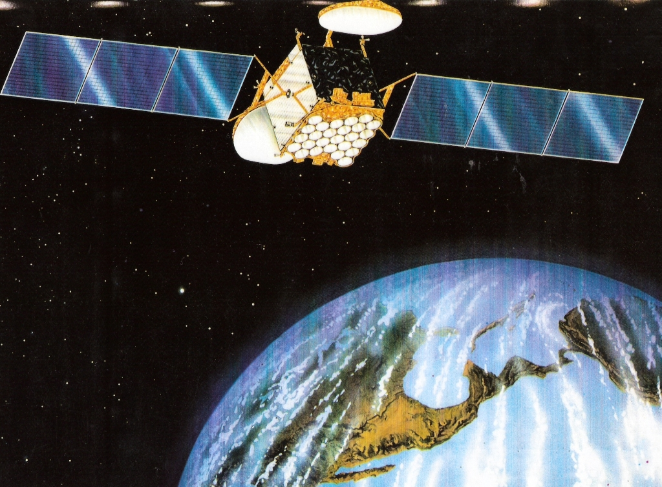
Solidaridad Satellite

Slide 51
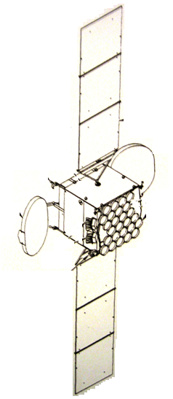
Spacecraft coordinate system definition
NORTH RADIATOR
SUN-ORIENTED SOLAR ARRAY
WEST C-BAND REFLECTOR
22N THRUSTER
EAST SHARED
C AND Ku BAND REFLECTOR
L-BAND DIPOLE ANTENNAS ON NADIR FACE (TYPICAL NADIR ANTENNA)
EARTH DIRECTION
ANTENNA FEEDS
SENSOR SUITE
ROLLAXIS
YAW AXIS
PITCHAXIS

Slide 52
Communication Subsystem
C – band
System
Frequency range | 5.925 to 6.425 GHz receive
 | 3.7 to 4.2 GHz transmit
Coverage | R1: Mexico and southwest U.S.
 | R2: Mexico plus Central America, excluding Brazil
Channel bandwith | 36 and 72 MHz
No. of channels | 6 x 72 MHz (R1 only) and 12 x 36 MHz (4 for R1 only; 8 individually switchable to receive from R1, R2 or R3; can each transmit to R1 or R2; 4 can each transmit to R1 or R3)
Performance
Min EIRP | 72 MHz: 40 dBW 36 MHz: 37 dBW
Min G/T | 72 MHz: 2.5 dB/K 36 Mhz: R1 =2.0, R2=-0.5 and R3=1.0 dB/K
Antenna | Dual aperture
Size | 1.83 x 2.44 m (72 x 96 in.)
Focal legth | 2.03 m (80 in.)
Polarization | Linear (vertical and horizontal)

Slide 53
Communication Subsystem (Cont.)
Receive
LNA/receiver | HEMT LNA
Redundancy | 3-for-2
Saturation flux density | 72 MHz: -75 to -89 dBW/m² 36 MHz: -78 to -92 dBW/m²
Transmit section
No. of SSPAs | 72 MHz: 8, 36 MHz: 16
SSPA power level | 72 MHz: 14.4 W 36MHz: 10.3/16.0 W switchable
Channel multiplexing | 72 MHz: contiguous, 36 MHz: noncontiguous
Ku – band
System
Frecuency range | 14.0 to 14.5 GHz receive 11.7 to 12.2 GHz transmit 11.701 ULPC transmit
Coverage | R4: Mexico and southwest U.S.
 | R5: selected U.S. cities
Channel bandwith | 54 MHz
No. of channels | 16, with 2 receive and 1 transmit switchable to R5

Slide 54
Communication Subsystem (Cont.)
Performance
Min EIRP | R4: 47.0 dBW R5: 46.4 dBW, ULPC:7 dBW
Min G/T | R4: (100% coverage): 2.2 dB/K R4: (98% coverage) and R5 2.5 dB/K
Antenna | Dual aperture
Size | 1.83 x 2.44 m (72 x 96 in.)
Focal legth | 2.03 m (80 in.)
Polarization | Linear (vertical and horizontal)
Receive
LNA/receiver | HEMT LNA
Redundancy | 5-for-3
Noise figure | <2.0 dB
Saturation flux density | -73 to -95 dBW/m²
Transmit section
No. of TWTAs | 20
TWTA power level | 45 W
Channel multiplexing | Contiguous

Slide 55
Communication Subsystem (Cont.)
L – band
System
Frecuency range
Forward | 14.248 to 14.265 GHz receive 1.528 to 1.559 GHz transmit
Return | 1.6295 to 1.6605 GHz receive 11.9515 to 11.9685 GHz transmit
L-band Coverage | Mexico and territorial waters
Channel bandwith | 31 MHz
No. of channels | 7 sub-bands
Performance of L-band
Fordward EIRP | 45 dBW (100% coverage)
Return G/T | -1,5 dB/K (100% coverage)
Antenna
Type | Diplexed phased array
Elements | 26 short backfire parabolic cups
Polarization | Right-hand circular polarization

Slide 56
Communication Subsystem (Cont.)
Receive
LNA | HEMT with 1.2 dB noise figure
Redundancy | 2-for-1
Noise figure | <2.0 dB
Saturation flux density | -123 dBW/m² total
Transmit section
No. of SSPAs | 6 (4 operating, 2 redundant)
SSPA power level | 24 W

Slide 57
Payload Power, Watts
Unit | Qty | Unit power | Power | Comments
C – band |  |  |  | Efficiency 38.64%
Low noise amplifier | 2 | 0.7 | 1.4
Downconverter | 2 | 7 | 14.0
Receiver | 2 | 7 | 14.0
Channel control unit | 18 | 1.3 | 23.4
SSPA | 18 | P RF: | 602.5
 | 4 | 16.0
 | 6 | 14.4
 | 8 | 10.3
Subtotal |  |  | 655.3
Ku – band |  |  |  | EPC Efficiency 91.4%
Low noise amplifier | 3 | 0.9 | 2.7 | TWT efficiency 55.6%
Downconverter | 3 | 6.0 | 18.0
ULPC beacon | 1 | 5.5 | 5.5
Channel control unit | 16 | 1.0 | 30.4
Linearizer | 3 | 1.5 | 4.5
TWTA - FSS | 15.45 | 42.6 | 1295.1 | Eclipse at 49.85 Sunlight unit power at 50.4 V=1309.4
Subtotal |  |  | 1356.2
Notes:
Master in Space Technology 2009

Slide 58
Payload Power, Watts (Cont.)
Unit | Qty | Unit power | Power | Comments
L – band |  |  |  | Efficiency 24.1%
Ku/IF | 1 | 5.3 | 5.3
IF/L | 2 | 10.5 | 21.0
Low noise amplifier | 1 | 1.7 | 1.7
L/IF | 2 | 7.8 | 15.6
IF/Ku | 1 | 5.2 | 5.2
Reg generator | 1 | 13.5 | 13.5
SSPA | 4 | 21.6 | 358.5
Subtotal |  |  | 420.8
Total
Eclipse |  |  | 2432.3
Sunlight |  |  | 2442.4

Slide 59
Solidaridad Satellite Regions conectivity
Up link | Band | Down link | Band | Transponder
R1 | C | R1 | C | 1N – 12N 1W – 6W
R2 | C | R2 R3 | C C | 6N, 8N, 10N, 12N 11N (UL), 12N (DL)
R3 | C | R3 R2 | C C | 5N, 7N, 9N, 11N 11N (DL), 12N (UL)
R4 | Ku | R4 R5 R6 | Ku Ku L | 1K – 16K 6K 5K – LP (UL-Ku), 5K (DL-L)
R5 | Ku | R5 R4 | Ku Ku | 6K 6K (UL), 8K (DL)
R6 | L | R4 | Ku | 5K – LP (UL-L), 5K (DL-Ku)
* Band L is used for mobil terminals-satellite links.
Ku band is used for Hub-Satellite links
LP: Low part

Slide 60
Solidaridad Satellites Transponders Characteristics
Band | Transponders | BW (MHz) | Coverage (Region) | Polarization
 |  |  |  | Uplink | Downlink | Transponder
C | 12 6 | 36 72 | R1, R2, R3 R1 | Horizontal Vertical | Vertical Horizontal | All All
Ku | 16 | 54 | R4, R5 | Vertical Horizontal | Horizontal Vertical | 1K – 8K 9K – 16K
L* | 1 | 15 | R6 | Vertical (Ku) Right Circular | Right Circular Horizontal (Ku) | 5K 5K
BW = Bandwith
* For L band traffic, transponder 5K (low part) is used

Slide 61
Solidaridad Satellite Layout
NORTH RADIATOR
C SSPA R2/R1 V TRANSMIT
16/12
TWT R4 H TRANSMIT
10 IN 20/16
EPC
KU R4
RECEIVE/TRANSMIT
C R2/R1 TRANSMIT
C R1 WB RECEIVE
EAST
X-WING
WEST
X-WING
H
v
KU R5 TRANSMIT
C R3 TRANSMIT
KU R4
RECEIVE/TRANSMIT
C R3 RECEIVE
v
H
KU R5 RECEIVE
C R3 TRANSMIT
C R2/R1 RECEIVE
C R1 WB TRANSMIT
EPC
L – BAND
SSPA
6/4
TWT R4 V TRANSMIT
10 IN 20/16
C SSPAS
R1 H 8/6
SOUTH RADIATOR

Slide 62
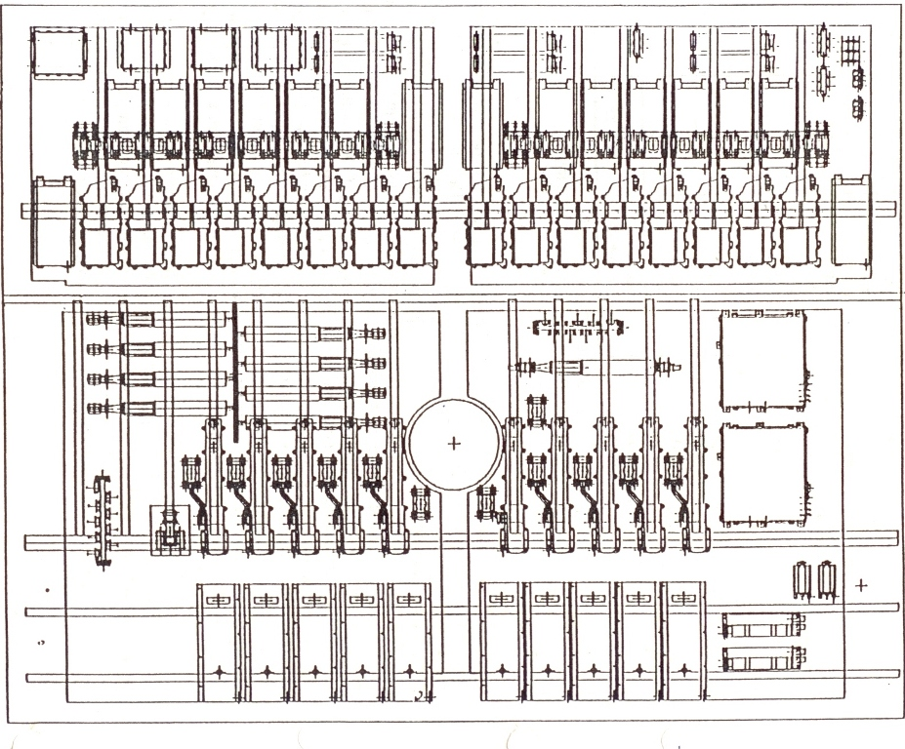
Solidaridad Repeater Layout
North
Panel

Slide 63
C – Band Block Diagram
Horizontal Receive
R1
Low noise signal amplification and frequency translation
Transponder Channelization
(Wide Band)
Commandable step attenuation and high power amplification
Output Channelization and filtering
Tx R3
Horizontal Receive
R2
Horizontal Receive
R3
Tx R1R2
Vertical Receive
R1
Transponder Channelization
(Narrow Band)
Commandable step attenuation and high power amplification
Output Channelization and filtering

Slide 64
C-Band Frequency Plan
R2 + R3
Individually switchable to receive from R1, R2, or R3
2
36
4
22
5945
5985
6025
6065
6105
6145
6185
6225
6265
6305
6345
6383
Horizontal
1N
2N
3N
4N
5N
6N
7N
8N
9N
10N
11N
12N
CMD Transfer orbit
5925
UPLINK
CMD on station
1W
2W
3W
4W
5W
6W
6425
Vertical
5985
6065
6145
6225
6305
6385
24
72
8
4
Individually switchable into region R2
Individually switchable into region R3
2
36
4
22
3720
3760
3800
3840
3880
3920
3960
4000
4040
4080
4120
4160
TM transfer orbit
1N
2N
3N
4N
5N
6N
7N
8N
9N
10N
11N
12N
Vertical
C - BAND
DOWNLINK
3700
1W
2W
3W
4W
5W
6W
4200
TM on station
Horizontal
3760
3840
3920
4000
4080
4160
24
72
8
4

Slide 65
Communication subsystem functional diagram (C Band)
Input Multiplexers
10.3 / 16w SSPA amplifiers
Output Multiplexers
Attenuators
C band repeater
12
HorizontalChannels
(36 MHz)
CCU
12
Horizontal
Channels
(36 MHz)
CCU
CCU
CCU
CCU
Redundancy Switching
Redundancy Switching
CCU
H
CCU
Vert.
CCU
C band feeds
CCU
CCU
CCU
Horiz.
3 for 2
Redundant receivers
CCU
CCU
Vert.
CCU
14.4 w SSPA amplifiers
Command and tracking
6
Vertical channels
(72 MHz)
Redundancy switching
CCU
6
Vertical
Channels
(72 MHz)
CCU
CCU
Redundancy Switching
H
CCU
Horiz.
CCU
CCU
CCU
CCU

Slide 66
Ku – Band Block Diagram
Vertical Receive R4
Low noise signal amplification and frequency translation
Transponder Channelization
Commandable step attenuation and high power amplification
Output Channelization and filtering
Tx
US Ports Vertical Receive R5
East
Horizontal Receive
R4
Transponder Channelization
Commandable step attenuation and high power amplification
Output Channelization and filtering
Tx

Slide 67
Ku – Band Frequency Plan
3
54
7
VERTICAL UPLINKS AND HORIZONTAL DOWNLINKS
L – BAND FEEDER
6K
8K
UPLINK ONLY
REGION 5
REGOIN 4
1400 (UPLINKS)
1K
2K
3K
4K
5K
6K
7K
8K
14500
(UPLINKS)
11700
(DOWNLINKS)
REGION 4
9K
10K
11K
12K
13K
14K
15K
16K
12200
(DOWNLIKS)
KU-BAND BEACON (11701)
Channel | Central Frequency Down, MHz | Central Frequency Up, MHz
1 | 11730 | 14030
2 | 11791 | 14091
3 | 11852 | 14152
4 | 11913 | 14213
5 | 11974 | 14274
6 | 12035 | 14335
7 | 12096 | 14396
8 | 12157 | 14457
9 | 11743 | 14043
10 | 11804 | 14104
11 | 11865 | 14165
12 | 11926 | 14226
13 | 11987 | 14287
14 | 12048 | 14348
15 | 12109 | 14409
16 | 12170 | 14470
16
54
7
HORIZONTAL UPLINKS AND VERTICAL DOWNLINKS

Slide 68
Communication subsystem functional diagram (Ku Band)
Input Multiplexers
Attenuators
45 w TWT amplifiers
Output Multiplexers
Ku band repeater
8
Vertical Channels
(36 MHz)
CCU
TWT
8
Vertical
Channels
(36 MHz)
CCU
TWT
CCU
TWT
CCU
TWT
Redundancy Switching
Redundancy Switching
H
CCU
TWT
Horiz.
CCU
TWT
CCU
TWT
CCU
TWT
Ku band feeds
CCU
TWT
CCU
TWT
Horiz.
5 for 3
Redundant receivers
Vert.
8
Horizontal channels
(72 MHz)
Redundancy switching
8
Horizontal
Channels
(72 MHz)
CCU
TWT
CCU
TWT
CCU
TWT
CCU
TWT
Redundancy Switching
H
CCU
TWT
Vert.
CCU
TWT
CCU
TWT
CCU
TWT
CCU
TWT
CCU
TWT

Slide 69






L-band repeater block diagram
Diplexer Combiner Assy
Forward Repeater
IF/L
X
Divider 1:4
S
RG
S
R
R
Dplx
X
From Ku band repeater
Ku/IF
X
IF/L
R
R
Dplx
BFP
R
RG
H
H
X
IF/L
R
R
Dplx
X
Ku/IF
X
S
RG
S
R
R
Dplx
X
IF/L
Combiner
Antenna
Return Repeater
L/IF
SSPA
LNA
S
RG
S
IF/Ku
L/IF
To Ku band repeater
BFP
F
RG
H
H
RG
L/IF
LNA
IF/Ku
S
RG
S
L/IF

Slide 70
Frequency bands, L band
Return
Forward
1626.5
1525.0
9
9
1629.5
1528.0
11948.5
1
1
14245.0
9
9
11951.5
1635.0
1533.5
14248.0
2
2
11953.5
1
1
14250.0
5
1638.5
1537.0
5
11957.0
14253.5
11958.0
2
1639.0
1537.5
2
14254.5
6
3
3
6
11960.5
14257.0
11961.0
14247.5
1644.0
1542.5
3
1645.5
1544.0
3
5
5
11965.0
1649.0
1547.5
14261.5
11966.0
8
1650.0
1548.5
8
14262.5
6
6
11968.5
1652.5
1551.0
14265.0
SATELITE | Sub-band
Solidaridad 1 | 9 | 2 | 5 | 8
Solidaridad 2 | 1 | 3 | 6
1657.0
1555.5
8
8
1660.5
1559.0

Slide 71
POLARIZATION
Region 1 | Tx Vertical | Tx Horizontal
 | Rx Horizontal | Rx Vertical
Region 2 | Tx Vertical
 | Rx Horizontal
Region 3 | Tx Vertical
 | Rx Horizontal
Region 4 | Tx Vertical | Tx Horizontal
 | Rx Vertical | Rx Horizontal
Region 5 | Tx Vertical
 | Rx Horizontal
Region 6 | Tx L – Band
 | Rx L – Band
 | Circular

Slide 72
Antenna System Functional Diagram
Horizontal Polarization
Command OMNI
Vertical Polarization
Telemetry OMNI
Horizontal Polarization
Ku R4
Transmit/Receive
C R1
Transmit/Receive
Vertical Polarization
EAST
WEST
Ku R5 Transmit
C R2 Transmit
Ku R4
Transmit/Receive
C R1
Transmit/Receive
Horizontal Polarization
Vertical Polarization
Ku R5 Receive
C R2 Receive
C R3 Transmit
C R3 Receive
L – BAND RECIEVE/TRANSMIT
CUP – DIPOLE ARRAY
ULPC
CMT
Vertical R4
HORN
Horizontal R4 + R5

Slide 73
Key Design Features
Features | Benefit
Large X-wing reflectors (C-band and Ku-band) | High gain, compact stowage, simple deployment, shared aperture, and feed array separation
Gridded apertures | Excellent polarization purity
Reflector sunshield | Reduced temperature gradients
Single mode transmit feed networks | Lightweight and low loss
Diplexed transmit /receive | Feed horn reuse and lower weight
Squareax feed network | Light, rigid, low loss, accurate, and stable
Planar waveguide feed network | Rigid, lightweight, and low loss
Cup dipole feeds for L-band array | Excellent performance, design heritage, and low PIM

Slide 74
Antennas
Dual Aperture
Size: 1.83x2.44 m
Focal length: 2.03m
Polarization: V-H
C and Ku band
Dual Aperture
Size: 1.83x2.44 m
Focal length: 2.03m
Polarization: V-H
C band
2.67m
2.67m

Slide 75
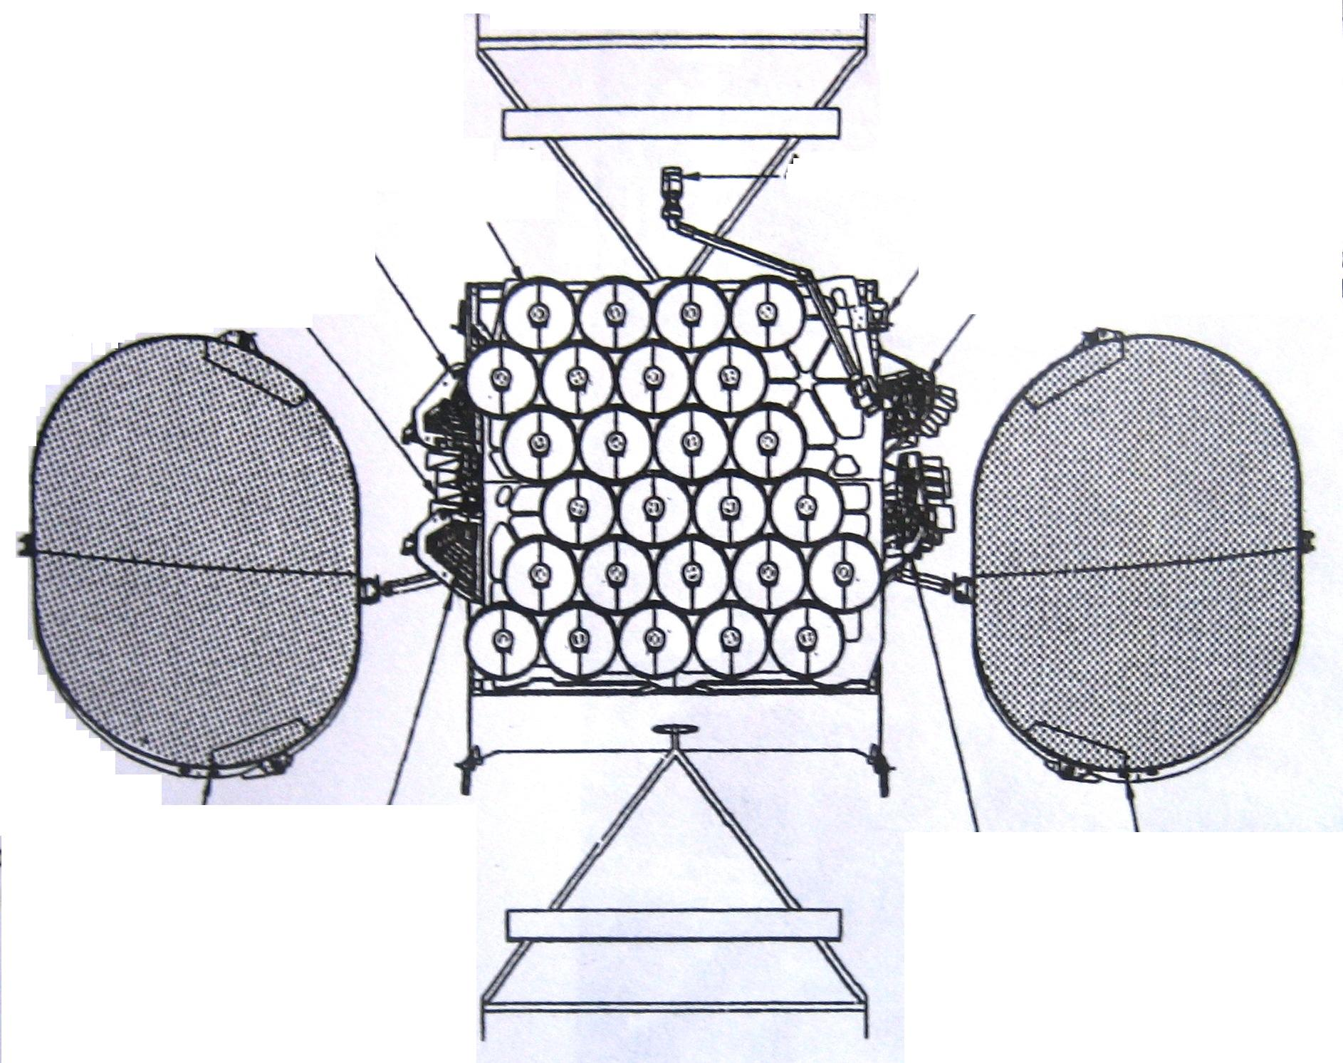
Antennas Configuration
Feed horn array for Ku-band (Horizontal)
L-band
Omni Antenna
Feed horn array for C-band (Tx,R3)
ULPC
Feed horn array for C-band (Vertical)
C and Ku band reflector (east)
C-band reflector (west)
Feed horn array for Ku-band (Vertical)
Feed horn array for C-band (Horizontal)

Slide 76
Antennas (Cont.)
X-WING REFLECTORS
2.44 m
1.83 m
Horn
FRONT VIEW
0.183 m
0.356 m
2.03 m
Diplexer
Focal Length
SIDE VIEW
0.610 m
TOP VIEW

Slide 77
Feed Network Losses
Frequency | Region Coverage | Beam | Loss, dB
C – band | R1 | Horizontal transmit | 0.40
 | R1 | Vertical transmit | 0.50
 | R2 | Vertical transmit | 0.50
 | R3 | Vertical transmit | 0.40
 | R1 | Vertical receive | 0.75
 | R1 | Horizontal receive | 0.75
 | R2 | Horizontal receive | 0.75
 | R3 | Horizontal receive | 0.45
Ku – band | R4 | Horizontal transmit | 0.40
 | R4 | Vertical transmit | 0.40
 | R5 | Horizontal transmit | 0.40
 | R4 | Horizontal receive | 0.70
 | R4 | Vertical receive | 0.70
 | R5 | Vertical receive | 0.70
L – band | R6 | RHCP transmit | 0.40
 | R6 | RHCP receive | 0.40
NOTE: Does not include waveguide loss from BFN to repeater interface

Slide 78
C – Band Vertical Array Location and Dimension
Horn No. | Principal Plane Dimension, cm |  | Location, cm
 | E | H | X | Y
1 | 5.23 | 22.76 | -5.97 | 6.86
2 | 5.49 | 22.25 | -0.51 | -0.13
3 | 4.98 | 7.01 | 4.83 | -12.70
4 | 5.99 | 9.04 | 5.33 | -4.57
5 | 7.52 | 6.25 | -1.52 | -14.48
6 | 7.01 | 6.76 | 3.81 | -21.08
7 | 4.98 | 20.32 | 9.91 | -19.81
8 | 5.99 | 17.27 | 15.49 | -19.81
WEST REFLECTOR
Horn No. | Principal Plane Dimension, cm |  | Location, cm
 | E | H | X | Y
8 | 13.68 | 20.32 | 15.88 | -15.88
9 | 8.79 | 19.30 | 25.27 | -18.92
10 | 8.79 | 20.32 | 34.16 | -19.94
11 | 8.79 | 18.80 | 43.05 | -11.81
EAST REFLECTOR

Slide 79
Region R1
No. | Relative Power |  | Location, cm
 | Even | Odd | Even | Odd
1 | 0.333 | 0.333 | 0 | 0
2 | 0.333 | 0.333 | 60 | -60
3 | 0.163 | 0.163 | 120 | -120
4 | 0.170 | 0.170 | 120 | -120
VERTICAL TRANSMIT HORN EXCITATIONS
1
2
4
3
D
D
D
D
VERTICAL TRANSMIT NETWORK
Rx
Rx
Rx
Rx
3.10 dB
2-TO-3 Converter
R3 Monitoring
Odd Mode
Even Mode
NETWORK SCHEMATIC

Slide 80
Region 1 Vertical Transmit Directivities
City | Directivity (109.2°) | Directivity (113°) | Expected EIRP, dBW (109.2°) | Expected EIRP, dBW (113°)
a) Channels 1 to 4
Puebla, Pue. | 31.80 | 31.83 | 40.0 | 40.0
San Luis Potosi | 31.85 | 31.87 | 40.1 | 40.1
Toluca | 31.55 | 31.60 | 39.8 | 39.8
Leon | 31.60 | 31.65 | 39.8 | 39.9
Mexicalli | 31.00 | 30.94 | 39.2 | 39.1
Aguascalientes | 31.59 | 31.63 | 39.8 | 39.8
Coatzacoalcos | 32.03 | 32.01 | 40.2 | 40.2
Tampico | 31.90 | 31.90 | 40.1 | 40.1
Torreón | 31.94 | 31.93 | 40.1 | 40.1
Chihuahua | 32.21 | 32.21 | 40.4 | 40.4
Campeche | 31.40 | 31.43 | 39.6 | 39.6
Oaxaca | 31.43 | 31.45 | 39.6 | 39.7
Los Angeles | 29.54 | 29.41 | 37.7 | 37.6

Slide 81
Region 1 Vertical Transmit Directivities (Cont.)
City | Directivity (109.2°) | Directivity (113°) | Expected EIRP, dBW (109.2°) | Expected EIRP, dBW (113°)
a) Channels 1 to 4
San Antonio | 29.62 | 29.72 | 37.8 | 37.9
Tijuana | 30.34 | 30.28 | 38.5 | 38.5
Monterrey | 31.47 | 31.47 | 39.7 | 39.7
Mexico | 31.73 | 31.76 | 39.9 | 40.0
Guadalajara | 30.99 | 31.08 | 39.2 | 39.3
Veracruz | 32.11 | 32.11 | 40.3 | 40.3
Acapulco | 30.35 | 30.46 | 38.6 | 38.7
Hermosillo | 32.08 | 32.09 | 40.3 | 40.3
Ciudad Juarez | 31.78 | 31.81 | 40.0 | 40.0
Matamoros | 30.70 | 30.74 | 38.9 | 38.9
Merida | 30.77 | 30.83 | 39.0 | 39.0
Cancul | 29.38 | 29.58 | 37.6 | 37.8
Chetumal | 30.82 | 30.86 | 39.0 | 39.1

Slide 82
Region 1 Vertical Transmit Directivities (Cont.)
City | Directivity (109.2°) | Directivity (113°) | Expected EIRP, dBW (109.2°) | Expected EIRP, dBW (113°)
a) Channels 1 to 4
Ensenada | 30.55 | 30.51 | 38.8 | 38.7
La Paz | 30.38 | 30.47 | 38.6 | 38.7
Nuevo Laredo | 30.79 | 30.82 | 39.0 | 39.0
Puerto Escondido | 30.72 | 30.76 | 38.9 | 39.0
Puerto Vallarta | 30.24 | 30.37 | 38.4 | 38.6
Tapachula | 30.70 | 30.63 | 38.9 | 38.8
Tuxtla Gutierrez | 31.65 | 31.62 | 39.9 | 39.8
Villahermosa | 31.97 | 31.94 | 40.2 | 40.1
Guatemala | 30.09 | 30.01 | 38.3 | 38.2
Average |  |  | 39.3 | 39.3
Specified |  |  | 38.3 | 38.3
Margin, dB |  |  | 1.0 | 1.0

Slide 83
Region R1 Vertical Receive Horn Excitations
No. | Relative Power | Phase, deg
1 | 0.195 | 0
2 | 0.463 | 20
3 | 0.163 | -20
4 | 0.138 | -20
5 | 0.041 | -50

Slide 84
R1 Vertical Receive Network
3
5
1
2
4
D
D
D
D
D
8.97 dB
8.97 dB
6.11 dB
5.90 dB
COMMAND
OUTPUT

Slide 85
Ku – Band Vertical Array
Horn No. | Principal Plane Dimension, cm |  | Location, cm
 | E | H | X | Y
1 | 5.46 | 3.05 | -4.71 | 9.60
2 | 7.62 | 4.06 | -2.67 | 5.94
3 | 10.16 | 2.67 | -1.02 | 2.47
4 | 11.18 | 2.67 | 0.02 | -0.30
5 | 3.56 | 2.79 | 1.93 | -5.92
6 | 3.43 | 5.21 | 5.52 | -7.12
7 | 3.05 | 4.06 | 2.18 | -9.70
8 | 9.91 | 2.67 | 1.47 | -3.08
9 | 2.03 | 4.06 | -8.56 | 10.46
10 | 2.29 | 3.68 | -4.72 | -3.58
11 | 2.03 | 4.06 | -0.71 | -11.61
12 | 4.06 | 4.06 | -9.32 | -7.09
13 | 4.06 | 4.06 | -8.28 | -11.25
14 | 2.54 | 4.57 | -4.88 | -9.40
LOCATION AND DIMENSION

Slide 86
Ku – Band Vertical Horns Aperture Layout
6
7
5
8
4
11
3
2
10
1
14
9
13
12

Slide 87
Region R4 Vertical Transmit Horn Excitations
No. | Relative Power | Phase, deg
1 | 0.105 | 0
2 | 0.154 | 0
3 | 0.182 | 0
4 | 0.165 | -10
5 | 0.040 | 0
6 | 0.086 | 0
7 | 0.091 | 0
8 | 0.177 | 0

Slide 88
Region R4 Vertical Transmit Network
6
7
5
8
4
3
2
1
D
D
D
D
D
D
D
D
Rx
Rx
Rx
Rx
Rx
Rx
Rx
Rx
5.15 dB
-3.17 dB
-3.92 dB
-4.02 dB
-3.84 dB
-4.11 dB
-3.56 dB
INPUT

Slide 89
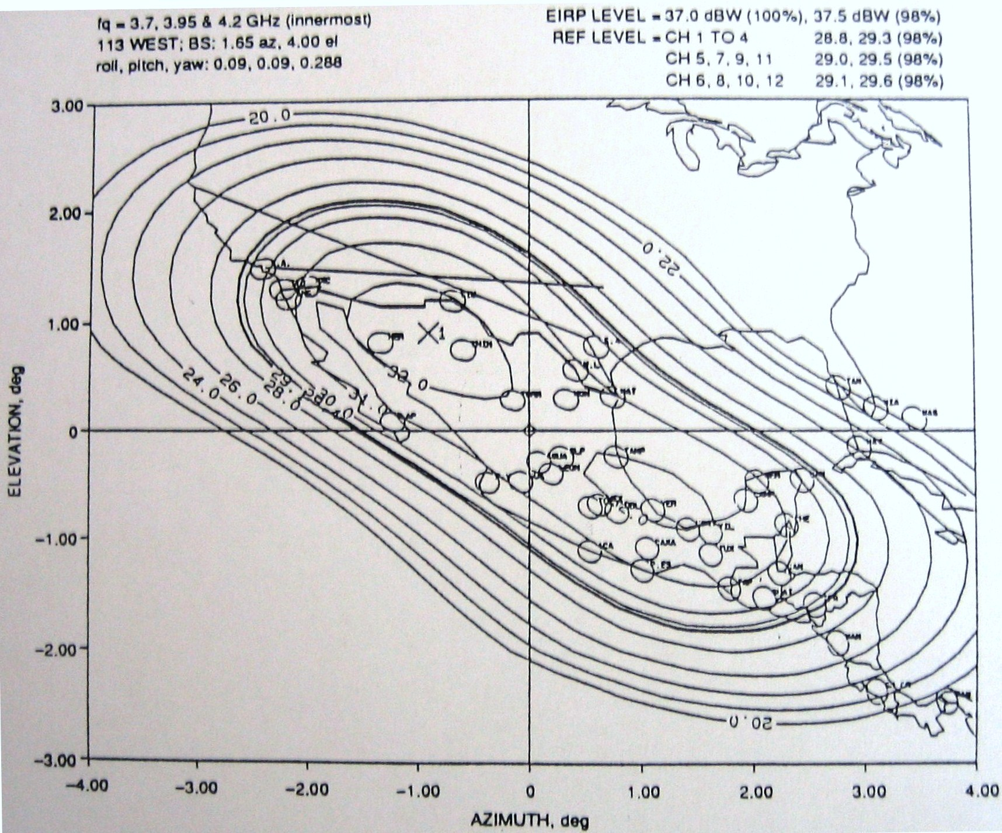
Region R1 Vertical Transmit Contours

Slide 90
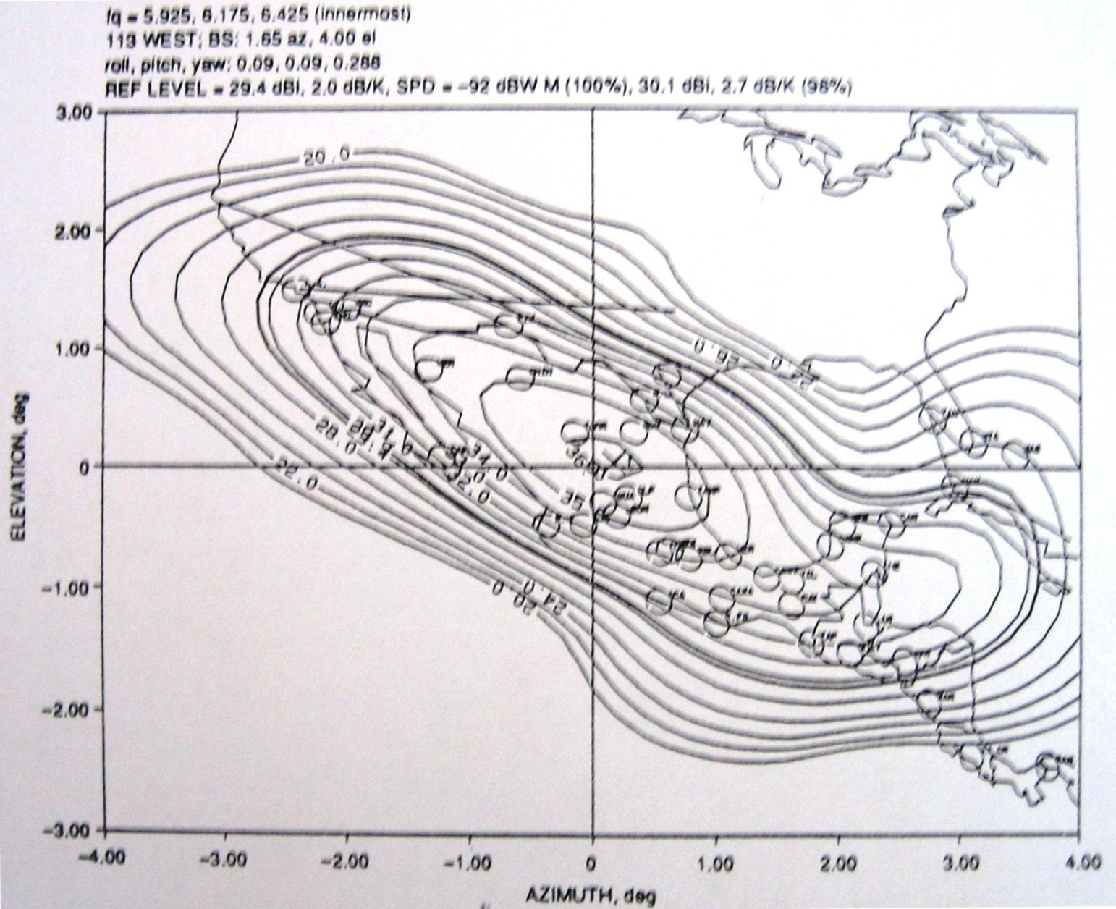
Region R1 Vertical Receive Contours

Slide 91
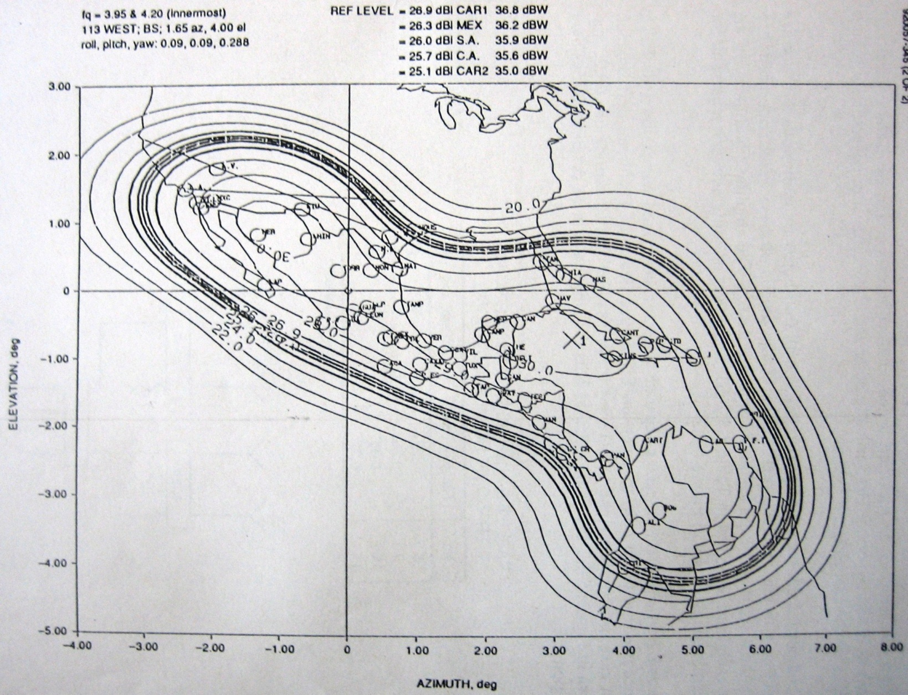
Region R2 vertical Transmit Contours

Slide 92
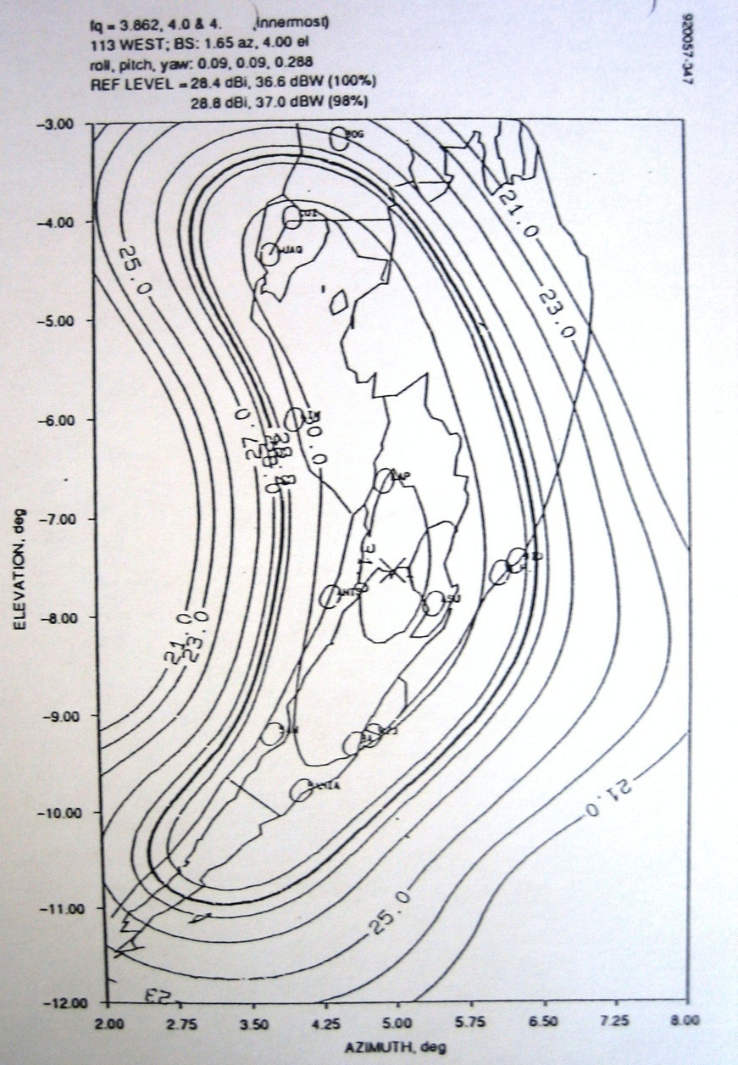
Region R3 Vertical Transmit Contours

Slide 93
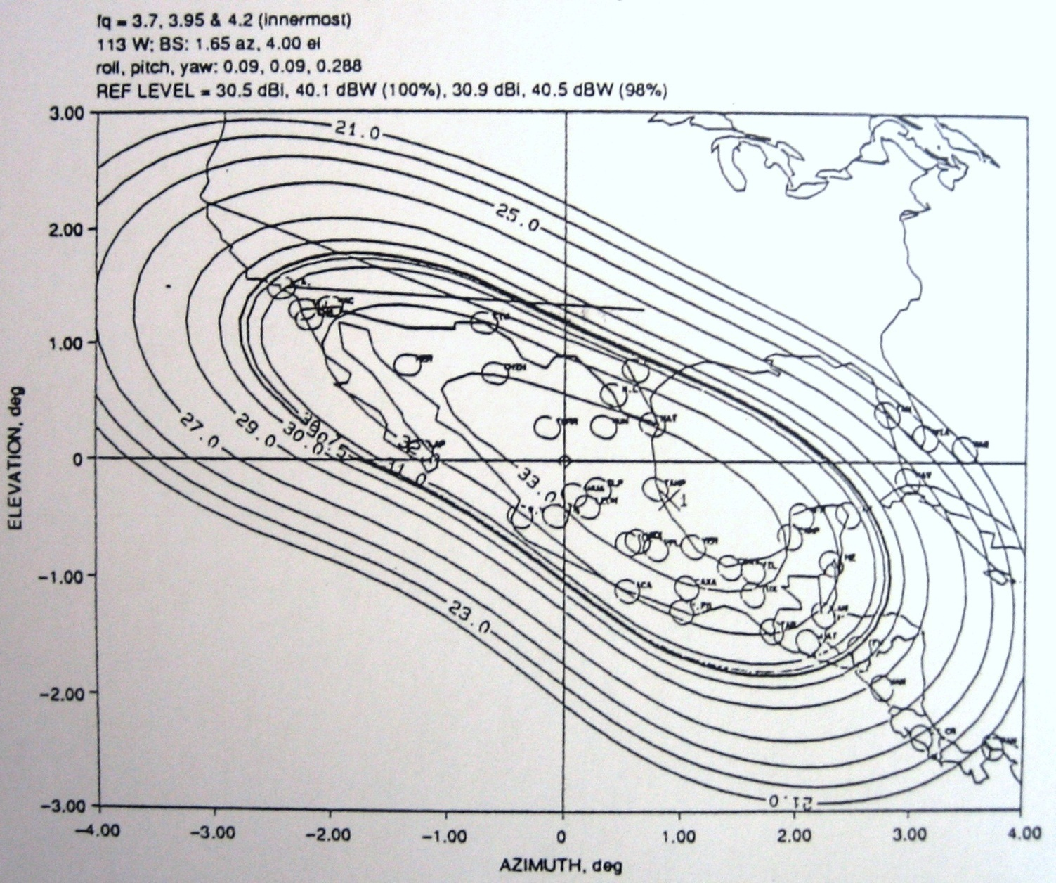
Region R1 Horizontal Transmit Contours

Slide 94
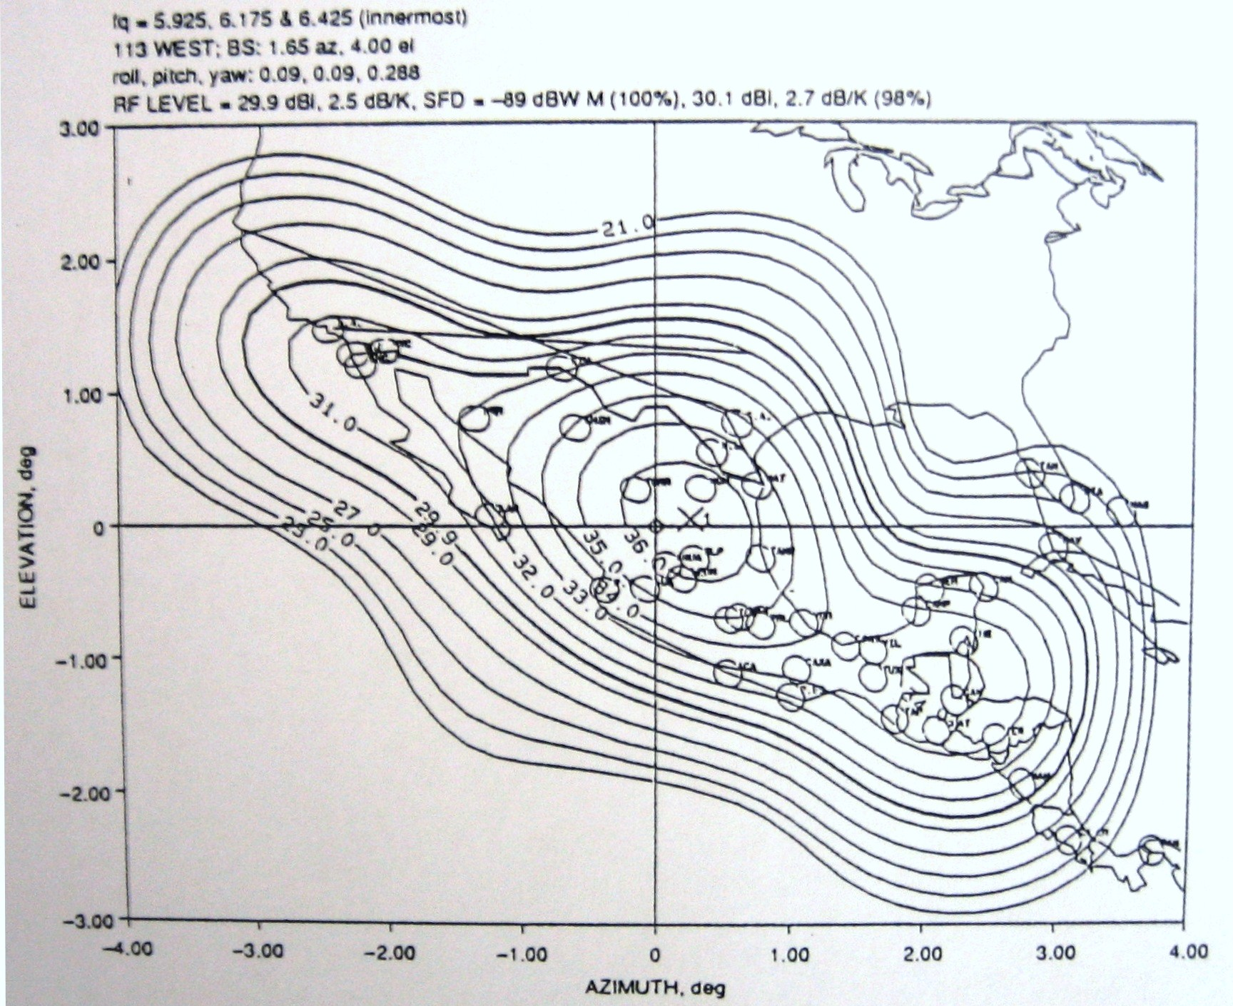
Region R1 Horizontal Receive Contours

Slide 95
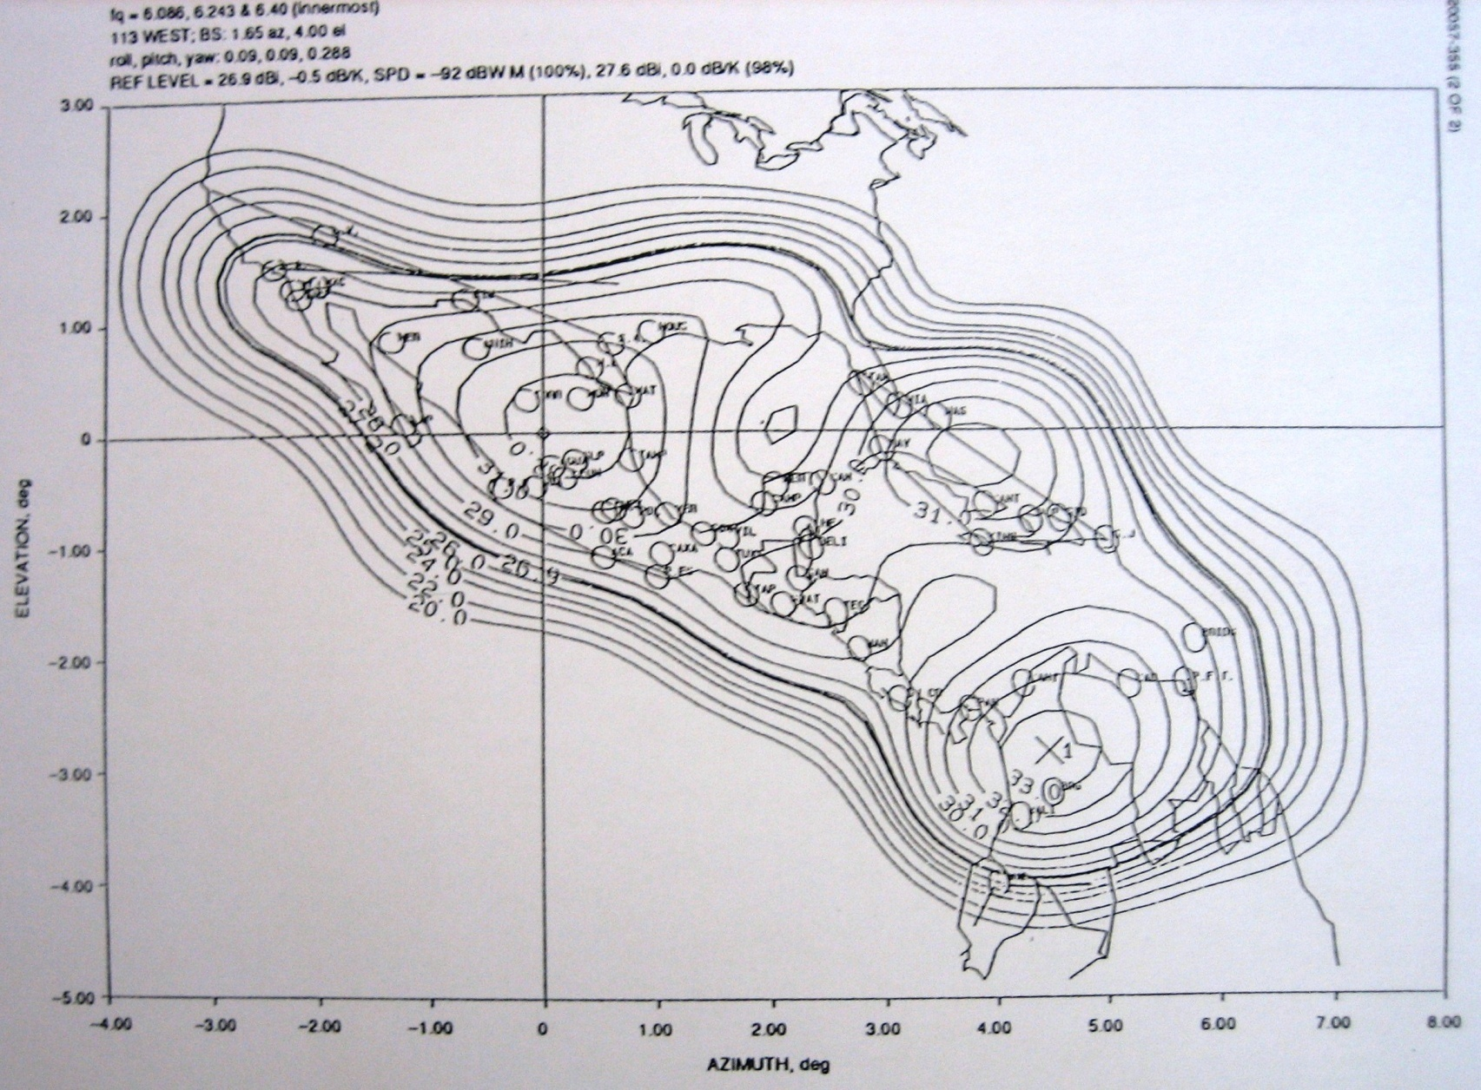
Region R2 Horizontal Receive Contours

Slide 96
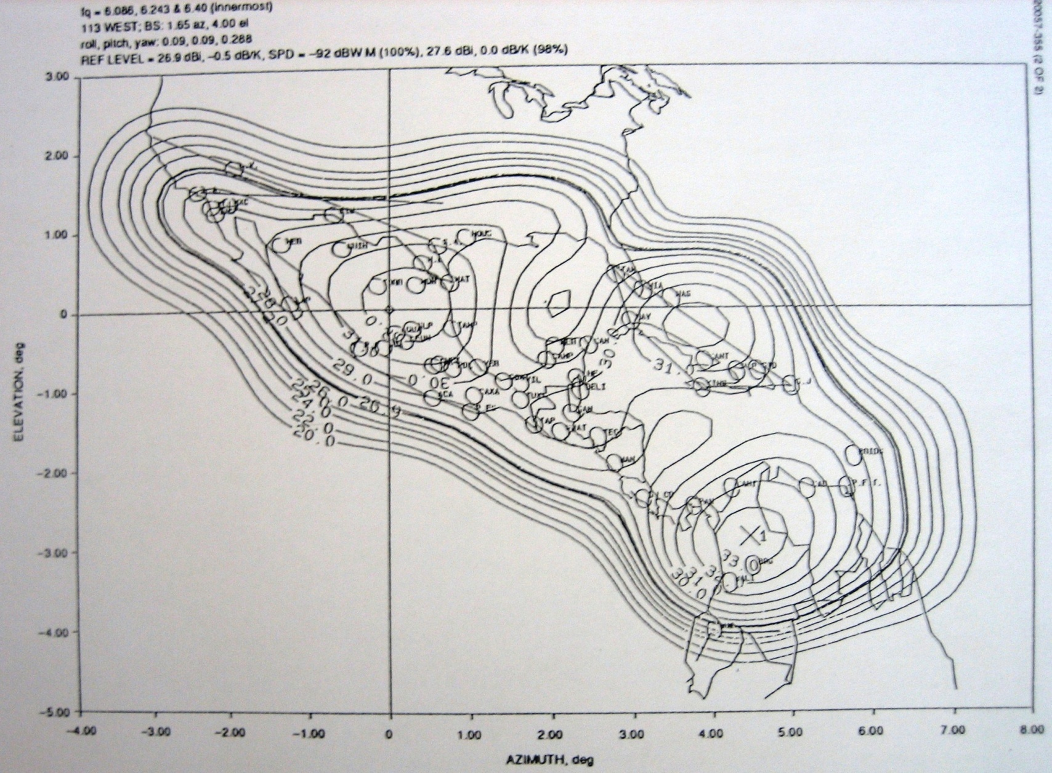
Region R2 Horizontal Receive Contours

Slide 97
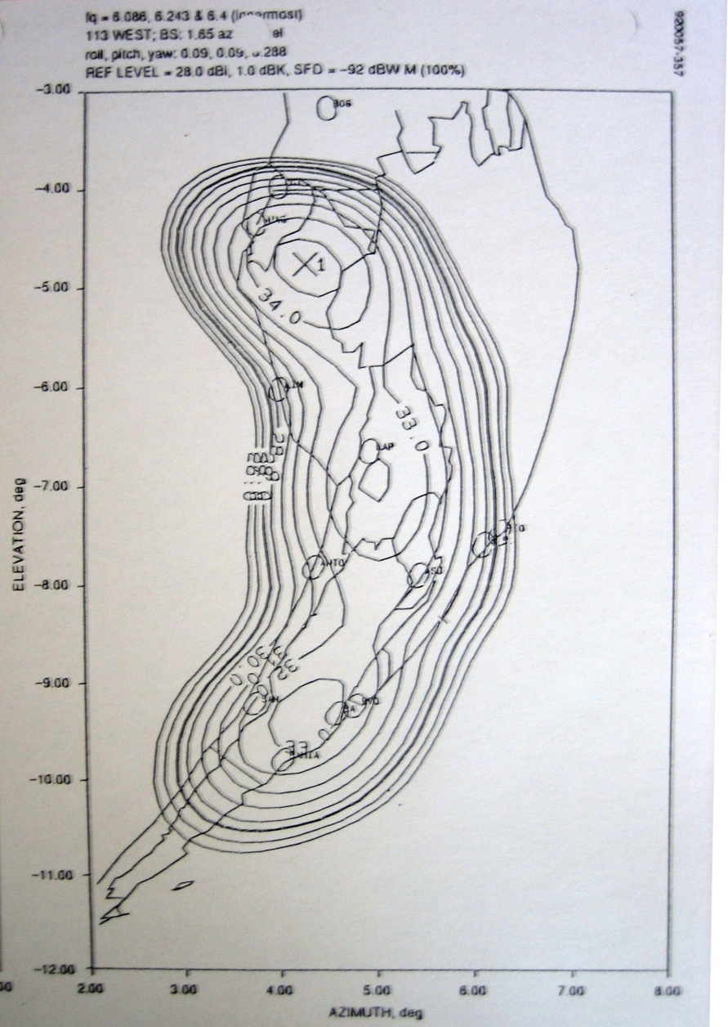
Region R2 Horizontal Receive Contours

Slide 98
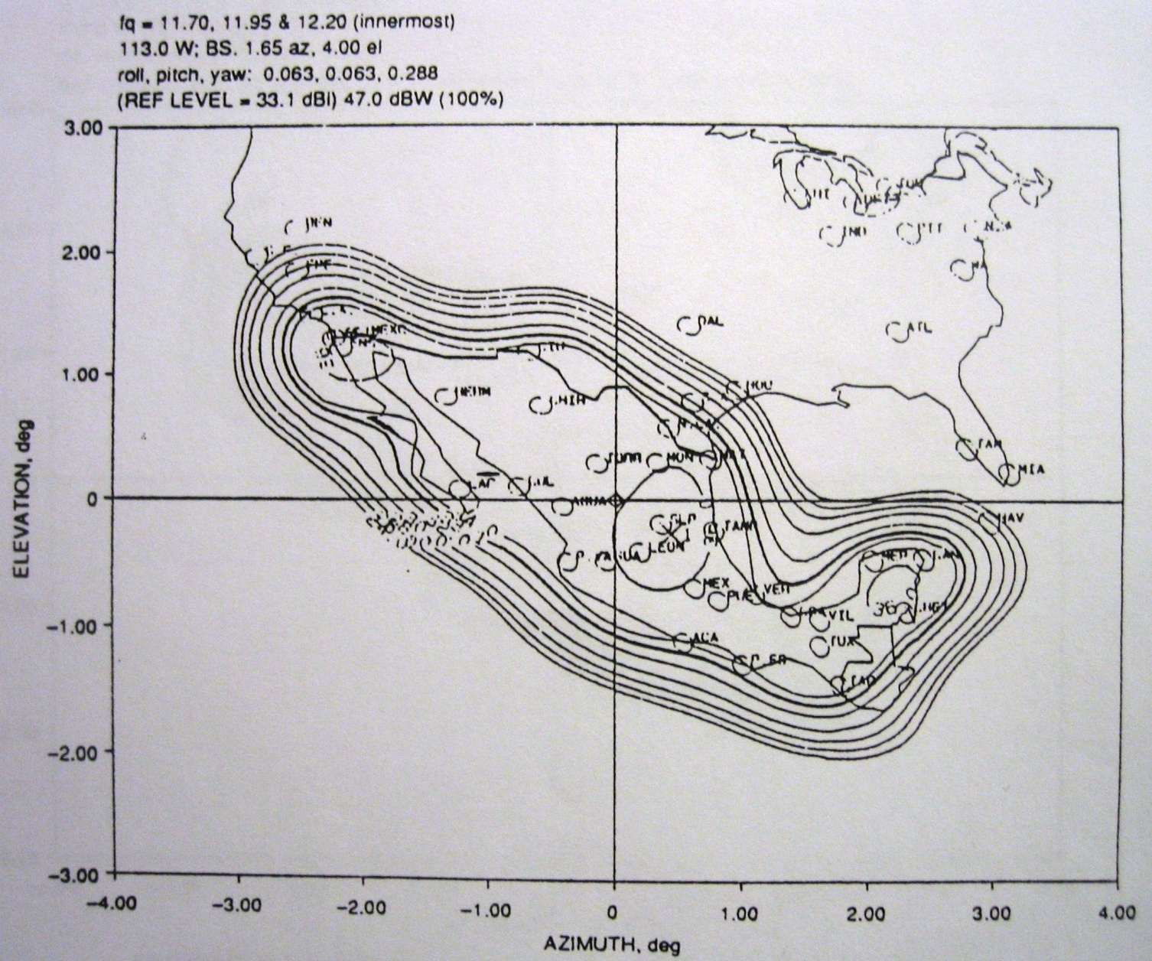
Region R4 Vertical Transmit Contours

Slide 99
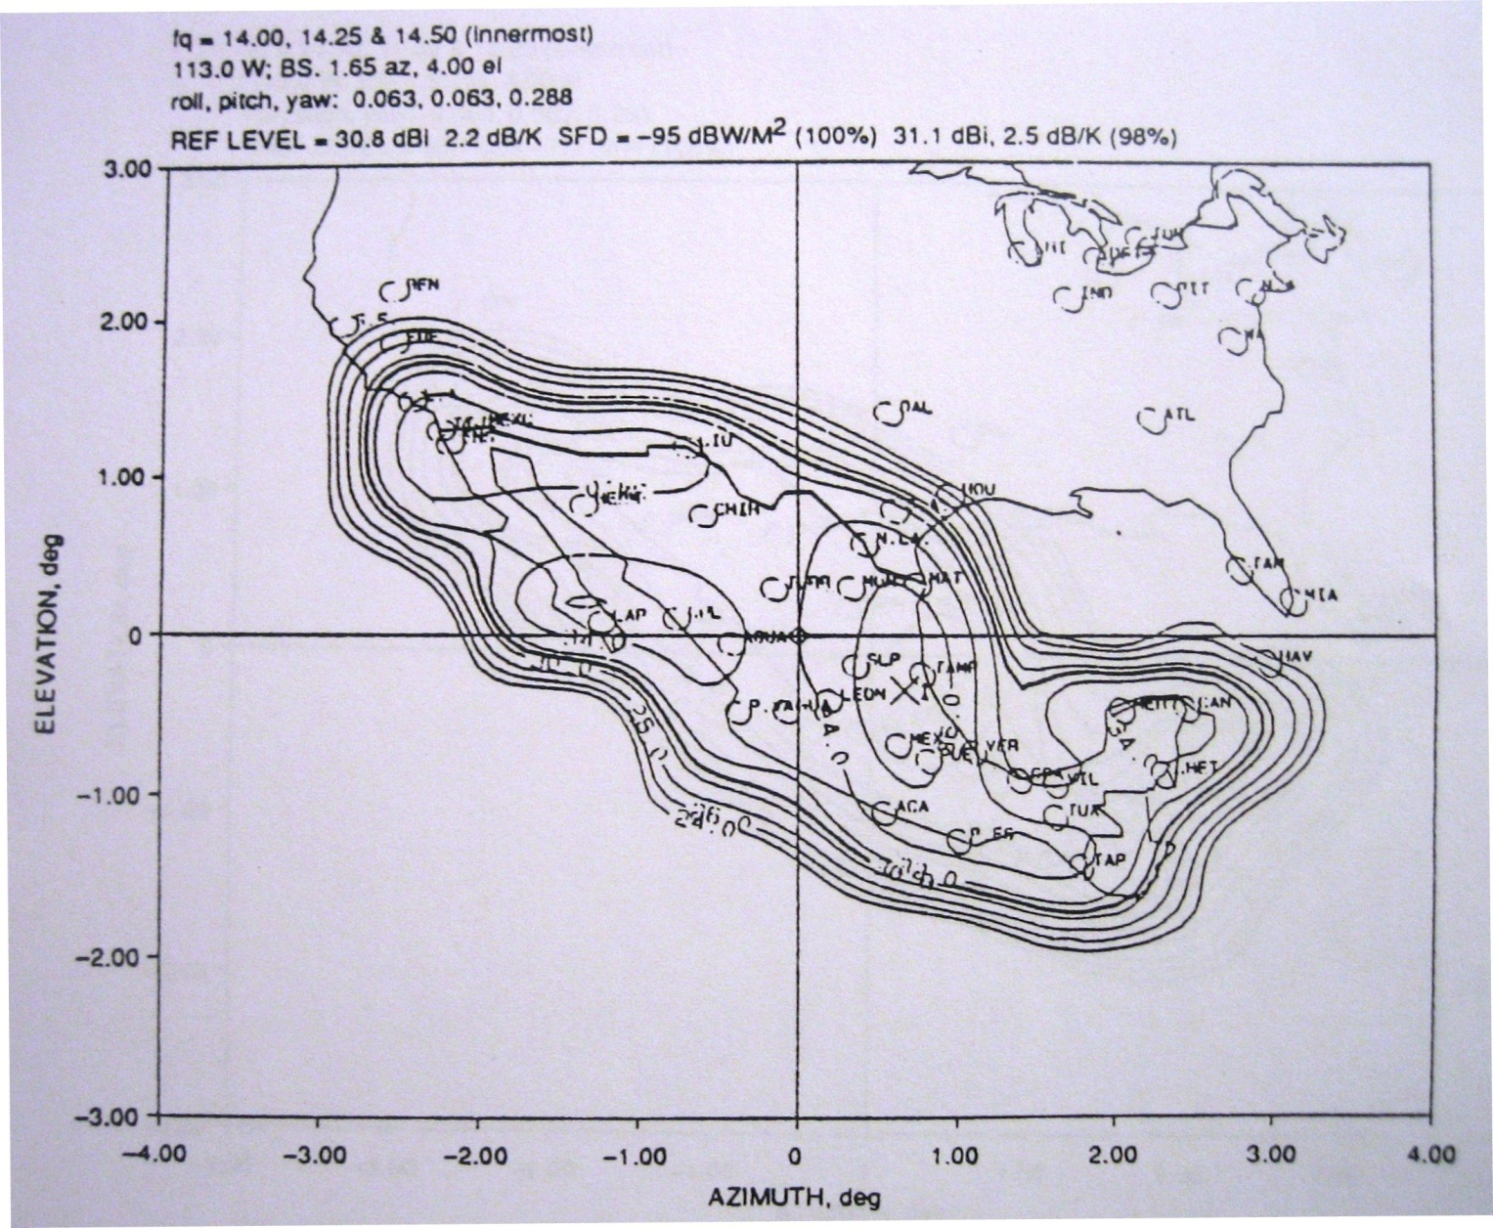
Region R4 Vertical Receive Contours

Slide 100
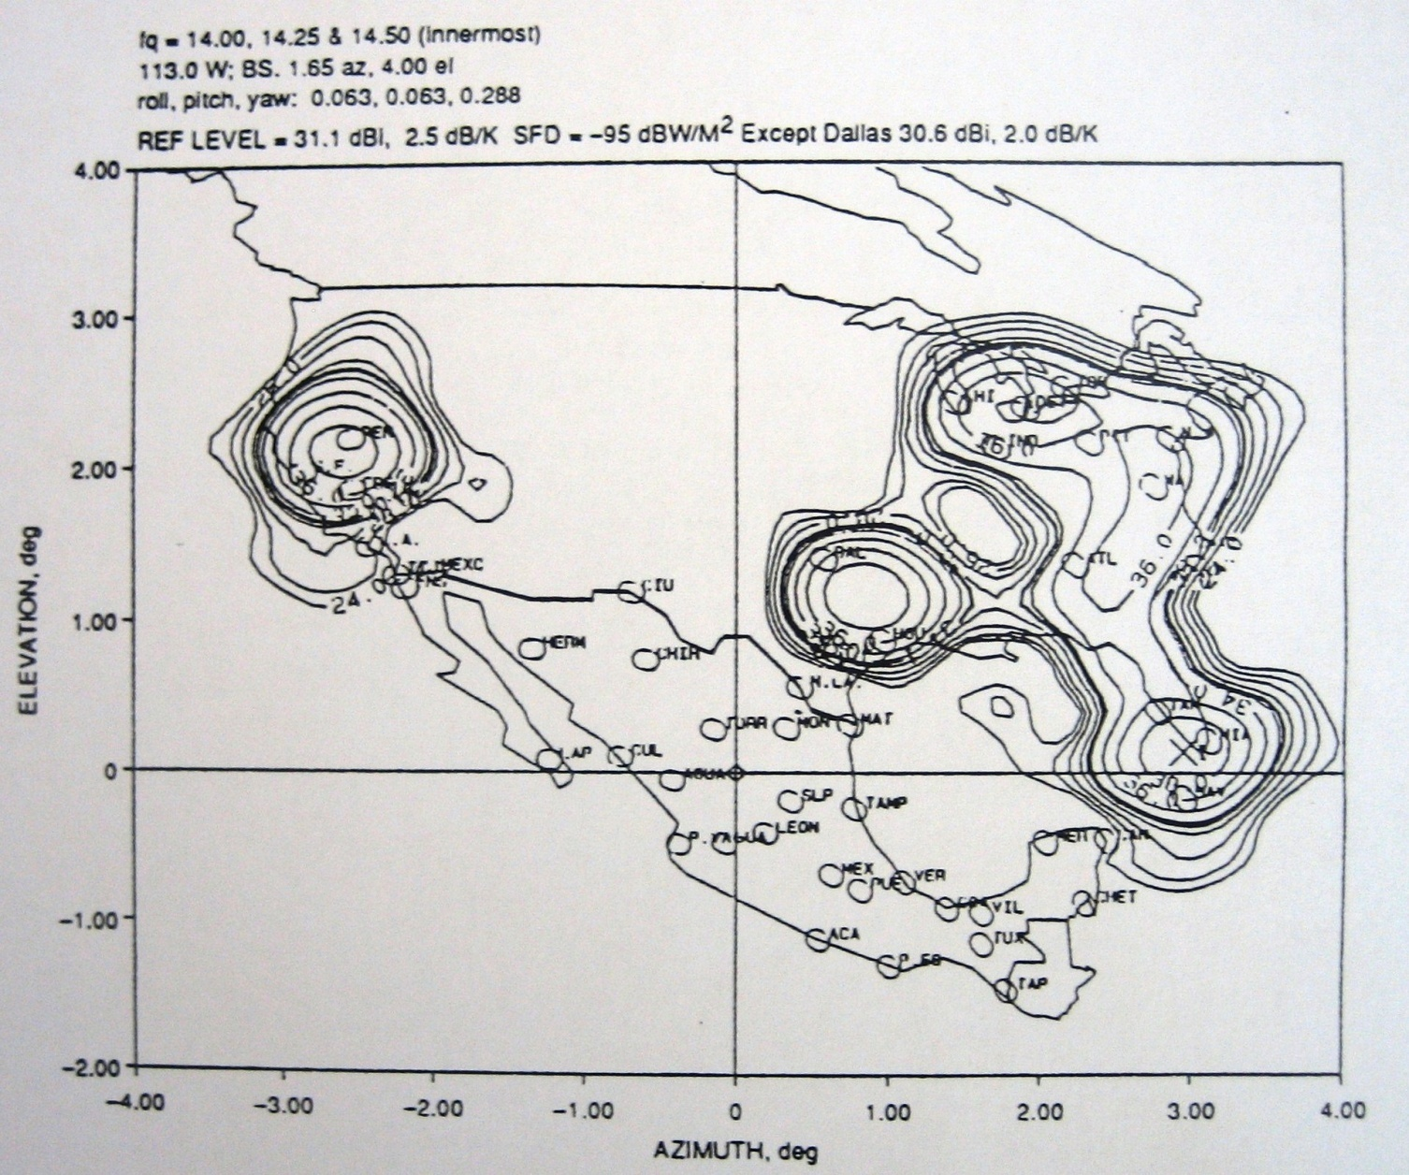
Region R5 Vertical Receive Contours

Slide 101
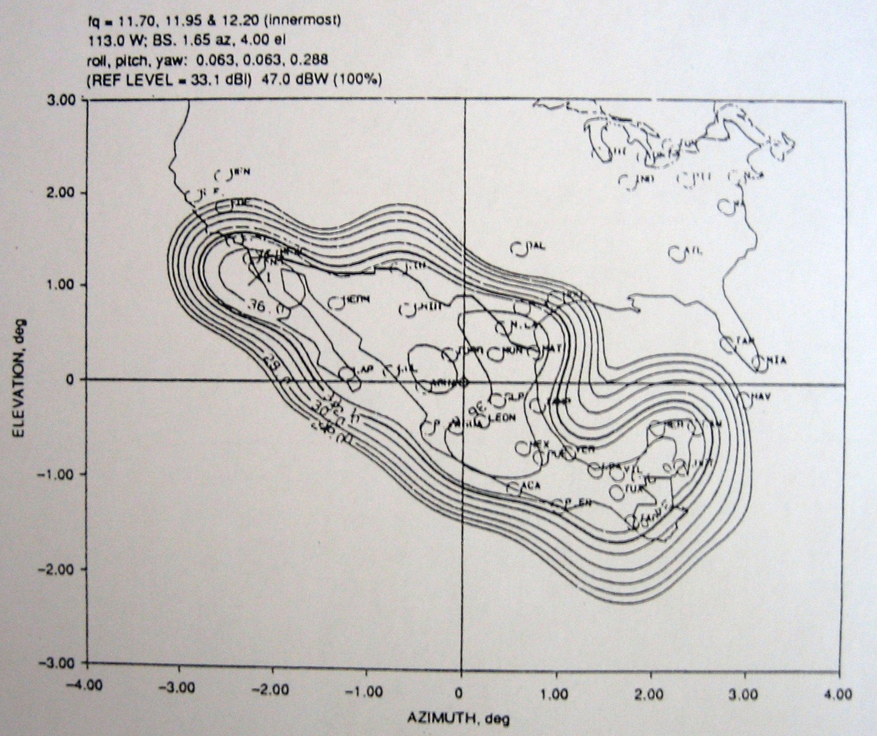
Region R4 Horizontal Transmit Contours

Slide 102
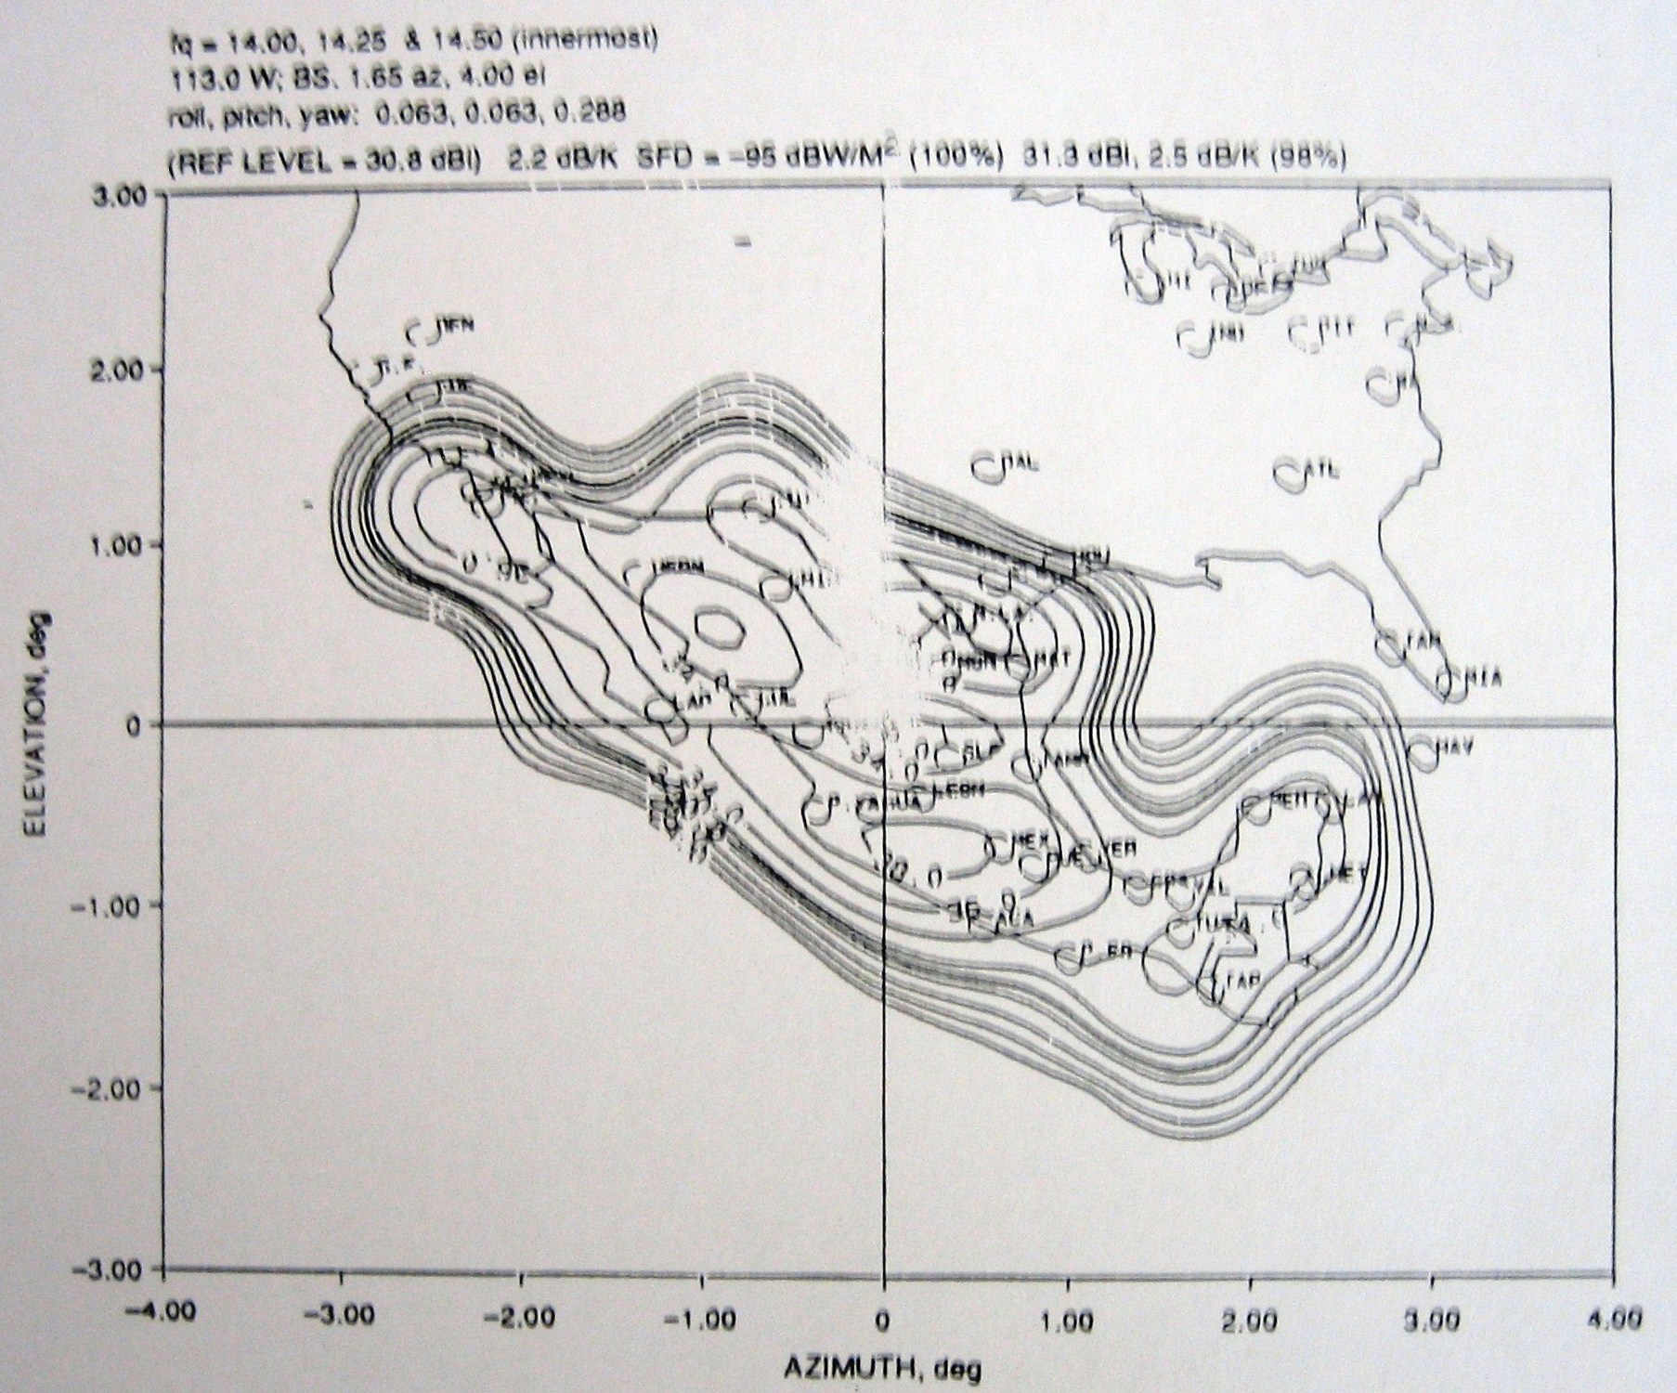
R4 Horizontal Receive Contours

Slide 103
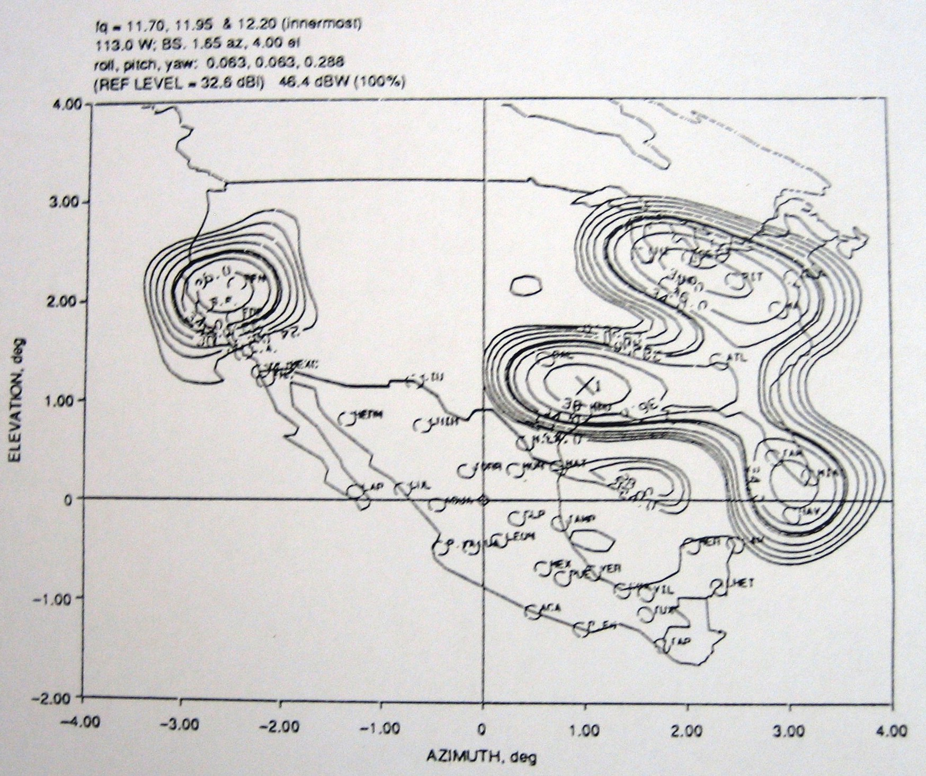
Region R5 Horizontal Transmit Contours

Slide 104
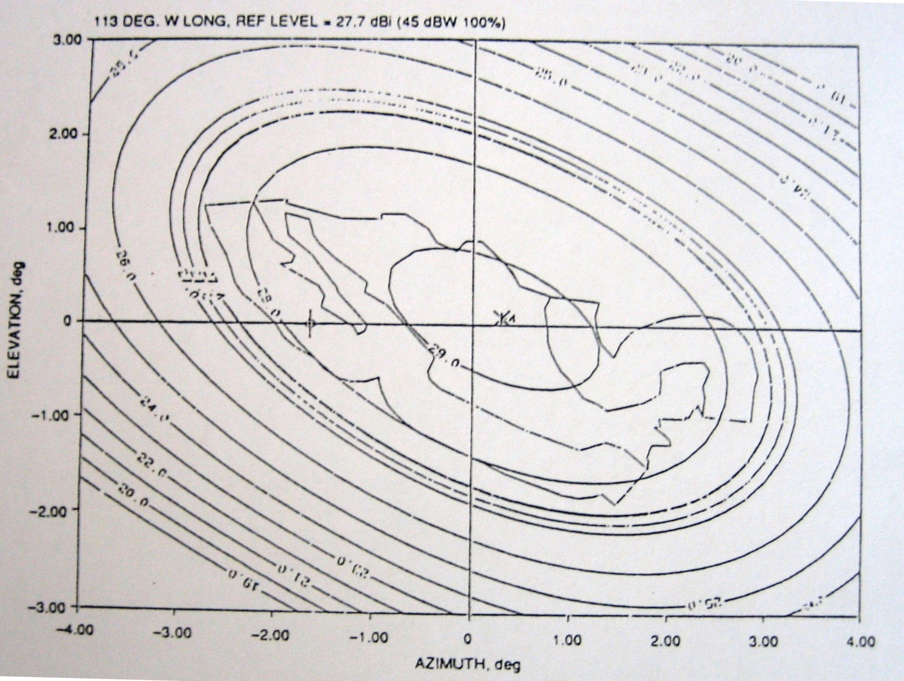
L-band Transmit Contours

Slide 105
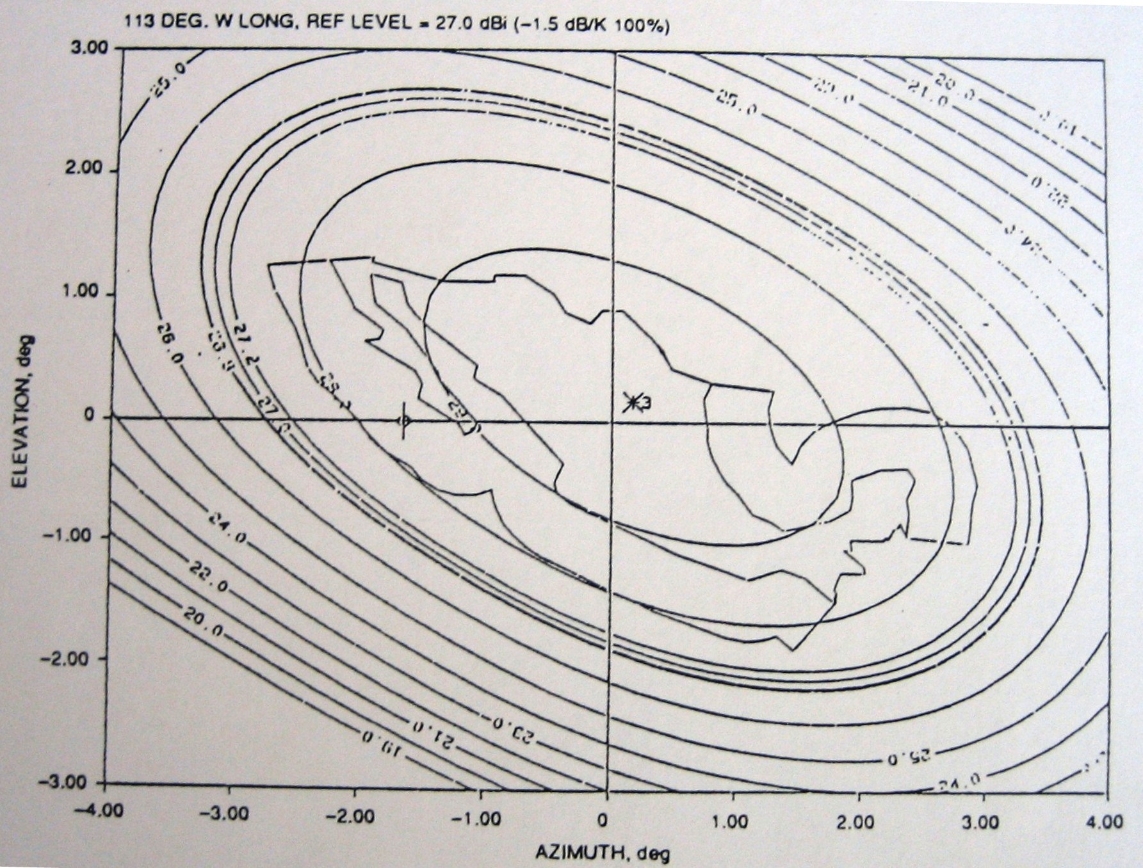
L-band Receive Contours

Slide 106
Solidaridad I (109.2°W)
REGION 4 (MEXICO) Pol Pol
Ku BAND V/H H/V
LOCATION | LONGITUD (deg) | LATITUD (deg) | PIRE (dBw) | D.F.S. (dBw/m₂) | G/T (dB/°k) | PIRE (dBw) | D.F.S. (dBw/m₂) | G/T (dB/°k)
Acapulco, Gro. | 99.55 | 16.51 | 48.10 | -98.05 | 5.05 | 47.30 | -98.20 | 5.20
Aguascalientes, Ags. | 102.03 | 21.86 | 47.80 | -98.45 | 5.45 | 49.30 | -99.30 | 6.30
Cancún, Q. Roo | 86.46 | 21.05 | 47.60 | -97.25 | 4.25 | 48.70 | -97.30 | 4.30
Cd. Juárez, Chich. | 106.29 | 31.44 | 48.40 | -97.95 | 4.95 | 47.95 | -100.70 | 7.70
Chetumal, Q. Roo. | 88.18 | 18.30 | 48.60 | -98.05 | 5.05 | 48.16 | -98.35 | 5.35
Chihuahua, Chih. | 106.06 | 28.65 | 49.30 | -97.10 | 4.10 | 49.35 | -98.70 | 5.70
Coatzacoalcos, Ver. | 94.45 | 18.20 | 49.00 | -96.00 | 3.00 | 47.92 | -97.80 | 4.80
Culiacán, Sin. | 107.40 | 24.82 | 48.90 | -99.22 | 6.22 | 49.62 | -99.15 | 6.15
Ensenada, B. C. N. | 116.37 | 31.52 | 51.10 | -99.90 | 6.90 | 50.32 | -101.30 | 8.30
Guadalajara, Jal. | 103.20 | 20.40 | 49.80 | -97.25 | 4.25 | 49.97 | -101.50 | 8.50
Hermosillo, Son. | 110.58 | 29.04 | 48.90 | -96.90 | 3.90 | 49.25 | -97.70 | 4.70
La Paz, B. C. S. | 110.18 | 24.10 | 49.30 | -98.75 | 5.75 | 48.65 | -99.90 | 6.90
León, Gto. | 101.25 | 21.07 | 50.20 | -98.00 | 5.00 | 50.20 | -100.00 | 7.00
Los Ángeles, Cal. | 118.15 | 34.03 | 48.00 | -97.70 | 4.70 | 47.75 | -98.10 | 5.10
Matamoros, Tamps. | 97.30 | 25.53 | 50.60 | -99.27 | 6.27 | 48.10 | -101.10 | 8.10
Mérida, Yuc. | 89.37 | 20.58 | 48.70 | -97.60 | 4.60 | 48.20 | -97.90 | 4.90

Slide 107
Solidaridad I (109.2°W) (Cont.)
REGION 4 (MEXICO) Pol Pol
Ku BAND V/H H/V
LOCATION | LONGITUD (deg) | LATITUD (deg) | PIRE (dBw) | D.F.S. (dBw/m₂) | G/T (dB/°k) | PIRE (dBw) | D.F.S. (dBw/m₂) | G/T (dB/°k)
Mexicali, B.C.N. | 115.45 | 32.65 | 49.00 | -98.85 | 5.85 | 49.35 | -98.10 | 5.10
México, D.F. | 99.01 | 19.24 | 50.70 | -100.55 | 7.55 | 49.45 | -102.10 | 9.10
Monterrey, N.L. | 100.19 | 5.40 | 50.80 | -99.00 | 6.00 | 49.60 | -99.90 | 6.90
Nuevo Laredo, Tamps. | 99.31 | 27.30 | 51.00 | -98.65 | 5.65 | 48.35 | -102.50 | 9.50
Pto. Escondido, Oax. | 97.10 | 15.50 | 47.30 | -98.45 | 5.45 | 47.15 | -96.70 | 3.70
Pto. Vallarta, Jal. | 105.15 | 20.37 | 48.60 | -97.60 | 4.60 | 48.20 | -100.10 | 8.10
Puebla, Pue. | 98.20 | 19.03 | 49.90 | -100.45 | 7.45 | 48.20 | -100.80 | 7.80
San Antonio, Tex. | 98.31 | 29.28 | 47.70 | -95.57 | 2.57 | 47.00 | -95.50 | 2.50
San Luis Potosi, S.L.P. | 100.98 | 22.15 | 50.00 | -99.45 | 6.45 | 50.50 | -96.00 | 3.00
Tampico, Tamps. | 97.85 | 22.21 | 48.70 | -101.25 | 8.25 | 49.52 | -98.90 | 5.90
Tapachula, Chia. | 92.17 | 14.54 | 48.10 | -98.05 | 5.05 | 47.87 | -97.90 | 4.90
Tijuana, B.C.N. | 117.01 | 32.32 | 50.50 | -99.60 | 6.60 | 49.95 | -100.60 | 7.60
Torreón, Coah. | 103.45 | 25.53 | 47.80 | -97.45 | 4.45 | 49.05 | -99.10 | 6.10
Tuxtla, Gtz. Chia. | 93.07 | 16.45 | 49.70 | -97.20 | 4.20 | 49.37 | -98.40 | 5.40
Vareacruz, Ver. | 96.08 | 19.12 | 48.40 | -97.77 | 4.77 | 47.85 | -98.50 | 5.50
Villahermosa, Tab. | 92.55 | 17.59 | 49.40 | -95.65 | 2.65 | 48.60 | -97.90 | 4.90

Slide 108
SOLIDARIDAD SATELLITE
LINK BUDGET

Slide 109
LINK BUDGET
Satellite Data
SATELLITE: | SOLIDARIDAD 2
LONGITUD: | 113.0 º WESTERN
OPERATION BAND: | C
TRANSPONDER TYPE: | 12N (36 MHz)
REGION: | R3-R2
UPLINK FREQUENCY | 6.385 GHz
DOWNLINK FREQUENCY: | 4.160 GHz
IBO: | 7.5 dB
OBO: | 5.0 dB
PAT: | 6.0 dB

Slide 110
Signal Data
RATE: | 4000 Kbps
MODULATION: | QPSK
ROLL OFF: | 14 %
FEC: | 0.69
BER: | 10E⁻⁷
Satellite Parameters in locations
LOCATION | QUITO, ECUADOR | MIAMI, USA
DFS | -94.00 | dBW/m²
G/T | 2.90 | dB/K
PIREsaturation |  | 37.60 dBW

Slide 111
E/T Transmision and Recepcion Data
LOCATION | QUITO, ECUADOR | MIAMI, USA
LATITUD | 0.22 | 25.77 ºN
LONGITUD | 78.50 | 80.20 ºO
ANTENNA DIAMETER | 3.80 | 4.20 m
ANTENNA GAIN Tx | 45.88 | dBi
ANTENNA GAIN Rx |  | 43.03 dBi
TOTAL SYSTEM TEMP |  | 89.99 ºK
Eb/No RECEIVER MODEM |  | 4.0 dB

Slide 112
BANDWITH
BW = Vinf. (FEC) ⁻¹ (FM) (1 + ROLL OFF) (Hz)
Vinf =Information Rate
FEC =Forward Error Correction
FM =Modulation Factor, it depend of used modulation.
If modulation is BPSK FM = 1.0
If modulation is QPSK FM = 0.5
ROLL OFF = Spread Spectrum Factor (modem feature)
Replacing:
USED BANDWITH
BW = 4000.000 *(0.69) ⁻¹ *(0.5) *1.14
BW = 3304.35 KHz

Slide 113
ANTENNA POINTING AND DISTANCE E/T-SATELLITE
AZIMUTH ANGLE FOR QUITO E/T :
A' = Tan ⁻¹ (Tan [ ABS (LONGSAT - LONGE/T ) ] / Sin LATE/T)
Where: LONGSAT = Satellite Longitude
LONGE/T = E/T Longitude.
LATE/T = E/T Latitude.
ABS = Absolute Value
If E/T location is in North Hemisphere and:
E/T west from the satellite : A = 180 - A´
E/T east from the satellite : A = 180 + A´
If E/T location is in South Hemisphere and :
E/T west from the satellite : A = A´
E/T east from the satellite A = 360 - A´
replacing for QUITO:
A' = Tan ⁻¹ (Tan[ ABS ( 113.0 - 78.50 ) ] / Sin 0.22)
A' = 89.68
such E/T is in south hemisphere and east of satellite
A = 360 - 89.68
A = 270.32º

Slide 114
ELEVATION ANGLE FOR QUITO E/T :
E = Tan ⁻¹ [(R - Re (w) / (Re Sin (Cos ⁻¹ w)))] - Cos ⁻¹ w
Where: R = Mean Distance from Earth Center to geostationary
orbit (42164.2 Km)
Re =Mean Radio of Earth (6378.155 Km)
w =Cos LATE/T ( Cos [LONGSAT - LONGE/T])
replacing:
w = (Cos 0.22)*( Cos [113.0 - 78.50])
w = 0.82142
E = Tan ⁻¹ [(42164.2 - 6378.155 ( 0.82142 )) / (6378.155 (Sen (Cos ⁻¹ 0.82142)))]-
Cos ⁻¹ 0.82142
E = 49.91º

Slide 115
DISTANCE BETWEEN QUITO E/T AND SOLIDARIDAD 2
D = {R ² + Re ² - (2 Re (R) Sen (E + Sin ⁻¹ ((Re / R) Cos E)))} ^{1/2}
Where:
R = Mean distance from Earth center to Satellite (42164.2 Km)
Re = Mean Radius of Earth (6378.155 Km)
E = Elevation angle
Replacing:
D = {42164.2 ² + 6378.155 ² - (2 (6378.155 (42164.2)) Sin (49.91 +Sin ⁻¹ ((6378.155 / 42164.2) Cos 49.91)))} ^{1/2}
D = 37084.22 Km
AZIMUTH ANGLE FOR MIAMI E/T :
A' = Tan ⁻¹ (Tan[ ABS ( 113.0 - 80.20 ) ] / Sin 25.77)
A' = 56.00
E/T location is in north hemisphere and east from the satellite
A = 180 + 56.00
A = 236.00º

Slide 116
ELEVATION ANGLE FOR MIAMI E/T :
w = Cos 25.77 Cos [113.0 - 80.20]
w = 0.75697
E = Tan⁻¹ [(42164.2 - 6378.155 (0.75697)) / (6378.155 (Sen (Cos⁻¹ 0.75697)))] -
Cos⁻¹ 0.75697
E = 42.83º
DISTANCE BETWEEN E/T MIAMI AND SOLIDARIDAD 2
D = (42164.2² + 6378.155² - (2 (6378.155 (42164.2)) Sin (42.83
+ Sin⁻¹ ((6378.155 / 42164.2) Cos 42.83)))) ^{-1/2}
D = 37567.88 Km

Slide 117
UPLINK
Adjacent Interference Satellite (Uplink)

Slide 118
CARRIER TO NOISE DENSITY RATIO UPLINK
(C/No)asc = EIRP E/T + (G/T)SAT - K - Ls asc - μasc - LΔasc
Where:
EIRP E/T = Equivalent isotropically radiated power from the E/T.
(G/T)SAT = Satellite characteristics.
K = Boltzman Constant = -228.6 (dBJ/ºK)
Ls asc = Free Space Losses (Uplink)
μasc = Rain Atenuation Margin, uplink
LΔasc = Miscelaneous losses , it is the summatory of atmospheric losses, pointing and
polarization losses and is approximately 1dB
replacing:
μasc = 0, For 99.98 availability in C band
PROPOSED VALUE OF 57.83 dBW FOR E/T EIRP .

Slide 119
Free Spece Losses (Uplink)
Ls asc = 20 Log ((4p*F*D) / C)
Where: F = Uplink Frequency (Hz)
D = Distance between E/T and satellite (m)
C = Ligth speed (3 E8 m/s)
replacing:
Ls asc = 20 Log ((4p(6.385 E9)(37084.22 E3) )/ 3 E8)
Ls asc = 199.93 dB
(C/No)asc = 57.83+ 2.90 - (-228.6) - 199.93 - 1.0 (dB Hz)
(C/No)asc = 88.40 dB-Hz

Slide 120
CARRIER TO NOISE RATIO UPLINK
(C/N)asc = (C/No)asc - 10 Log (AB)
replacing:
(C/N)asc = (88.40) - 10 Log (3304.35 E3)
(C/N)asc = 23.21 dB
TOTAL CARRIER TO NOISE RATIO

Slide 121
Where:
C/I Ascending Intemodulation: C/I = - HPA INT - IPBO - 10 LOG(AB)
C/X Ascending cross polarization : C/X pol = - INTASCCPOL - IPBO - 10 LOG(AB)
C/X Ascending adjacent Satellite : C/Xsatady =- INTASCSADY - IPBO -10 LOG(AB)
CARRIER IPBO
IPBO = DFS - EIRPE/T + Lp asc + ATP + LATM + μasc
replacing:
IPBO = DFS - PIREE/T + Lp asc + ATP + LATM + μasc
Where:
Lp asc = 10 Log (4 * p * D²)
Lp asc = 10 Log ((4p)(37084.22 E3) ²)
Lp asc = 162.38 dB
IPBO = -94.00 – 57.83 + 162.38 + 6 + 0.5 + 0
IPBO = 17.05 dB

Slide 122
C/I ASCENDING INTERMODULATION
C/I Intermodulation=-(-106.0) – 17.05 - 10*log(3304.35 E3) =106 – 17.05 – 65.19
C/I = 23.77 dB
C/X ASCENDING CROSS POLARIZATION
C/X Cross polarization = - (-112.5) – 17.05 – 65.19
C/X Pol = 30.27 dB
C/X ASCENDING ADJACENT SATELLITE
C/X AdJacent Satellite = - (-110.0) – 17.05 – 65.19
C/X Satady = 27.77 dB
(C/N) ASC TOTAL = 19.36 dB

Slide 123
DOWN LINK
Adjacent Interference Satellite

Slide 124
CARRIER TO NOISE DENSITY RATIO DOWN LINK
(C/No)desc = EIRPSAT + (G/T)E/T - K - Ls desc - μ desc - LΔ desc
Donde:
EIRPSAT = EIRP of satellite for carrier
(G/T)E/T = Earth station Rx
K = Boltzman Constant = -228.6 (dBJ/ºK)
Ls desc = Free Space Losses (Downlink)
μ desc = Rain atenuation Margin, uplink
L Δ desc = Other losses, it is the summatory of athmospheric losses, pointing and
polarization losses and is approximately 0,8dB
replacing:
μ desc = 0, For 99.98 availability in C band
SATELLITE EIRP
EIRPSAT = - SDFTX - ATP + IBO - Lp asc + EIRPE/T - OBO + PIRESATU(RX) - Latm
Where: SDFTX is the Saturation Density flow to locality Tx
EIRPSATU(RX) is the saturation EIRP to location Rx

Slide 125
replacing:
EIRPSAT = -(-94.00) - 6 + 7.5 - 162.38+ 57.83- 5.0 + 37.60 - 0.5
EIRPSAT = 23.05 dBW
FREE SPECE LOSSES (DOWNLINK) :
Ls desc = 20 Log ((4p (4.160 E9)(37567.88 E3) )/ 3 E8)
Ls desc = 196.32 dB
MERIT FIGURE OF THE MIAMI E/T
(G/T) = GRX - 10 LOG ( Ts )
Ts = T LNA + T ANTENNA = 65 + 24.99 ( K )
:
(G/T)E/T = 43.03 - 10* Log ( 89.99 )
(G/T)E/T = 23.49 dBºK
replacing in (C/No)desc:
(C/No)desc = 23.05 + 23.49 - (-228.6) - 196.32 - 0.8
(C/No)desc = 78.02 dB-Hz

Slide 126
CARRIER TO NOISE RATIO(DOWN LINK)
(C/N)desc = (C/No)desc - 10 Log (AB)
replacing:
(C/N)desc = (78.02) - 10 Log (3304.35 E3)
(C/N)desc = 12.82 dB
TOTAL CARRIER TO NOISE RATIO

Slide 127
Where:
C/I Intermodulation desc : C/I = - SAT INT - OPBO - 10 LOG(AB)
C/X Cross Polarization desc : C/X pol = - INTDESCPOL - OPBO - 10 LOG(AB)
C/X Adyacent Satellite desc: C/X satady = EIRPSAT -(INTDESSADY- GANT RX) -10 LOG(AB)
OPBO CARRIES
OPBO = MOBO - MIBO + IPBO
replacing:
OPBO = 5.0 - 7.5 + 17.05
OPBO = 14.55 dB
C/I INTERMODULATION DESCENDENT
C/I Intermodulation = - (-97.2 )- 14.55 – 65.19
C/I = 17.47 dB

Slide 128
C/X CROSS POLARIZATION DESCENDENT
C/X Cross Polarization = - (-107.5) – 14.55 – 65.19
C/X pol = 27.77 dB
C/X ADJACENT SATELLITE DESCENDENT
C/X Adyacente Satellite = 23.05 - (-15.00 – 43.03) - 65.19
C/X satady = 15.89 dB
replacing:
(C/N) DESC TOTAL = 10.11 dB

Slide 129
Link Evaluation
TOTAL CARRIER TO NOISE RATIO
Replacing:
(C/N)TOTAL = 9.63 dB

Slide 130
CARRIER TO NOISE RATIO REQUIRED
(C/N)REQ. = Eb/No + 10 Log (Vel inf) - 10 Log (AB)
replacing:
(C/N)REQ. = 4.0 + 10 Log (4000 E3) - 10 Log (3304.35 E3)
(C/N)REQ = 4..83 dB
LINK MARGIN
ME = (C/N)TOTAL - (C/N)REQ.
replacing:
ME = 9.63 - 4.89
ME = 4.74 dB

Slide 131
PERCENTAGE OF POWER CONSUMPTION BY CARRIER IN THE SATELLITE
% POT = [ALog { ( EIRPSAT - EIRPSATU + OBO )} ] * 100
10
replacing:
% POT = [ALog { (23.05 - 37.60 + 5 ) } ] * 100
10
% POT = 11.1100 %
POWER CONSUMPTION IN HPA
POTHPA = EIRPE/T - GTx + LHPA Y ANT
Replacing values:
POTHPA = 57.83 - 45.88 + 0.5
POTHPA = 12.45 dBW
In Watts:
POTHPA = ALOG( 12.45 dBW / 10 )
POTHPA = 17.58 W

Slide 132
Topic 4: Subsystems solution

Slide 133
Telemetry, Tracking and Command
 | Telemetry | Command | Tracking
Frequency | 3701.1 MHz | 5935 MHz for dish antenna | 5943 MHz
Capacity | 256 words for minor frame 32 minor frames for major frame 1 major frame every 65.5 seg | 768 pulse commands 16 serials
Polarization | For dish antenna: vertical For OMNI antenna: horizontal | For dish antenna: vertical For OMNI antenna: horizontal
EIRP | 10 dBw for dish antenna | - | -
Technique | - | - | Transponder range
accuracy | - | - | 15 m

Slide 134
Telemetry, Tracking and Command Subsystem
ANTENNA
COMMUNICATIONS REPEATER
DIGITAL EQUIPMENT
H
OMNI/SPOT
Diplexer
Command Decoder1
PULSE COMMANDS
Command Receiver 1
SERIAL
COMMANDS
CMD
VERTICAL
C-BAND
ANTENNA
PULSE COMMANDS
OMNI/SPOT
Diplexer
Command Receiver 2
Command Decoder2
CMD
HORIZONTAL
TLM
VERTICAL
SERIAL
COMMANDS
DEPLOYED OMNI
LPF
R
E
CCU
R
Telemetry
Transmitter 1
TEU 1
EL NULL PORT (C BAND HORIZONTAL TRANSMIT FEEDS)
R
R
LPF
R
F
CCU
R
Telemetry
Transmitter 2
AZ NULL PORT (C BAND VERTICAL TRANSMIT FEEDS)
TEU 2
H
TEST COUPLER
WAVEGUIDE TO COAX ADAPTER
COAX ISOLATOR
R1 HORIZONTAL
R3 VERTICAL
S
OUTPUT TO TLM FILTERS
ON C-BAND OUTPUT MUX

Slide 135
Telemetry Subsystem Block Diagram
PCM1
Telemetry Transmitter 1
Telemetry Enconder Unit 1
Data
Clock
PCM2
Valves driver units
N
D
Satellite Control Processor Data
High resolution pressure transducter
N
D
Sensors:
Earth
Sun
IRU
Telemetry Transmitter 2
Telemetry Encoder Unit 2
Data
Clock
PCM1
PCM2
It is not part of this system
Normal Telemetry
Dwell Telemetry
N
D

Slide 136
Telemetry transmitter Input/Output interfaces
Command
Receivers
(CR)
Range Tones
Telemetry Transmitter
To Omni Antenna
To high gain Antenna
Telemetry Encoding Units (TEU)
Subcarrier
32 KHz
Telemetry
On/Off
Ranging CR1/CR2
Command
Decoding Units (CDU)
Commands:
ON/Off
Ranging Selection /PCM
Ranging CRI/Ranging CR2

Slide 137

Command Simplified Block Diagram
CDU
Scanne
r
Uplink Input Control
Pulse Commands (768)
RF
T&C
50 bps
Satellite Units
Tones
SCPs
Commands storage buffers
Automatic control
Serial Commands (16)
(1000bps)
*SCP/CDU
Interface
SCP Input Control
SDUs
BVLs
TEUs
(1000bps) SCP/CDU
Interface
* It is fitted out from earth by a command when only one the SCP’s is turn on.

Slide 138
Telemetry, Tracking and command subsystem
Telemetry, Tracking and Command
Telemetry
Frequency | 3700.1 to 3701.1 MHz
Modulation index | 1.0 ± 0.15 rad
PCM data
Major frame rate | 65.536 sec/frame
Minor frame rate | 2.048 sec/frame
Minor frame length | 256 words (8bits/word)
Subcarrier | 32 kHz, phase modulated
Capacity | 256 channels
Bilevel (digital) | 69
Conditioned bilevel | 9
Analog | 108
Conditioned analog | 62
Serial | 8

Slide 139
Telemetry, Tracking and command subsystem (Cont.)
Polarization
Transfer orbit and on-station (reflector) | Vertical command, horizontal telemetry
On-station (omni) | Horizontal command, vertical telemetry
EIRP
Transfer/drift orbit | 4.0 dBW (±20°)
On-station | 10.0 dBW min
Command
Frecuency range | 6415 MHz (transfer orbit), 5935 MHZ (on-station)
Coverage
Transfer orbit | ±35°
On-station | Spot beam Mexico
Polarization
Transfer orbit and on-station(reflector) | Horizontal
On station (omni) | Vertical
Capacity | 768 pulse; 16 serial

Slide 140
Telemetry, Tracking and Command subsystem (Cont.)
Threshold flux density
Transfer/drift orbit | -91.5 dBW/m²
On-station | -93.9 dBW/m²
Peak deviation | 300 kHz
Format | RZ tone digital, sync tone
Tracking
Transfer orbit | Via bicone antenna
On-station | Via reflector
Modulation index | 1.0 ±0.15 rad
Peak deviation | 300 kHz
Accuracy | 15 m

Slide 141
Attitude Subsystem
Attitude Processor : Managements and processes the information of all the units for the self- control of the satellite.
Momentum Wheels : Provide attitude control in the three reference axis of the satellite (Roll, Pitch and Yaw)
Inertial reference unit: 3-for-1 redundancy in pitch and roll
2-for-1 redundancy in yaw
Operation Range : /Pitch/ + /Roll/ < 0.4º
Gyroscope: Measures the angular velocity in Roll, Pitch and Yaw.
Sun sensors: Silicon photovoltaic elements
Earth Sensors: Detectors in the infrared

Slide 142
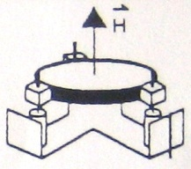
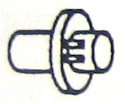
Attitude Control Subsystem Block Diagram
SPACECRAFT CONTROL PROCESSOR
Transfer Orbit Processing
Attitude data processing
Thruster pulse firing
Perigee assist maneuvers
LAM thruster firing
Acquisition Control:
Auto mode sequencing
Sun search/Acquisition
Earth search/Acquisition
Stationkeeping Control
Auto mode sequencing
Gyro calibration
Stationkeeping attitude control
Transition to normal
Normal Mode Control
Attitude estimation
Momentum bias control
Thruster H-dumping
Mechanism Control
Solar panel control
Reflector positioning control
Fault protection
Spacecraft Systems Support
T&C precessing
Battery Charge management
Tank pressure transducer processing
Receive antenna deployment actuator
OMNI Deplyment Actuator
Transfer Orbit sun sensor
Commands
Command decoder unit
Load Shedding
Battery Charging
Acquisition sun sensor
Thruster valve driver units
LAM Thruster
Inertial Reference Unit (2)
Thrusters 12
Wheel Torque Commands
Index Pulses
Wheel Drive Electronic
Momentum Wheel Platform Assembly
Transfer Orbit Earth Sensor (2)
Operational Orbit Earth Sensor (2)
Jackscrew Drive Signals
N Solar Wing Drive
POT TLM
POT TLM
Battery Cell Pressure Transducters
S Solar Wing Drive
POT TLM
Reflector Positioning Mechanism
POT TLM
Tank Pressure Transducters
Telemetry Encoder Unit
Telemetry
ACS Hardware
Non ACS Hardware

Slide 143
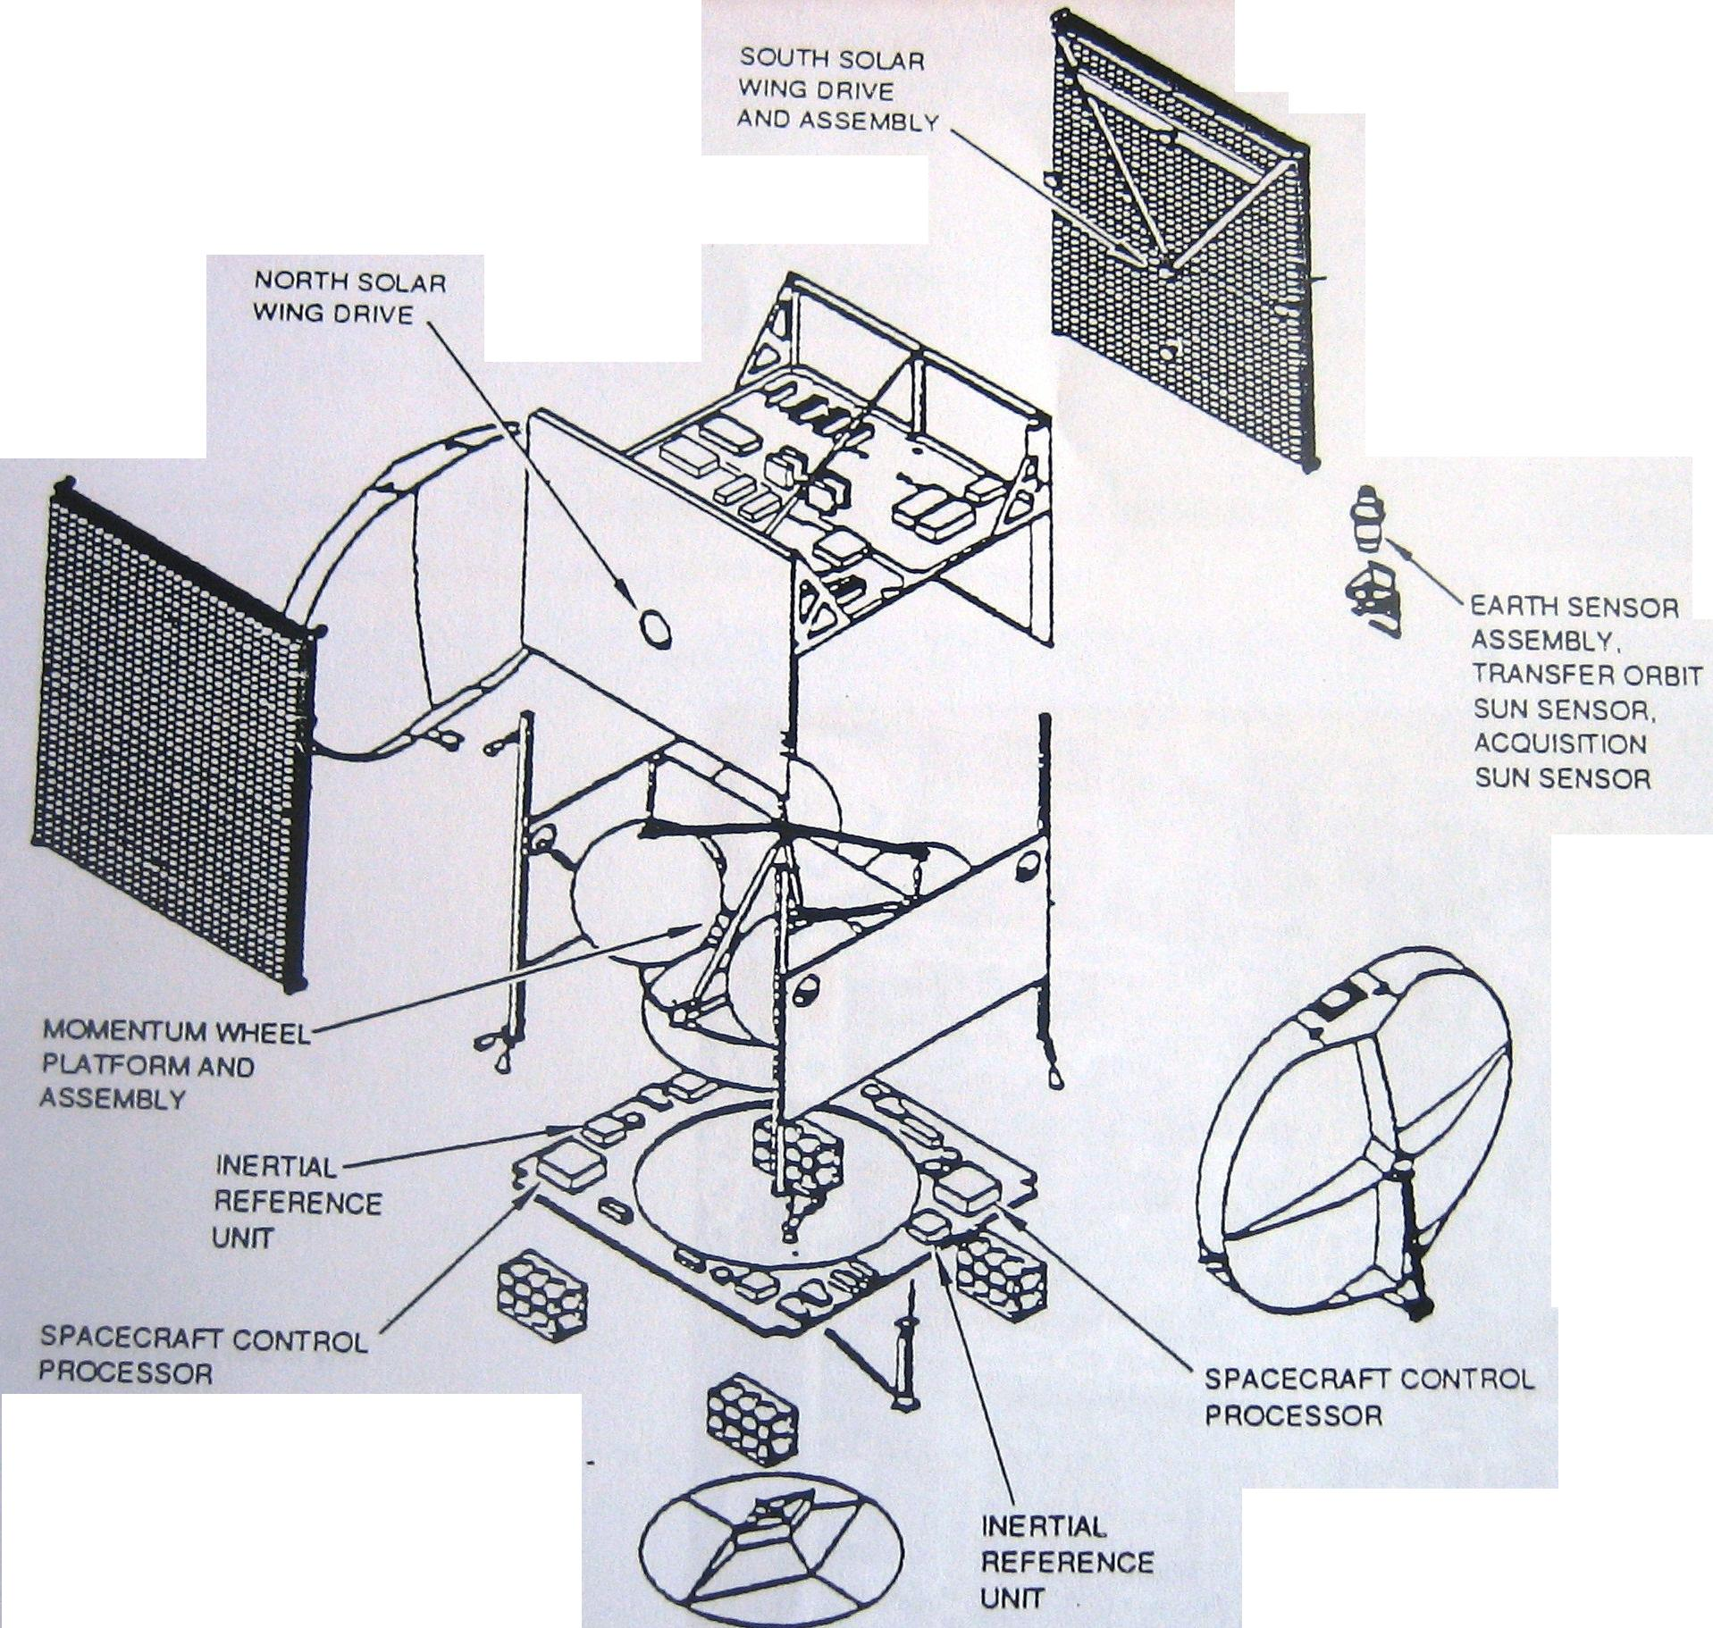
ACS Component Locations

Slide 144
Spacecraft Body Control Modes
Mode | Sensors | Actuators | Phase / Configuration | Mode/Phase Function
Standby | None | None | Inactive, ground control | Default at turnon, or eq failure Ground mechanism control
Ascent | Transfer orbit sun sensor HCI earth sensors | Thrusters | Passive stable spin | Ground transfer orbit operations
Gyro pointing | 3-axis IRU | Thrusters | Gyro rate configuration Rate Integrate gyro | Hold rate; IRU range high or low Hold rate and position; IRU low range
Sun pointing | Acquisition sun sensor Transfer orbit sun sensor 3-axis IRU | Thrusters | Pitch sun acquisition Yaw sun acquisition Sun hold | Search for sun in pitch Search for sun in yaw Hold sun pointing
Earth pointing | Static earth sensor 3-axis IRU | Thrusters | Earth search Capture Lockon Earth hold | Around roll to find earth Center earth in FOV Null earth sensor errors Hold nadir pointing
Normal | Static earth sensor | MWA, MWP. SWD | Capture Steady state | Rapid capture entering Normal mode >99% of operational life
Momentum dump | Static earth sensor | As Normal mode plus thrusters | Pitch dump Roll/yaw dump | Dump pitch momentum Dump roll/yaw momentum
Station keeping | 3-axis IRU Static earth sensor | Thursters |  | Attitude Control during maneuvers
Transition | Static earth sensor 3-axis IRU | Thrusters MWA, MWP | Thruster Whell | Reduce rates for wheel capture Reduce rates before Normal mode

Slide 145
Electrical subsystem
Electrical Power
System | Single regulated bus
Solar cel array type efficiency | High
Cells | Thickness
Total array power
On-station (EOL)
Jun solstice | 3156 W
Sep equinox | 3370 W
Battery system | 1 nickel-hydrogen battery
Capacity | 160 A-hr (EOL)
DOD, EOL | 70% max
Recharge time at EOL | < 16 hr

Slide 146
Electrical Power Subsystem Key Features
Purpose | Provide regulated power to all active payload and bus units
Operational phases | Transfer orbit On station Sunligth operation Eclipse operation
Requirements | Maintain tightly regulated bus voltage Provide sufficient current for nominal loads Provide additional current for transient loads Provide fusing for units loads Provide commandable switched power Provide current/voltage telemetry

Slide 147
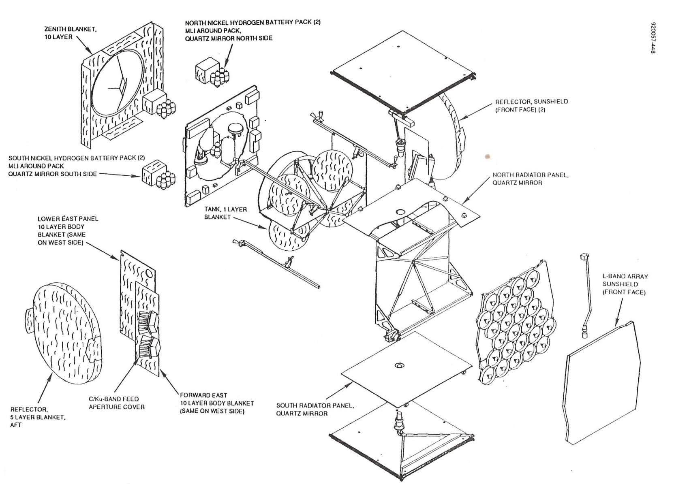
Thermal and Electrical design elements
Battery charging controller
Thermal subsytem elements
Electrical subsystem elements
Battery discharging controller
Battery cells pack (4)
Power distribution unit
Solar Panel (2)
Bus voltage limiter
Assembly for handling southern solar panel
YOKE (1)

Slide 148
Power Subsystem Block Diagram
Propulsion
Loads
SWD
Control
Control
SWD
North Solar wing drive
Propulsion Power Distribution Unit
South Solar wing drive
North Solar Wing
BVL 1
BVL 2
South Solar Wing
North bus loads
Bus Power Distribution Unit 1
Bus Power Distribution Unit 2
South bus loads
Bus Crosstrap
1
MT/ ANWA
SCP
Current
2
Battery Discharge Controller 1
Battery Charge Controller
1
Battery Discharge Controller 2
1: Charge control
2: Battery charge
1
CP
OT
BEP
Battery Pack 4 North
OT
Battery Pack 3 North
Battery Pack 2 South
OT
Battery Pack 1 South

Slide 149
Electrical Power Subsystem Performance Characteristics
Bus voltage regulation range | 51.0 to 52.4 V
Sunlight | 50.35 to 50.65 V
Eclipse | 49.85 V
Minimum bus voltage at farthest load | 2 three panel deployable wings
Solar array power at 50.9V (nominal temp) ±5°C | BOL | 14 Yr
21 Jun solstice | 3674 W | 3156 W
21 Sep equinox | 4083 W | 3370 W
Solar array power margin | BOL | 14 Yr
21 Jun solstice | 692 W | 206 W
21 Sep equinox | 742 W | 61 W
Battery | Single nickel-hydrogen battery
Number of cells | 27
Capacity | 160 A-hr (EOL)
Average eclipse voltage | 33.5 V (EOL)
Cell bypass | Thermostatically actuated relays for open circuit cell protection
Depth of discharge | BOL |  | 14 Yr
All cells good | 66.6% |  | 66.9%
One cell failed | 69.5% |  | 69.8%
Two cells failed | 72.6% |  | 73.0%
Battey discharge controller | Constant power boost regulator Internally redundant units
Number of units | 2 per spacecraft
Efficiency | 94%
Bus voltage limiter | Full shunt switching regulators Solar wing yoke mounted Provides shunted current telemetry
Battery charge control | Regulated constant cuurrent power Provides battery pressure telemetry
Charge rates available | 0.8, 8.0, 13.0 A
Efficiency at high rate | 95.0%
Efficiency at trickle | 80.0%

Slide 150


Key Bus Voltages
65.00
52.90
52.50
52.40
52.00
51.90
51.50
51.40
51.00
50.90
50.65
50.35
50.00
49.85
49.50
47.36
46.00
43.00
40.00
31.00
24.00
20.00
19.00
Units Survive for 1 Min
BLV Regulation
Array voltage at EOL
BOC Regulation
VOLTAGE
MIN voltage at furthest load
HPAs turnoff
Noncritical (payload) units turnoff
Critical Units (A) maintain T&C function: ESA, IRU, MWA
Critical Units (B) maintain T&C function: T&C power electronics
Minimum battery voltage
SCP (Except motor stepping) functions

Slide 151
On station end of life power budget
Item | Jun. Solstice |  | Sep. Equinox |  | Eclipse
a) Payload
Repeater
C-band | 656 |  | 656 |  | 656
Ku-Band | 1370 |  | 1370 |  | 1356
L-Band | 421 |  | 421 |  | 421
T&C | 54 |  | 54 |  | 54
Attitude control | 46 |  | 46 |  | 46
Thermal | 226 |  | 254 |  | 194
Power electronics | 59 |  | 68 |  | 38
Battery charge | 32 |  | 324
Total loads (at 49.85 V) | 2865 |  | 3194 |  | 2765

Slide 152
Subsystem/Unit | Active Units | Season
 |  | Jun. Solstice | Sep. Equinox | Eclipse
a) Bus
T & C
Decoders | 2 | 13 | 13 | 13
Encoders | 1 | 10 | 10 | 10
Squib driver | 1 | 2 | 2 | 2
Valve driver units | 2 | 0 | 0 | 0
T & C receivers | 2 | 18 | 18 | 18
Telemetry transmiters | 2 | 11 | 11 | 11
Subtotal |  | 54 | 54 | 54
Attitude control
SCP | 1 | 22 | 22 | 22
Earth sensor |  | 4 | 4 | 4
Momentum wheel |  | 20 | 20 | 20
Subtotal |  | 46 | 46 | 46
Thermal
Thruster heaters |  | 22 | 22 | 27
Line heaters |  | 17 | 17 | 21
Battery heaters |  | 28 | 56 | 0
Sensor suite heater |  | 27 | 27 | 22
Reflector actuator heaters |  | 0 | 0 | 0
SSPA/output multiplexer heater |  | 112 | 112 | 112
LNA heater |  | 12 | 12 | 12
ASWA heater |  | 8 | 8 | 0
Subtotal |  | 226 | 254 | 194
Power electronics
Battery charge controller | 1 | 8 | 17 | 6
Bus voltage limiters | 2 | 8 | 8 | 8
BDCs | 2 | 4 | 4 | 0
PDU current sensors | 4 | 4 | 4 | 4
Heater controllers | 46 | 20 | 20 | 20
Magnetic torquer |  | 15 | 15 | 0
Subtotal |  | 59 | 68 | 38

Slide 153
Solar Array Construction
SOLAR ARRAY
SOLAR WING
YOKE
SOLAR PANEL
CELL CIRCUIT
BUS VOLTAGE LIMITER (BVL)
SOLAR WING ACTUATOR (SWA)
(SPRING DRIVEN VISCOUS DAMPER)
CELL STRING
CELL-INTERCONECT-COVER (CIC)

Slide 154
Deployed Solar Wing Dimensions
Spacecraft
Centerline
10m
(34ft)
BVL C/L
9.34m
(367.766 In
Hinge C/L
158.156 cm
(62.266 In)
259.588 cm
(102.200 In)
(3PL)
2.794 cm
(1.100 In) Hinge C/L to edge of panel (all locations)
111.15 cm
(43.266 In)
114.3 cm
45.0 In)
STA 82.500
STA 40.000
+Z
(Out of Page)
STA -2.500
PANEL 1
PANEL 2
PANEL 3
Panel Hinges
(4 PL)
Sheaar fittings
(6 pairs per panel)
Tiedwon Brackets
(6 PL)
Yoke Hinges
(2PL)
Solar Wing Actuator
Solar Panels
(3 per wing)
Coordination cables
(3 PL)
Bus Voltage Limiter
Yoke Assembly

Slide 155
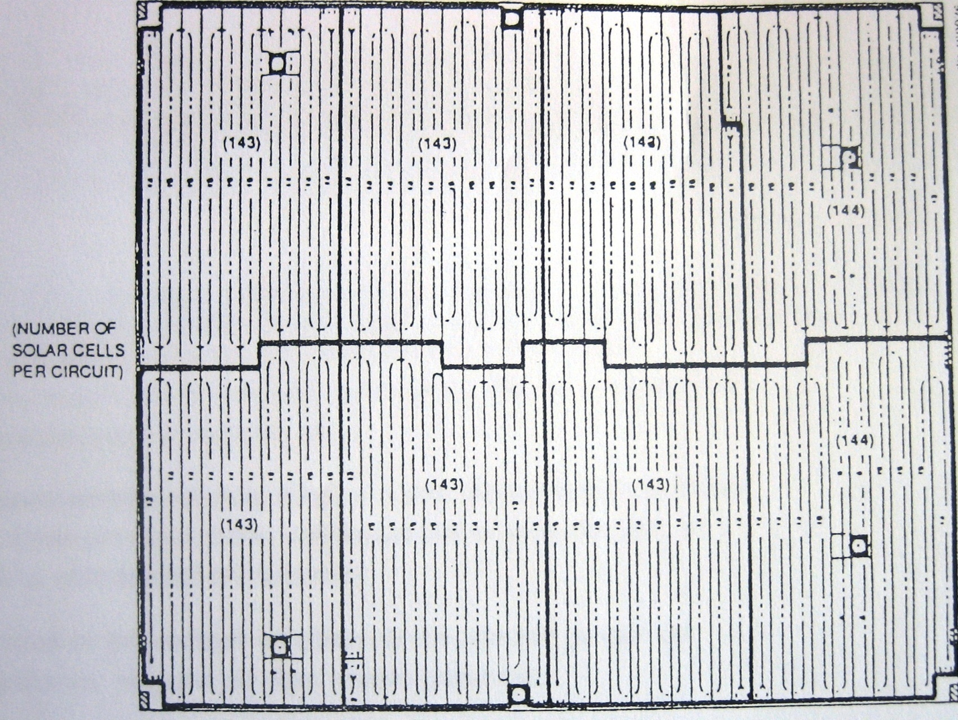
Typical Solar Panel Layout

Slide 156
Solar Wing Deployment Mechanism
FEMALE YOKE HINGE
PANEL HINGE
PANEL HINGE
SOLAR WING ACTUATOR
YOKE
COMBINATION CABLE
MALE YOKE HINGE
PANEL HINGE
PANEL HINGE

Slide 157
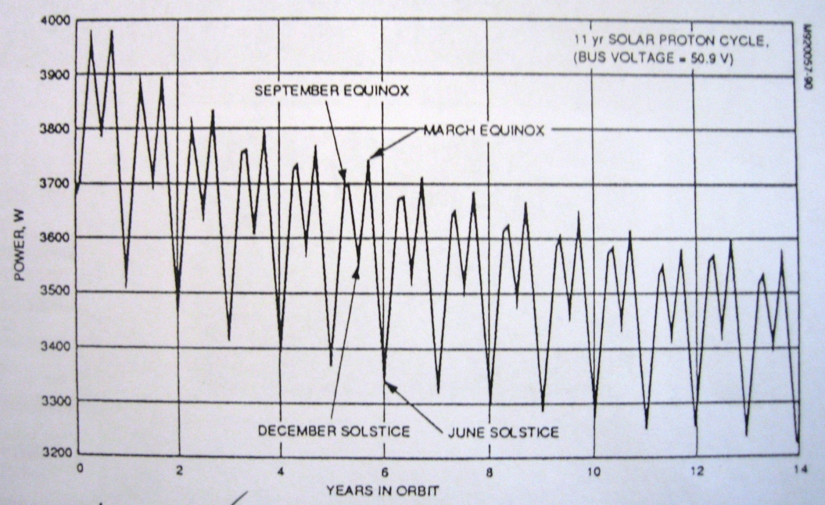
Predicted Solar Array Power Mission Profile

Slide 158
Battery Cell Location
NORTH
6 Cell Pack
7 Cell Pack
WEST
AFT SIDE OF BUS PANEL
EAST
7 Cell Pack
7 Cell Pack
SOUTH
All four packs mounted in standard (corner) position

Slide 159
Battery Parameters
Nameplate capacity | 160 A-hr
Number of cells in series | 27
Number of cells per pack | 6, 7, 7, 7
Heater size | 2 x 14 W maximum
Heater control | 2 electronics thermostats
Mounting locations
Northeast pack | Standard position
Northwest pack | Standard position
Southwest pack | Standard position
Southeast pack | Standard position

Slide 160
Propulsion Subsystem
Thrusters: 12 thrusters with a thrust of 22 Nw with the following distribution:
4 axials
4 north-south
4 east-west
Helium tanks: 2 tanks of aluminum liner with graphite epoxy overwrap to support a maximum pressure of 4,200 psia and a capacity of 2650 In³ min
Propellant tanks: 2 fuel tanks (monometyl hydrazine) and 2 oxidizer tanks (nitrogen tetroxide) to support a maximum pressure of 1,800Kpa and a capacity of 367,89 dm³

Slide 161
Propulsion Subsystem Layout
NORTH
FTK 2
OTK 1
HT1
WEST
EAST
HT2
OTK 2
FTK 1
SOUTH
FTK=Fuel Tank
OTK=Oxidant Tank
HT=Helio Tank

Slide 162
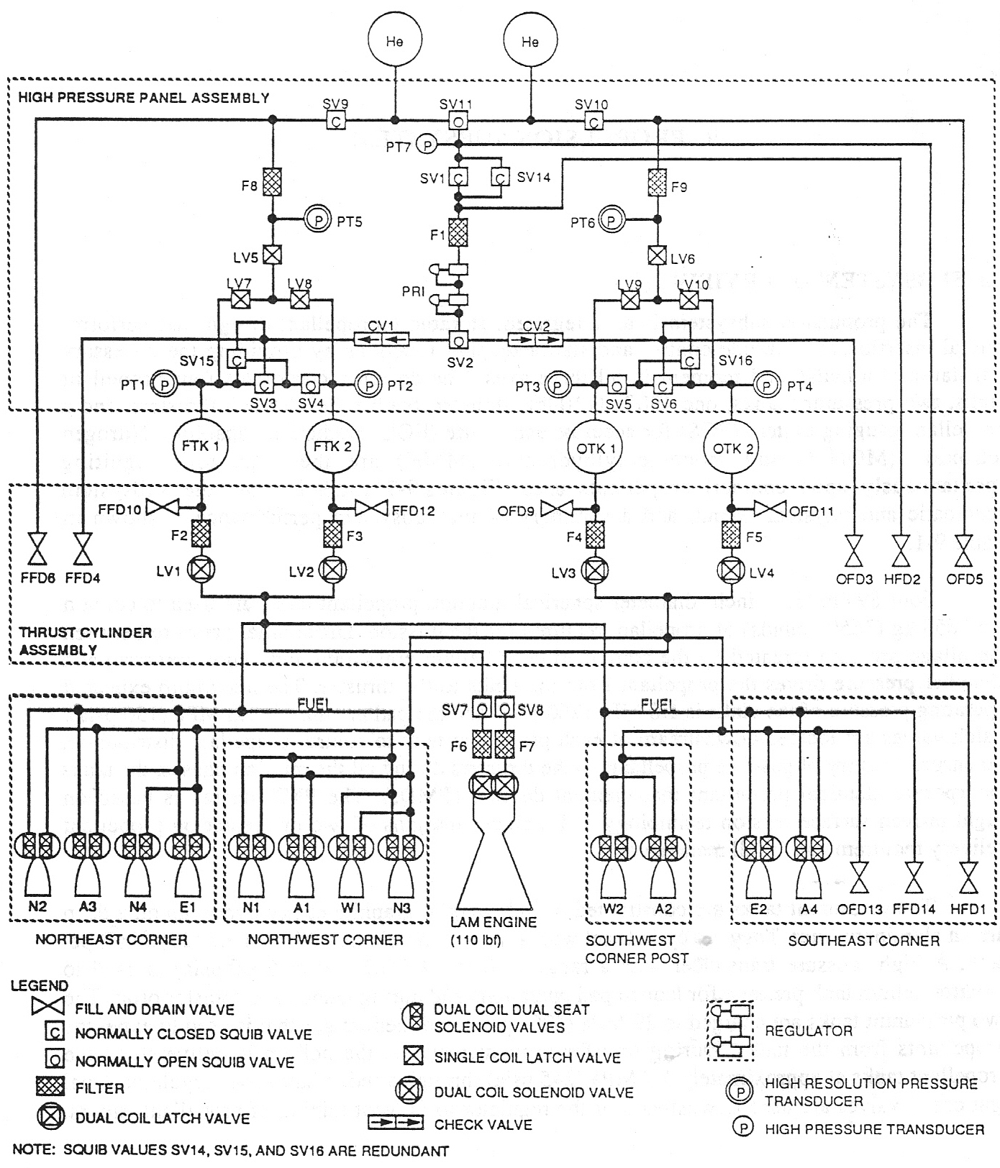
Propulsion Subsystem Schematic

Slide 163
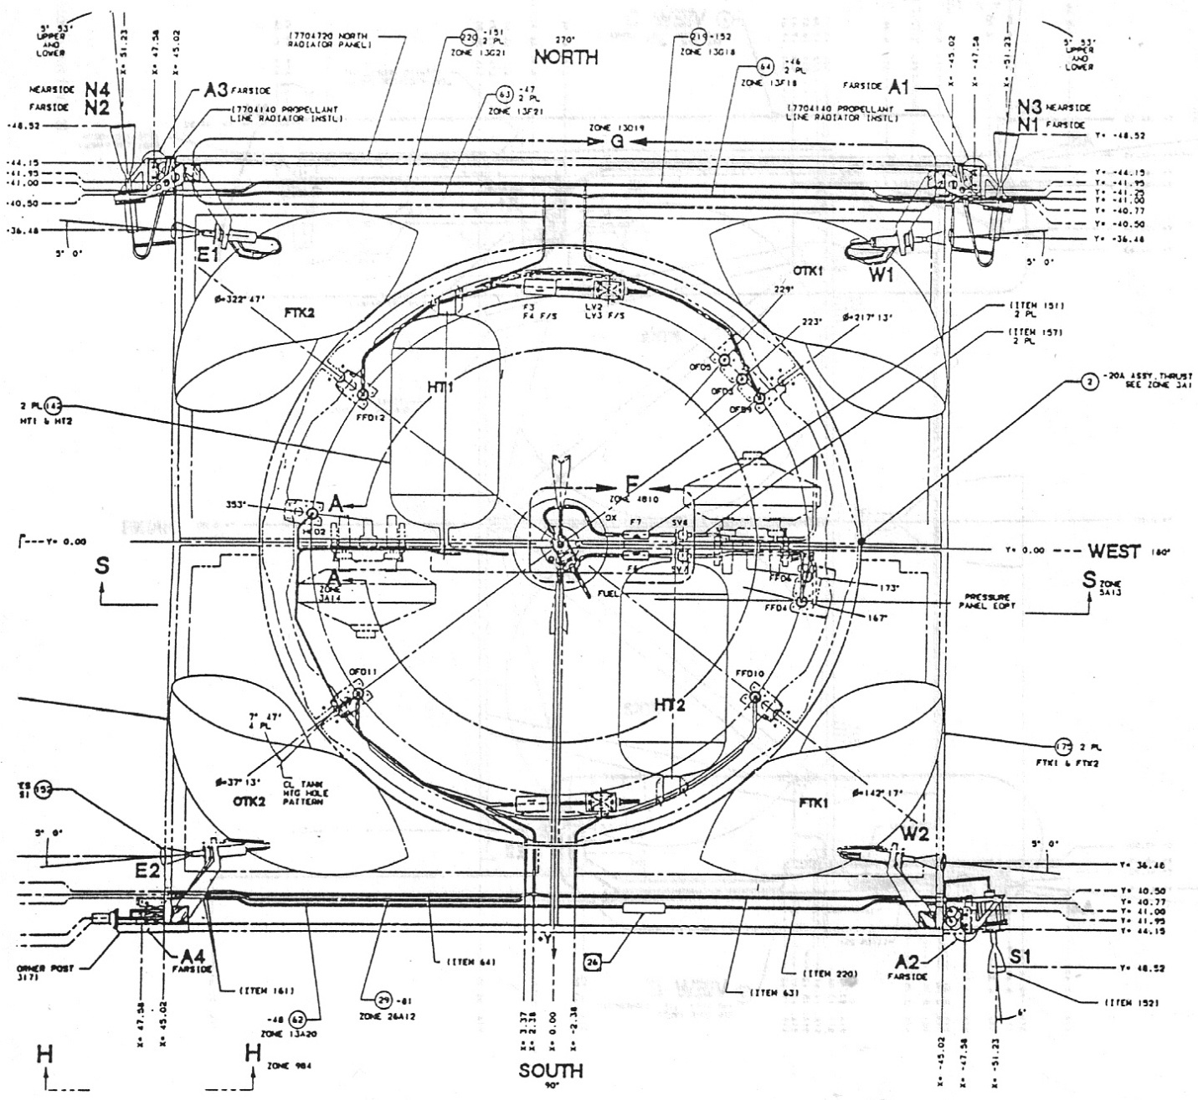
Propulsion Subsystem Layout

Slide 164
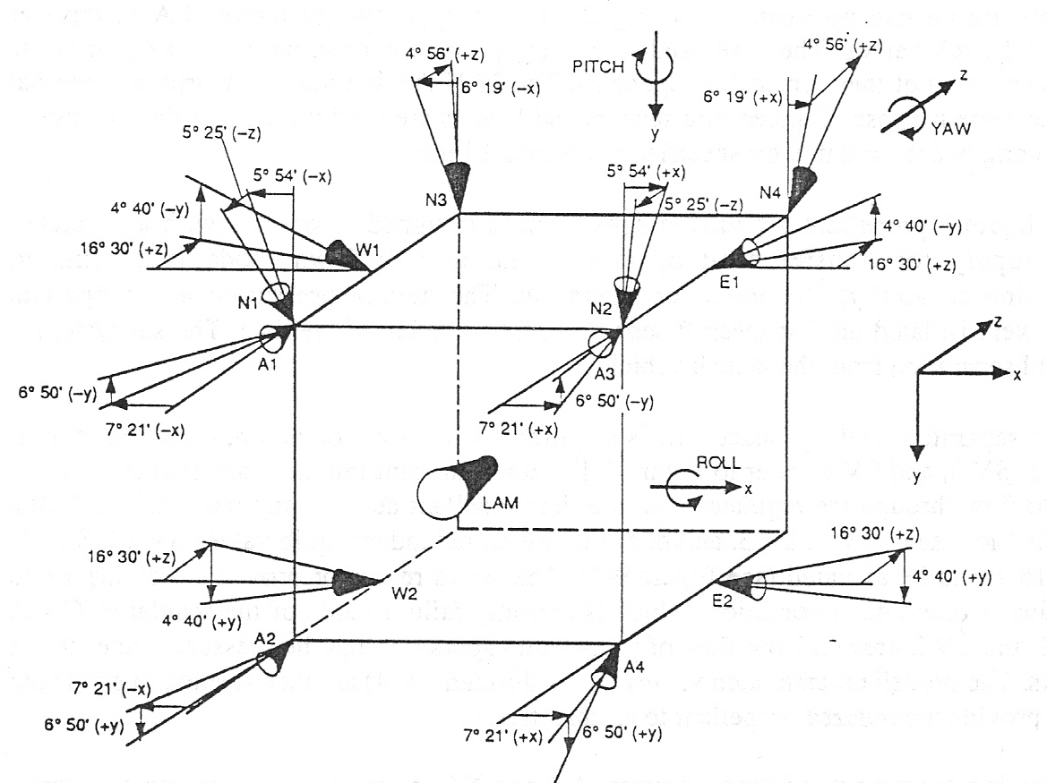
Thruster Configuration and Usage

Slide 165
Thruster Configuration and Usage (Cont.)
Torque or ΔV |  | Thruster Usage
 | Stationkeeping | Non-Stationkeeping | Backup options for thruster failures
+ ROLL | N1 + N2 | A2 + A4 | N2 + E1: N1 + W1: N2 + W2: N1 + E2
ROLL | N3 + N4 | A1 + A3 | N4 + E1: N3 + W1: N4 + W2: N3 + E2
+ PITCH | A1 + A2 | A1 + A2 | A2+(N3+N4): A1+(N1+N2): A2+N4+E1: A1+N2+E1:…
-PITCH | A3 + A4 | A3 + A4 | A4+(N3+N4): A3+(N1+N2): A4+N4+E1: A3+N2+E1:…
+YAW | N2 + N4 | E2 | W1
YAW | N1 + N3 | E1 | W2
SOUTH ΔV | N1 + N4 | - | N2 + N3
EAST ΔV | W1 + W2 | - | W1 + (N1 + N3): W2 (N2+N4)
WEST ΔV | E1 + E2 |  | E1 + (N2 + N4): E2 + (N1 + N3)
SPINUP | - | N2 ≠ N4 | N2: N4

Slide 166
Presurant Tank and Characteristics
Manufacturer: | Structural composites ind
Safety Factor: | 1.5 to 1
Pressure range. | MPa
Operating | 28.95 (4200psi)
Proof | 36.19 (5250psi)
Burst | 43.43 (6300psi)
Temperature range | -65 to 60°C
 | (-85 to 140°F)
Volume | 43.42 liter (2650 in)
Weight | 7.44kg (16.40 lb)
Material
Liner | 6061 aluminum
Overwraps | Graphite/Carbon
318 mm
(12.54 in)
633 mm
(25.04 in)

Slide 167
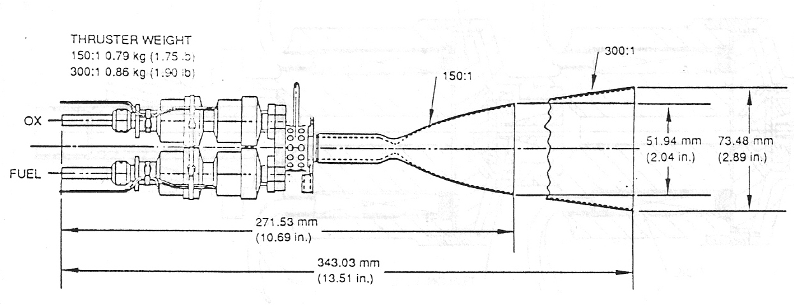
Atlantic Research Corporation 22 N Thruster

Slide 168
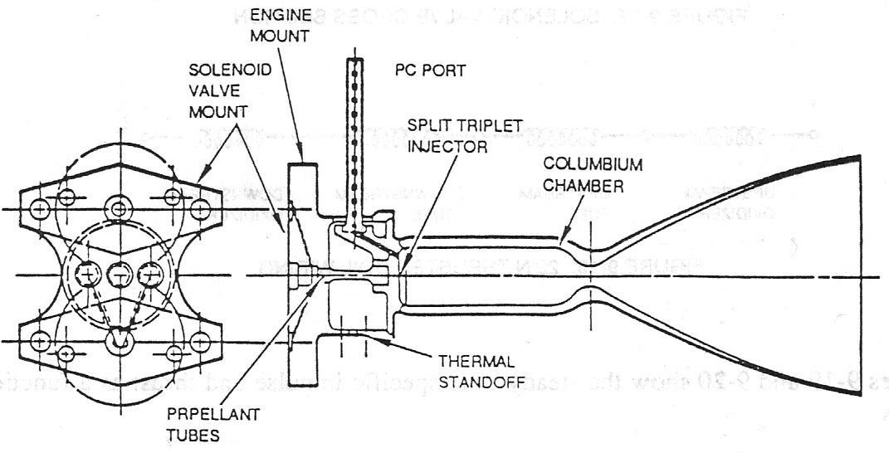
Atlantic Research Corporation 22 N Thruster (Cont.)
Propellants | Oxidizer – N204 (MON-3) Fuel – MMH
Feed pressure | 1620 kPa (235 psid)
Thrust | 22N (5.0 lbf)
Chamber Pressure | 862 kPa (125 psid)
Mixture Ratio | 1.65
Area Ratio | 150:1, 300:1
Specific Impulse | 285 sec, 290

Slide 169
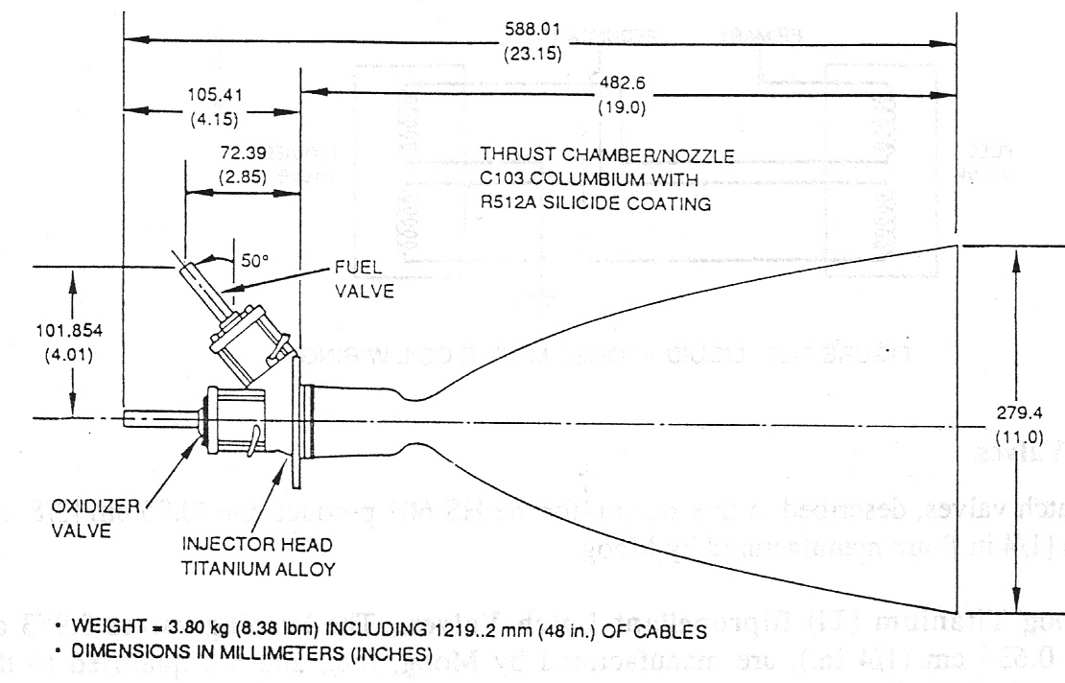
Marquardt 490 N Thruster and Performance Data
Thrust | 492 ±5 N (110.6 ±1.1 lbf)
Isp | 311 ± 1.2 sec
Mixture Ratio | 1.625 ± 0.002
Combustor Temperature | 1229 ± 20°C (2245±36°F)

Slide 170
Thermal subsystem
Heat pipes: They uniformly distribute the heat generated from the interior of the satellite.
Heaters: They maintain in a pre-established level the temperature of certain units.
Thermal blankets: Passive control of temperature of certain units using special covers.
Mirrors: 2 radiators, one in the north face and another one in the south

Slide 171
HS 601 Mission Environments
Environment | Nominal Value
Transfer orbit
Solar radiation | 1369 ± 50 W/m²
Earth albedo | 0.3
Earth IR | 243 W/m²
Space sink temp | -273 °C
Attitude | Sun 60° to 115° from spin axis normal (except during maneuvers)
Eclipse | Satellite spin stabilized (0.3 to 0.7 rpm) 72 min max
On orbit
Solar radiation | 1369 ± 50 W/m²
Space sink temp | -273°C
Orbit | Geosynchronous
Attitude | Orbit normal – 3 axis stabilized
Sun Angle | 23.5 max out of orbit plane
Eclipse | 72 min max

Slide 172
Thermal Control Finish Requirements
Suface Area | Chosen Finish | Solar ABS BOL/EOL | Infrared Emittance | Other Requirements
External
N-S radiators | Ag/quartz mirror* | 0.08/0.24 | 0.80 | Indium coat plus Ni edge coat (ESD)
E-W MLI | Black/Kapton | 0.90/0.90 | 0.85 | ITO (ESD), PIM
Nadir MLI | Kapton |  | 0.53
Aft barrier MLI | ITO Kapton | 0.36/0.59 | 0.53
LAM plume shield | Sperex VHT white | 0.40/0.70 | 0.85
LAM light shield | Sperex VHT white | 0.40/0.70 | 0.85
SWD VCM barrier | Conductive Keviar | 0.95/0.95 | 0.91
SWD housing | Black painted Be | 0.95/0.95 | 0.83 | ESD
Solar wing yoke MLI | ITO/Kapton | 0.36/0.59 | 0.53
Solar Array | Solar cells | 0.74/0.74 | 0.83
BVL radiator | White | 0.40/0.60 | 0.85
MLI VCM barriers | Conductive Kevlar | 0.95/0.95 | 0.91
Launch locks | White painted aluminium | 0.40/0.60 | 0.85
Ku- band antenna sun shield | Ge/Kapton/VDA | 0.42/0.60 | 0.65 | ESD, E = 0.16 inside
L- band antenna sun shield | Ge/Kapton/black | 0.55/0.66 | 0.72 | ESD
Thruster shield | Sperex VHT black | 0.95/0.95 | 0.85
Earth sensor MLI | Black/Kapton | 0.90/0.90 | 0.85 | ESD, PIM
Earth sensor radiator | Ag/quartz mirror | 0.80/0.24 | 0.80
Battery MLI | ITO Kapton | 0.36/0.59 | 0.65
Feed array aperture cover | Ge/Kapton/VDA | 0.42/0.60 | 0.65 | ESD, E=0.16 inside

Slide 173
Thermal Control Finish Requirements (Cont.)
Suface Area | Chosen Finish | Solar ABS BOL/EOL | Infrared Emittance | Other Requirements
Line radiator | Ag/quartz mirror | 0.80/0.24 | 0.80
Type I MLI | Cond black/Kapton | 0.90/0.90 | 0.85
Type II MLI | ITO/Kapton | 0.36/0.59 | 0.53
Type III MLI | ITO/Kapton | 0.36/0.59 | 0.53
Type IV MLI | Kapton/VDA | 0.36/0.59 | 0.53
Type V MLI | Nickel foil | – / – | 0.10
Type VI MLI | Kapton VDA (2 sides) | – / – | 0.16
 | Black painted Be | – / –
Internal
Structure | Conductive black | – / – | 0.85 | R<10⁹ Ω, Z<10
Units | Conductive black | – / – | 0.85 | R<10⁹ Ω, Z<10
MLI | VDA/Kapton | – / – | 0.16
Aft barrier shield | Nickel foil/quartz mat | – / – | 0.10
Thruster shield | Nickel foil/quartz mat | – / – | 0.10
Battery | Bare aluminium | – / – | 0.10
Earth sensor | Conductive black | – / – | 0.85 | R<10⁹ Ω, Z<10
Propellant tank MLI | VDA/Kapton | – / – | 0.16
Helium tanks | Graphite | – / – | 0.85
Propulsion lines | Alumunium tape | – / – | 0.10
Propulsion componenets | Bare metal | – / – | 0.10 to 0.15
Thruster valves | Bare stainless steel | – / – | 0.15 | ESD, E=0.16 inside

Slide 174
Unit Thermal Control Finish Requirements
Subsystem Unit | Surface Property
C – Band
Input coaxial cables | Bare copper
Test coupler, 6 GHz | Conductive black
Receive low pass filter | Conductive black *
LNA | Conductive black
Switch, coax 3/2 | Conductive black
Hybrid, 6 GHz | Conductive black *
Receiver bandpass filter | Conductive black *
Receiver, 6/4 GHz | Conductive black
Input filter R2V | Low emittance
Input filter R1H | Low emittance
Input filter R1V | Low emittance
R-switch, coax | Conductive black
Switch drivers | Conductive black *
CCU | Conductive black
SSPA nonswitchable (14.4W) | Conductive black
SSPA power supply (14.4W) | Conductive black
SSPA switchable (10.3/16.0W) | Conductive black
SSPA power supply (10.3/16.0W) | Conductive black
R-switch waveguide 4 GHz | Conductive black
Variable power divider | Conductive black
Output multiplexer, 7 channels, horizontal | Conductive black
Output multiplexer, 5 channels, vertical, R2 | Conductive black
Output multiplexer, 6 channels, vertical | Conductive black
Output multiplexer, 5 channels, vertical, R3 | Conductive black
Receiver reject filter | Conductive black
Test coupler, 4 GHz | Conductive black
Output coaxial cables | Conductive black
* Permissible to leave unpainted.

Slide 175
Unit Thermal Control Finish Requirements (Cont.)
Subsystem Unit | Surface Property
Ku – Band
Receiver bandpass filter (WR-75) | Conductive black *
LNA 14 GHz | Conductive black
Switch drivers | Conductive black *
Receiver, 14/12 GHz | Conductive black
Input filter channels 1,2,4,5,6,7,8 | Low emittance (gold)
Input filter channels 9,10,11,12,14,15,16 | Low emittance (gold)
CCU driver amplifier | Conductive black
Limiter / linearized | Conductive black
TWT (42.5 W) | Low emittance (Bare aluminium)
EPC (42.5 W) | Conductive black
R-switch waveguide 12 GHz | Conductive black
Output multiplexer, 8 channels, horizontal | Conductive black
Output multiplexer, 8 channels, vertical | Conductive black
Output multiplexer, 1 channel, U.S. port | Conductive black
Harmonic Filter | Conductive black
Isolator, output | Conductive black
Isolator, WR-75 (High power) | Conductive black
Notch filter | Conductive black
Test coupler, WR- 75GHz | Conductive black
Bacon transmitter (ULPC) | Conductive black
* Permissible to leave unpainted.

Slide 176
Thermal Control Design Issues and Elements
System/Subsystem | Design Issue | Thermal Control Element
Main body | Minimize solar heating due to diurnal solar impingement | East-west blankets Nadir-aft blankets Morrored north-south radiators (low solar absortance) Locate high dissipating units on radiators
High dissipating electronics | Reduce temperatures | Mirrored radiators Heat sinks/doublers Heat pipes High emittivity black paint
Batteries | Reduce upper temperatures Minimize lifetime operating temperature | Mirrored radiators Conductive brackets Heaters Blankets
Propulsion | Control low end temperatures to avoid frezing | Low emissivity aluminium tape Heaters
Antennas | Minimize upper temperatures Reduce operating temperature range | Blankets High emissivity black paint (internal reflectors) Sunshield (germanium coated Kapton exterior, gridded VDA interior)

Slide 177
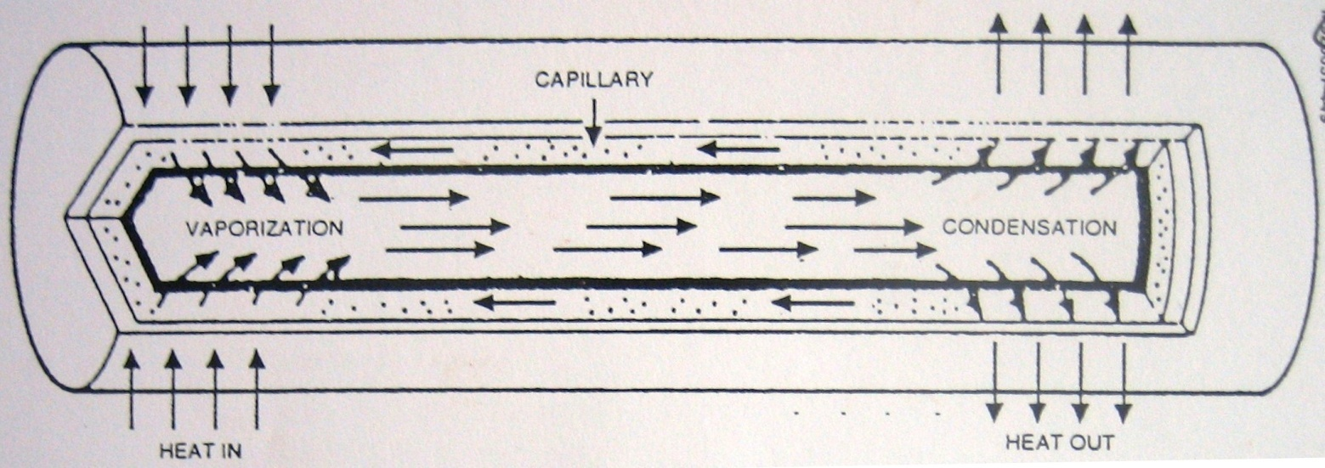
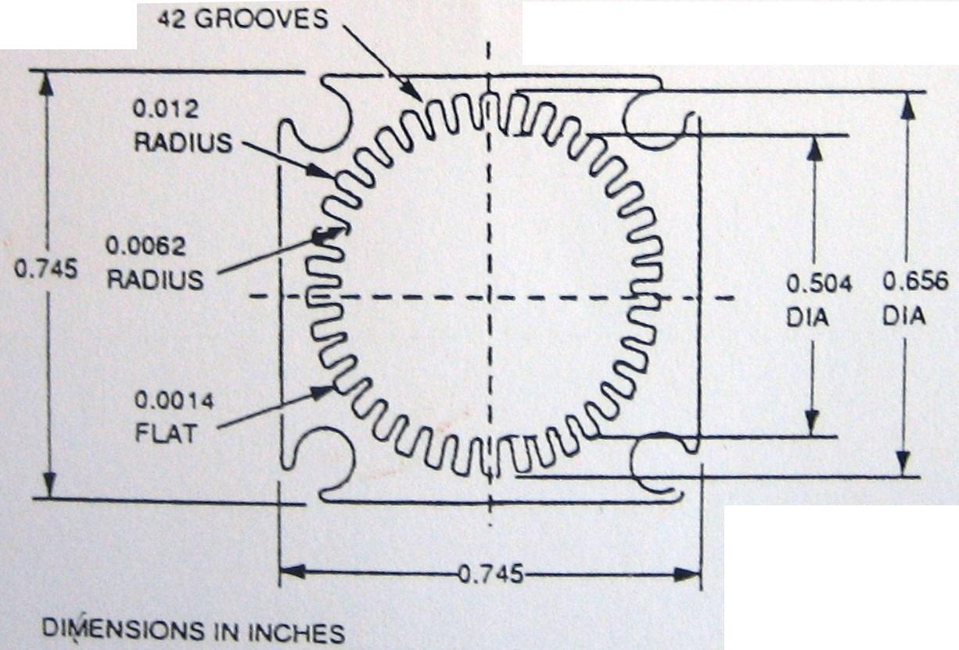
Heat Pipes

Slide 178
Spacecraft Blanket Design
Blanket Location | No. of Layers | Blanket Type | Emmitance Inner/Outer* | Effective Through Emmitance | Outer Absorption BOL/ECL
Nadir blanket | 10 | MLI Kapton | 0.85/0.85 | 0.010
East-west sides | 10 | MLI Kapton | 0.53/0.85 | 0.025 | 0.90/0.90
Battery packs | 10 | MLI Kapton | 0.53/0.53 | 0.025 | 0.36/0.90
Aft barrier closeout | 10 | MLI Kapton | 0.16/0.53 | 0.025 | 0.36/0.59
Thrust cylinder flat section closeout | 9 layers +0.003 Al foil | MLI Kapton plus Kapton outer layer | 0.16/0.53 | 0.025 | 0.36/0.59
490 N (110lbf) thruster shield (pyramid panel) | 4 quartz / 5 foil | Nickel foil/quartz mat | 0.10/0.85 | 0.002 | 0.40/0.70
Propellant tanks | 1 | Kapton | 0.16/0.53 | 0.48 | -
Interior of TWT radiator | 3 | Kapton | 0.16/0.53 | 0.03 | -
Reflector antenna blankets | 5 | MLI Kapton | 0.16/0.65 | 0.015 | 0.36/0.59
Separation ring | 1 | Kapton | 0.16/0.53 | - | 0.36/0.59
Deployable aft blanket | 5 | Kapton | 0.16/0.53 | 0.060 | 0.36/0.59
Interior of L-band radiator aft of subnadir | 1 | Kapton | 0.16/0.53 | - | -

Slide 179
Spacecraft Blanket Configuration
Type | Description | Location
I | 10 layer, carbon Kapton exterior | Battery, east-west launch locks, north-south internal porpellant lines along bus panel, propellant line radiators, sensor suite, 22N (5lbf) thrusters, antenna tripods.
II | Not used | -
III | 5 layer, mylar, VDA on side | Aft deployable shield, solar panel yoke, bus voltage limiter
IV | 1 layer, ITO Kapton exterior | TWT collector (aft subnadir), fordward SSPA radiator, entire fordware side subnadir shelf (decouplers subnadir from hot TWT zone) propellant tanks
V | Not used | -
VI | 11 layer, ITO Kapton exterior with Kevlar separators | Aft closeout outside thrust cylinder, umbilical bracket closeout
VII | 11 layer, nickel foil, quartz cloth | East-west thruster plume shields, LAM plume shield
VIII | 11 layer, carbon Kapton exterior with internal aluminium foil | East-west side blankets
IX | 12 layer, Kapton exterior with internal aluminium foil/Kevlar separators | Aft barrier closeout internal to thrust cylinder
X | 10 layer, ITO Kapton exterior | Battery radiator frame, sensor suite radiator frame

Slide 180
Flight Temperature Sensors
Unit | Number
PAYLOAD
Communication electronics
C-band OMUX 4 plex even temp 2
C-band OMUX 4 plex odd temp 1
C-band OMUX 6 plex even temp 3
C-band OMUX 6 plex odd temp 2
C-band OMUX 6 plex temp 1
C-band OMUX receiver 4
C-band SSPA north panel temp 5 V
C-band SSPA north panel temp 6 V
C-band SSPA south panel temp 3 H
C-band SSPA south panel temp 6 H | 10
Ku-band EPC 6
Ku-band EPC 15
Ku-band LNA 1
Ku-band OMUX filter temp 1
Ku-band OMUX filter temp 2
Ku-band receiver 2
IF/Ku-band upconverter 1
IF/Ku-band upconverter
Ku-band/IF downconverter 1
CCU/driver amplifier 6 Ku-band temp 2
CCU/driver amplifier 15 Ku-band temp 1 | 11

Slide 181
Flight Temperature Sensors (Cont.)
Unit | Number
TWT north panel temp 2
TWT north panel temp 6
TWT south panel11
TWT south panel temp 15 | 4
L-band LNA
L-band output filter assembly
L-band ref generator temp 1
L-band ref generator temp 2
L-band SSPA 1
L-band SSPA 2
L-band SSPA 3
L-band SSPA 4
L-band/IF downconverter | 9
Command receiver 2 temp
ULPC beacon 2 | 2
Total | 36
BUS
Telemetry
Propulsion
A1 thruster (primary = TEU 1)
A1 thruster (redundant = TEU 2)
A2 thruster (primary = TEU 1)
A2 thruster (redundant = TEU 2)
A3 thruster (primary = TEU 1)
A3 thruster (redundant = TEU 2)

Slide 182
Flight Temperature Sensors (Cont.)
Unit | Number
A4 thruster (primary = TEU 1)
A4 thruster (redundant = TEU 2)
E1 thruster (primary = TEU 1)
E1 thruster (redundant = TEU 2)
E2 thruster (primary = TEU 1)
E2 thruster (redundant = TEU 2)
N1 thruster (primary = TEU 1)
N1 thruster (redundant = TEU 2)
N2 thruster (primary = TEU 1)
N2 thruster (redundant = TEU 2)
N3 thruster (primary = TEU 1)
N3 thruster (redundant = TEU 2)
N4 thruster (primary = TEU 1)
N4 thruster (redundant = TEU 2)
W1 thruster (primary = TEU 1)
W1 thruster (redundant = TEU 2)
W2 thruster (primary = TEU 1)
W2 thruster (redundant = TEU 2)
Total | 24
Fuel tank 1 temp 1
Fuel tank 1 temp 2
Fuel tank 1 temp 3
Fuel tank 2 temp 1
Fuel tank 2 temp 2
Fuel tank 2 temp 3
 | 6
Helium tank 1 temp 1 (TEU 1 only)
Helium tank 1 temp 2 (TEU 2 only)

Slide 183
Flight Temperature Sensors (Cont.)
Unit | Number
Helium tank 2 temp 1
Helium tank 2 temp 2
High resolution pressure transducer 5 (helium 1)
High resolution pressure transducer 6 (helium 2)
 | 6
Oxidizer tank 1 temp 1
Oxidizer tank 1 temp 2
Oxidizer tank 1 temp 3
Oxidizer tank 2 temp 1
Oxidizer tank 2 temp 2
Oxidizer tank 2 temp 3
 | 6
LAM oxidizer valve
LAM thruster | 2
Propellant line 1 (southeast aft panel)
Propellant line 1 (southeast bus panel)
Propellant line 2 (norhwest aft panel)
Propellant line 2 (northwest bus panel)
Propellant line radiator northeast
Propellant line radiator northwest | 6
Total | 25
Power
Battery pack 1
Battery pack 2
Battery pack 3
Battery pack 4

Slide 184
Flight Temperature Sensors (Cont.)
Unit | Number
BDC 1
BDC 2
BVL 1 (splice to TEU 1/2)
BVL 2(splice to TEU 1/2)
Solar wing 1 north back splice to TEU 1/TEU 2
Solar wing 2 south back splice to TEU 1/TEU 2
SWD 1 (north) housing
SWD 2 (south) housing | 12
Attitude control
ESA channel 1
ESA channel 2
IRU 1 gyro
IRU 2 gyro
MWA 1 (north) (primary = TEU 1)
MWA 1 (north) (redundant = TEU 2)
MWA 2 (south) (primary = TEU 1)
MWA 2 (south) (redundant = TEU 2)
SPC 1 | 9
Telemetry nad command
VDU 1
Transfer 1 | 2
Antenna
RDA 1 (west C-band)
RDA 2 (east Ku-band)
East reflector RPM
West reflector (back) (C-band)
ODA | 5
Total | 28

Slide 185
Unit Qualification/Acceptance Temperatures
Definition
Minimum Qualification Temperature
5 °C
Qualification Margin
Minimum Hot Acceptance Temperture
5 °C
Acceptance Margin
Hot Prediction Limit
5 °C
Uncertainty Margin
Top End Thermal Model
Guaranteed Qualification Range
Guaranteed Acceptance Range
Maximum Expected Range
Computer Model Range
5 °C
Bottom end Thermal Model
5 °C
Uncertainty Margin
Cold Prediction Limit
5 °C
Acceptance Margin
Maximum cold Acceptance temperature
5 °C
Qualification Margin
Maximum Cold Qualification Temperature

Slide 186
Expected Flight Temperature Limits
Subsystem / Unit | On-orbit Predicted Temperature, °C |  | Qualification Limits, °C |  | Unit Operating Survival Limits, °C |  | Unit Nonoperating Survival Limits, °C
 | Min | Max | Min | Max
Communication electronics
TWT | 14 | 51 | 4 | 80 | 3 | 85 | -20 | 85
SSPA | 13 | 47 | -3 | 57 | -20 | 60 | -20 | 85
EPCs | 3 | 50 | 3 | 60 | -18 | 71 | -23 | 71
Communication receivers | 17 | 43 | 3 | 54 | -20 | 70 | -20 | 85
Output multiplexer panels north, south | 24 | 73 | 24 | 83 | -20 | 99 | -20 | 99
L/Ku-band upconverter | 25 | 42 | 0 | 54 | -20 | 70 | -20 | 85
Antenna/feeds
Reflectors east, west | -112 | 119 | -125 | 138 | -150 | 149 | -150 | 149
Ku/band feeds | -38 | 117 | -56 | 135 | -65 | 140 | -65 | 140
Power
Solar wing north | -148 | 57 | -181 | 79 | -190 | 100 | -190 | 100
Solar wing south | -148 | 57 | -181 | 79 | -190 | 100 | -190 | 100
BVLs | -16 | 49 | -39 | 75 | -39 | 83 | -39 | 83
Battery packs | -10 | 27 | -15 | 37 | -19 | 40 | -19 | 40
BCDs | -2 | 51 | -34 | 71 | -34 | 71 | -34 | 71
Telemetry and command
TCR | 21 | 46 | 2 | 56 | -20 | 70 | -20 | 70
VDU | 4 | 31 | -34 | 71 | -34 | 71 | -34 | 71
Telemetry transmitter 1 | 17 | 44 | -5 | 55 | -20 | 70 | -20 | 70

Slide 187
Expected Flight Temperature Limits (Cont.)
Subsystem / Unit | On-orbit Predicted Temperature, °C |  | Qualification Limits, °C |  | Unit Operating Survival Limits, °C |  | Unit Nonoperating Survival Limits, °C
 | Min | Max | Min | Max
Attitude Control
SCP | 20 | 49 | -34 | 70 | -34 | 71 | -34 | 71
IRUs | 7 | 33 | -34 | 71 | -34 | 71 | -34 | 71
MWAs | 15 | 50 | -34 | 71 | -34 | 71 | -34 | 71
ESA | 24 | 26 | -34 | 71 | -50 | 81 | -50 | 81
SWDs | -7 | 42 | -34 | 71 | -34 | 81 | -34 | 71
RDA 1 west | -15 | 47 | -34 | 71 | -50 | 85 | -50 | 85
RPM 2 east | -25 | 47 | -34 | 71 | -50 | 85 | -50 | 85
Propulsion
22 N thrusters | 9 | 70 | -7 | 121 | -12 | N/A | -12 | N/A
LAM thruster injector | N/A | N/A | -7 | 121 | -12 | N/A | -12 | N/A
Oxidizer tanks | 7 | 35 | -7 | 41 | -12 | 54 | -12 | 54
Fuel tanks | 7 | 35 | -7 | 41 | -12 | 54 | -12 | 54
Helium tanks | 8 | 34 | -65 | 60 | -65 | 60 | -65 | 60
Porpellant line 1 southeast aft | 4 | 47 | -7 | 41 | -12 | 54 | -12 | 54
Porpellant line 2 northwest bus | 4 | 47 | -7 | 41 | -12 | 54 | -12 | 54
Porpellant line 1 southeast bus | 4 | 47 | -7 | 41 | -12 | 54 | -12 | 54
Porpellant line 2 northwest aft | 4 | 47 | -7 | 41 | -12 | 54 | -12 | 54
Porpellant line radiators northwest, norteast | 4 | 47 | -7 | 41 | -12 | 54 | -12 | 54
High resolution pressure transducter 5, 6 | 12 | 39 | -7 | 71 | -12 | 107 | -12 | 107

Slide 188
Blanket Requirements for North-South Radiator Panels
Blenket | Blanket Type | Emittance In/Out | Efficiency through θ
TWT
South-north (inboard) | 3 layer Kapton | 0.16/0.53 | 0.03
North radiator (outboard) | 3 layer Kapton | 0.16/0.53 | 0.03
L-band
South (inboard) | 1 layer Kapton | Bare/0.16 | --

Slide 189
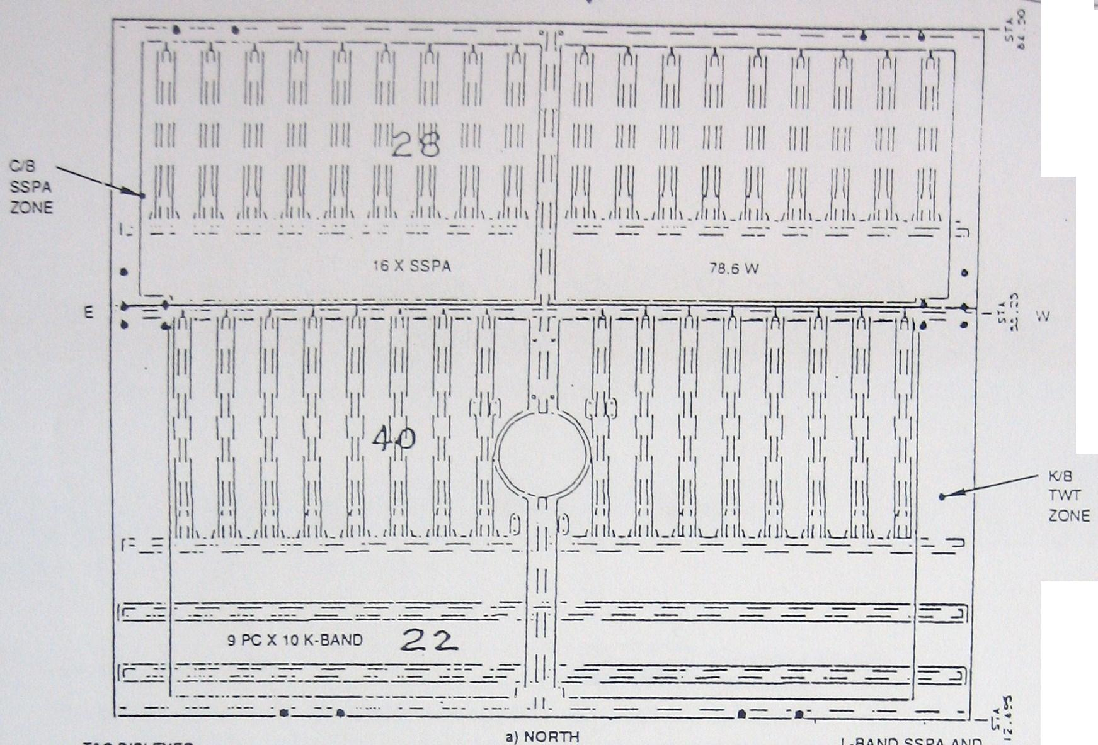
Solidaridad Panel Layout (units and heat pipes)

Slide 190
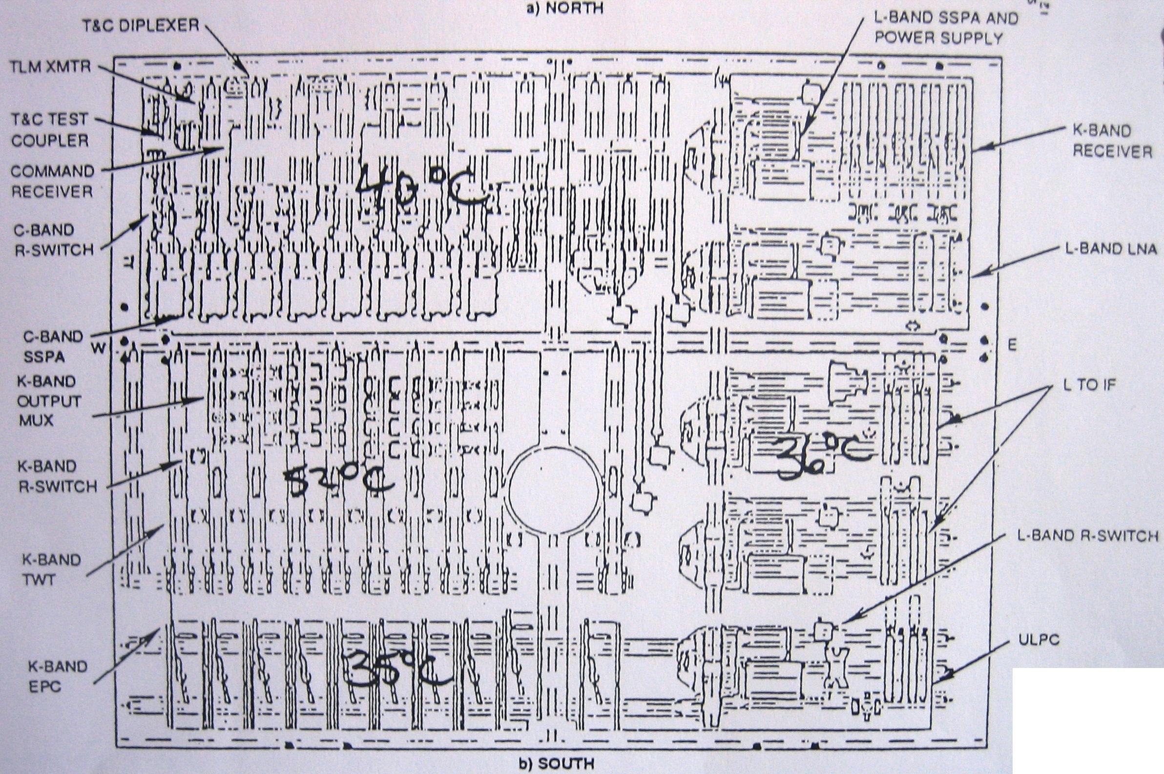
Solidaridad Panel Layout (units and heat pipes) (Cont.)

Slide 191

Reflector Blanket Design

Slide 192
On Orbit Thermal Dissipation Summary
Radiator Node | Case, W
 | Hot 1 | Hot 2 | Hot 3 | Hot 4 | Hot 5 | Hot 6 | Hot 7 | Cold 1 | Cold 2
North C-band zone | 254 | 350 | 361 | 350 | 361 | 361 | 361 | 294 | 294
Aft | (65.4) | (80) | (81) | (80) | (81) | (81) | (81) | (49) | (49)
Forward | (188) | (270) | (280) | (270) | (280) | (280) | (280) | (245) | (245)
North TWT zone | 404.3 | 404.3 | 404.3 | 404.3 | 404.3 | 404.3 | 404.3 | 382.4 | 382.4
North EPC zone | 80.2 | 80.2 | 80.2 | 80.2 | 80.2 | 80.2 | 80.2 | 56 | 56
Total north | (738) | (834) | (845) | (834) | (845) | (845) | (845) | (732) | (732)
South C-band zone | 240 | 265 | 299.3 | 200 | 299 | 234 | 210 | 127.3 | 194.8
Aft | (51) | (57) | (52) | (51) | (52) | (51) | (52) | (32) | (32)
Forward | (188) | (208) | (247) | (149) | (147) | (183) | (158) | (95) | (163)
South L-band zone | 304 | 304 | 304 | 370 | 239 | 304 | 393.4 | 288 | 220.5
South TWT zone | 350 | 350 | 350 | 350 | 350 | 350 | 350 | 322.4 | 322.4
South EPC zone | 74.4 | 74.4 | 74.4 | 74.4 | 74.4 | 74.4 | 74.4 | 51 | 51
Total south | (968) | (994) | (1028) | (994) | (963) | (963) | (1028) | (788.7) | (788.7)
Total radiator | (1704) | (1828) | (1873) | (1828) | (1808) | (1808) | (1873) | (1521) | (1521)
Total subnadir | 154.3 | 124.1 | 122.5 | 124.1 | 122.5 | 122.5 | 122.5 | 135.2 | 135.2
Feeds
C-band | 27.7 | 3 | 0 | 3 | 0 | 0 | 0 | 27.7 | 27.7
Ku-band | 63.8 | 63.8 | 63.8 | 63.8 | 63.8 | 63.8 | 63.8 | 0 | 0
L-band | 0 | 3 | 0 | 3 | 13.6 | 13.6 | 0 | 13.6 | 13.6
Bus shelf | 48 | 48 | 48 | 48 | 48 | 48 | 48 | 48 | 48
Cruciform panel | 40 | 40 | 40 | 40 | 40 | 40 | 40 | 40 | 40
Total internal | (334) | (282) | (275) | (282) | (288) | (288) | (275) | (264) | (264)
Harness loss | 33 | 33 | 33 | 33 | 33 | 33 | 33 | 30 | 30
Total spacecraft dissipation | 2071 | 2143 | 2181 | 2143 | 2129 | 2129 | 2181 | 1815 | 1815

Slide 193
Structural subsystem
Structure
Bus/propulsion module | Honeycomb with strut stabilization for tanks, shelves
Payload module | Honeycomb with strut stabilization

Slide 194
Structure design description
Distribution of all mechanical loads
Support of all payload flight hardware
Support of all bus flight hardware
Support thermal control elements
Maintenance of proper dimensional relationships among flight hardware
Provision of a ground plane for flight electronics
Provision of a faraday cage for flight electronics
Provision of a mechanical interface with the Ariane booster

Slide 195

Solidaridad primary structure

Slide 196

Payload module primary structure

Slide 197

Overall integrated configuration

Slide 198

Materials Use

Slide 199
Subsystem Weight Summary
Title | Total Mass (Kg)
Antenna | 143.83
Ku Band Repeater | 114.81
C Band Repeater | 119.57
L Band Repeater | 58.39
T & C RF | 11.29
TT & C Digital | 30.43
Attitude Control | 80.71
Propulsion | 97.72
Electrical Power | 278.98
Thermal Control | 67.96
Structure | 175.02
Wire Harness | 80.34
Growth | 14.33
S/C Unbal Dry | 1259.26
Prop in lines | 2.49
S/C Unbal (W/TRPD PROP) | 1261.75
Bal Weight Pre Split | 5.26
Bal Weight Split | 6.63
S/C Bal (W/TRPD PROP) | 1268.38
S/C Dry (W/Bal WT) | 1265.88
PYLD Subtotal | 447.88
Bus Subtotal | 811.15

Slide 200
Topic 5: Integration and Test

Slide 201

Solidaridad tests

Slide 202
Solidaridad Satellite Tests, General Plan
Initial test
Environmental test (Build up)
Full up integrated system test
Functional test at launch site

Slide 203
Communication Subsystem Test
Unit acceptance test | Functional and environmental test
Antenna test | PIRE, G/T, SFD Polarization Isolation Radiation Patterns
Hardline (Communications Electronics) | End to end transponder test
Initial test of the integrated Subsystem | Verify the electronics and antenna intefaces with platform. Characterization of gain transference and frecuency response in band (pre-environmental)
Thermal Test | End to end electronics performance under severe conditions
Full-up integrated system test | Test and compare. Post environmental
On orbit test | See next slide

Slide 204
On orbit test
Communications | TTC
Transfer Characteristic | Commands functionality
PIRE and SFD | Commands sensibility
G/T | Telemetry PIRE
Radiation Patterns | Telemetry modulation index
Frequency Convertion Co –Polarization Frequency Response (out band and in band Cross Polarization Discrimination | Authomatic Control Gain calibration of the telemetry receiver Telemetry carrier frequency

Slide 205
Solidaridad Satellite Test and Integration Schedule

Slide 206
Solidaridad launch request for tender participants
General dynamics(Atlas)
Arianespace(Ariane)
China Great Wall Industry(Long march)
--------------------------------------------------------------
Propellant consumption
Useful life
Cost
Launch windows

Slide 207
Topic 6: Launch

Slide 208

Ariane and Solidaridad
Third
stage
Second
stage
First
stage

Slide 209

Solidaridad Launch
Solidaridad
Ariane V 61

Slide 210

Ariane single and dual launch configutations

Slide 211

TRANSFER AND STATIONARY ORBITS MISSION PHASES
Solidaridad sequency

Slide 212
Solidaridad launch characteristics
Perigee altitude: 20
Apogee altitude: 35,786 Km
Inclination: 7º
Argument of the perigee: 178º
Right ascension of the
ascending node: 11º

Slide 213
Solidaridad launch stages
0 seconds: Ignition
4,4 seconds: Lift-off
3,5 minutes: First stage separation and second stage
ignition
5,5 minutes: second stage separation and third stage
ignition
18 minutes: GTO orbit injection
22 minutes: Solidaridad2 separation
27 minutes: Thaicom2 separation

Slide 214
Topic 7: Earth segment solution

Slide 215


Control Center

Slide 216
Control Centers
Primary Control Center (PCC)
Backup Control Center (BCC)
L-Band
Ku-Band
C-Band
C-Band
Ku-Band
L-Band
2.4m
4.6m
7.6m
8.1m
11m
11m
11m
12m
11m
11m
4.5m
4.5m
2.4m
SS
SS
Monitoring Communications System
Telemetry, Tracking
and
Command
Telemetry, Tracking
and
Command
Monitoring Communications System
To BCC
To BCC
Satellite Simulator (SS)
Payload Test Laboratory

Slide 217





Primary Control Center
Orbital Dynamics Software
On-orbit test equipment
Satellite
Dynamics Simulator
Procedures/ Instructions Operations
Telemetry, command and range Software
Computer and Periphericals
Base band
Antennas and RF equipment
Payload Tests Laboratory
To backup control center
Link between both control centers
Monitoring Communications System

Slide 218
Telemetry and Command Characteristics of the Mexican Satellites
 | Morelos II | Solidaridad 1 | Solidaridad 2
Orbital Longitude | 116.8° | 109.2° | 113.0°
Command:
Dish | 6422 MHz (Vertical) | 5935 MHz (Vertical) | 5935 MHz (Vertical)
Omni | 5928 MHz (Horizontal) | 6415 MHz (Horizontal) | 6415 MHz (Horizontal)
Modulation | R-FSK, 5 to 15 KHz FM, 75 to 173 KHz | RZ-FSK, 5 to 15 KHz FM, 75 to 173 KHz | RZ-FSK, 5 to 15 KHz FM, 75 to 173 KHz
Deviation | 300 KHz 2.5 MHz Peak-Peak | 300 KHz 2.5 MHz Peak-Peak | 300 KHz 2.5 MHz Peak-Peak
Data Rate | 0 to 50 BPS | 0 to 50 BPS | 0 to 50 BPS
Telemetry
Dish (Horizontal) | 4198.625 MHz 4199.625 MHz | 3700.1 MHz 3700.6 MHz | 3700.1 MHz 3700.6 MHz
Omni (Vertical) | 4198.625 MHz 4199.625 MHz | 3700.1 MHz 3700.6 MHz | 3700.1 MHz 3700.6 MHz
RF Modulation | Phase | Phase | Phase
Mod. Index | 1.00 ± 0.1 RAD | 1.00 ± 0.15 RAD | 1.00 ± 0.15 RAD
Subcarrier | Biphase/32 KHz | Biphase/32 KHz | Biphase/32 KHz

Slide 219
Users. Request for testing
Cross-polarization isolation
Verification of the antenna pattern (if requested)
Power level adjustment
Optimal antenna pointing
Coordination for carrier activation/deactivation
Signal absence
Interference
Verification of technical parameters

Slide 220
Required information
Registered name of the company, name and telephone number of the E/S operator
Satellite to access
Transponder and polarization
Transmission and reception frequencies
Transmission rate
Type of modulation
Brand name and antenna diameter
Access technique
Name of the locations that will be connected at the transmission and reception

Slide 221
Preliminary adjusments to the reception
The user must previously carry out the following actions without transmitting any carrier to the satellite
Pointing the antennas correctly in the azimuth and elevation angle towards desired satellite
Adjust the cross-polarization isolation of the antennas through the observation of signals coming from the satellite. The user can ask the CCC to ask for a reference signal to obtain a maximum level of reception
Calculate and adjust the transmission power, which, at the time of transmission, it must not exceed the assigned power
Verify the configuration and the operating status of the baseband and RF equipments of the E/S before activating the carrier.

Slide 222
Transmission radio frequency tests
The carrier will be transmitted, under the guidance of the CCC, in the assigned frequency, by using a low power level in order to perform the following measurements:
Orthogonal cross-polarization isolation
Antenna pattern (its execution depends on the antenna diameter)
Carrier frequency
Dispersal energy, audio subcarrier (for TV/FM/FDMA analog carriers)
Transmission rate and FEC
Modulation
Bandwidth
Spectral shape
Satellite EIRP
Spurious emissions
NOTE: If the CCC does not detect a carrier on the satellite, the user will be advice to deactivate the carrier, since this could indicate an anomaly in the operation and the possibility that a wrong satellite may be accessed. The user will need to check the E/S and correct the anomaly and then establish contact again with the CCC.

Slide 223
General guidalines
Orthogonal cross-polarization isolation
The orthogonal cross-polarization isolation of the antenna must be > 30dB and have no induction over the opposite channel
Antenna pattern
All the antenna transmitting to the SATMEX satellites must meet the following envelope for side lobes
29-25log(θ)
For antennas ≥ 3.6m it is neccesary to perform an antenna pattern test under SATMEX guidance
A non modulated carrier(CW)
The E/S needs to have the capability to transmit a non modulated carrier(CW), sinthesizable and stable in frequency as well as in amplitude

Slide 224
Report and interference management
All incidents regarding radio frequency interference (RFI) must be reported to the CCC
Before starting an RFI report, the E/S operator must verify the transmission equipment (master and VSAT’s stations) in order to be sure that the interference is not generated by themselves.
If possible, the RFI should be verified with a second E/S to confirm it. In case that the user does not have a second station, the CCC will verify through a reference station.

Slide 225

Rain margins R4
Rain Fade |  | 99.50% (dB) | 99.80% (dB) | 99.90% (dB)
North Wes NW | Tx | 1.50 | 3.00 | 3.50
 | Rx | 0.00 | 1.00 | 1.50
North Central NC | Tx | 0.00 | 1.00 | 1.30
 | Rx | 0.00 | 0.00 | 0.00
Gulf North GN | Tx | 3.60 | 6.80 | 9.20
 | Rx | 1.60 | 4.80 | 7.20
Central C | Tx | 2.20 | 4.20 | 6.30
 | Rx | 0.20 | 2.20 | 4.30
Pacific Central PC | Tx | 3.60 | 5.90 | 8.50
 | Rx | 1.60 | 3.90 | 6.50
Isthmus IT | Tx | 2.50 | 5.80 | 8.20
 | Rx | 0.50 | 3.80 | 6.20
Yucatan YU | Tx | 2.90 | 6.00 | 8.90
 | Rx | 0.90 | 4.00 | 6.90

Slide 226

Rain margins R5
Rain Fade |  | 99.50% (dB) | 99.80% (dB) | 99.90% (dB)
B1 | Tx | 0.14 | 0.29 | 0.46
 | Rx | 0.10 | 0.20 | 0.32
B2 | Tx | 0.21 | 0.40 | 0.65
 | Rx | 0.15 | 0.28 | 0.46
C | Tx | 0.39 | 0.72 | 1.15
 | Rx | 0.27 | 0.51 | 0.81
D1 | Tx | 0.70 | 1.44 | 1.95
 | Rx | 0.49 | 1.02 | 1.39
D2 | Tx | 1.17 | 2.34 | 3.74
 | Rx | 0.83 | 1.66 | 2.67
D3 | Tx | 1.59 | 3.47 | 5.69
 | Rx | 1.12 | 2.48 | 4.08
E | Tx | 2.10 | 5.66 | 9.79
 | Rx | 1.49 | 4.06 | 7.07
F | Tx | 0.29 | 0.49 | 0.70
 | Rx | 0.20 | 0.34 | 0.50

Slide 227

Rain margins Central and SouthAmerica
Rain Fade |  | 99.50% (dB) | 99.80% (dB) | 99.90% (dB)
C’ | Tx | 0.15 | 0.48 | 0.66
 | Rx | 0.11 | 0.34 | 0.47
D | Tx | 1.36 | 2.04 | 2.84
 | Rx | 0.95 | 1.44 | 2.02
IT | Tx | 2.50 | 5.80 | 8.20
 | Rx | 0.50 | 3.80 | 6.20
E’ | Tx | 0.28 | 0.73 | 1.10
 | Rx | 0.19 | 0.51 | 0.77
K | Tx | 2.37 | 4.06 | 6.14
 | Rx | 1.67 | 2.88 | 4.38
N | Tx | 2.65 | 5.38 | 8.98
 | Rx | 1.89 | 3.86 | 6.48
P | Tx | 6.73 | 11.37 | 17.25
 | Rx | 4.84 | 8.23 | 12.55
Y | Tx | 2.90 | 6.00 | 8.90
 | Rx | 0.90 | 4.00 | 6.90

Slide 228
Topic 8: Training and operations

Slide 229
Training Activity
Training Category
Spacecraft Systems Eng and Test (6)
System
Overview Course 1
Spacecraft Course 6
Spacecraft Systems Test OJT
Extended spacecraft test OJT and Launch Operation (Optional)
Orbital Dynamics (4)
Orbital Dynamics Course 7
Participate in Software/ Hardware Task (7)
Sorftware Conversion & Hardware Support
TT&C Eng tests and operations (8)
System Overview Course 1
TT&C subsystems Course 2
Software Course 4
Participate in TT&C Factory test OJT
USA
Mexico
On-site OJT
Mission Rehearsals
Participate in TT&C Installation test OJT
TT&C Operation and Maintenance (6)
System Overview Course 1
TT&C subsystems Course 2
Software Course 4
TT&C Maintenance Course 3
Operations Support
Satellite Control (11)
System Overview Course1
TT&C subsystems Course 2
Software Course 4
Satellite Control Courses

Slide 230
Organization
General Direction
Control Direction
Space System Engineering Direction
Earth segment Direction
Commercial Direction
Orbital Operations
Space Segment
Instalation
Promotion and Publicity
Spacecraft and Control
Earth Segment
Maintenance
Billing
Maintenance
Software Engineering
Operations
Communications
Computing
Training

Slide 231
C band tariffs(USA dollars)
Speed (KBPS) up to | Assigned power (dBw) up to | Morelos II | Assigned power (dBw) up to | Solidaridad Region I
32.0 | 4.22 | 123.0 | 4.72 | 130.0
64.0 | 7.23 | 245.0 | 7.73 | 260.0
128.0 | 10.24 | 490.0 | 10.74 | 520.0
256.0 | 13.25 | 980.0 | 13.75 | 1,040.0
384.0 | 15.01 | 1,470.0 | 15.51 | 1,560.0
512.0 | 16.32 | 1,986.0 | 16.82 | 2,108.0
768.0 | 18.02 | 2,940.0 | 18.52 | 3,120.0
1,544.0 | 21.21 | 6,125.0 | 21.71 | 6,500.0
2,048.0 | 22.00 | 7,350.00 | 22.50 | 7,800.0
3,200.0 | 24.22 | 12,250.00 | 24.72 | 13,000.0
4,096.0 | 25.01 | 14,700.00 | 25.51 | 15,600.0

Slide 232
Ku band tariffs(USA Dollars)
Speed (KBPS) up to | Assigned power (dBw) up to | Morelos II | Assigned power (dBw) up to | Solidaridad Region I
32.0 | 6.92 | 193.0 | 13.39 | 350.0
64.0 | 9.93 | 386.0 | 16.40 | 700.0
128.0 | 12.94 | 772.0 | 19.41 | 1,400.0
256.0 | 15.96 | 1,547.0 | 22.42 | 2,811.0
384.0 | 17.73 | 2,325.0 | 24.22 | 4,234.0
512.0 | 18.97 | 3,094.0 | 25.45 | 5,622.0
768.0 | 20.77 | 4,680.0 | 27.28 | 8,574.0
1,544.0 | 24.00 | 9,853.0 | 30.51 | 18,052.0
2,048.0 | 24.75 | 11,700.0 | 31.26 | 21,437.0
3,200.0 | 26.58 | 17,829.0 | 33.30 | 34,300.0
4,096.0 | 27.50 | 22,024.0 | 33.76 | 38,110.0

Slide 233
INVESTMENT PROJECT
Cash Flow
Concept | Years
 | 1995 $ | 1996 $ | 1997 $ | 1998 $ | 1999 $ | 2000 $ | 2001 $ | 2002 $ | 2003 $ | 2004 $ | 2005 $ | 2006 $ |  | 2007 $
Income | 87,514.16 | 104,167.98 | 123,200.93 | 123,411.65 | 137,686.36 | 154,340.18 | 159,098.42 | 168,614.89 | 173,373.13 | 182,889.60 | 185,268.72 | 190,026.95 |  | 194,785.19
Financial cost | 19,546.15 | 19,546.15 | 19,546.15 | 38.368.38 | 38.368.38 | 38.368.38 | 38.368.38 | 38.368.38 | 38.368.38 | 38.368.38 | 38.368.38 | 38.368.38 |  | 38.368.38
Costs | 3,000.00 | 3,000.00 | 3,000.00 | 3,000.00 | 3,000.00 | 3,000.00 | 3,000.00 | 3,000.00 | 3,000.00 | 3,000.00 | 3,000.00 | 3,000.00 |  | 3,000.00
Depreciation | 25,384.62 | 25,384.62 | 25,384.62 | 25,384.62 | 49,829.06 | 49,829.06 | 49,829.06 | 49,829.06 | 49,829.06 | 49,829.06 | 49,829.06 | 49,829.06 |  | 49,829.06
Taxable Base | 59,129.54 | 75,783.37 | 94,816.31 | 95,027.03 | 84,857.30 | 101,511.12 | 106,269.36 | 115,785.83 | 120,544.07 | 130,060.54 | 132,439.66 | 137,197.89 |  | 141,956.13
Income Tax IT 40% | 23,651.82 | 30,313.35 | 37,926.52 | 38,010.81 | 33,942.92 | 40,604.45 | 42,507.74 | 46,324.33 | 48,217.63 | 52,024.22 | 52,975.86 | 54,879.16 |  | 56,782.45
Taxable Base – IT | 35,477.72 | 45,470.02 | 56,889.79 | 57,016.22 | 50,914.38 | 60,906.67 | 63,761.61 | 69,471.50 | 72,326.44 | 78,036.32 | 79,463.79 | 82,318.74 |  | 85,173.68
Assets investment | 330,000.00 | 0.00 | 0.00 | 220,000.00 | 0.00 | 0.00 | 0.00 | 0.00 | 0.00 | 0.00 | 0.00 | 0.00 |  | 0.00
Net cash flow(NCF) | (269,137.66) | 70,854.64 | 82,274.40 | (137,599.17) | 100,743.44 | 110,735.73 | 113,590.67 | 119,300.56 | 122,155.50 | 127,865.38 | 129,292.85 | 132,147.80 |  | 135,002.74
Discount Rate(DR) | 12.00% | 12.00% | 12.00% | 12.00% | 12.00% | 12.00% | 12.00% | 12.00% | 12.00% | 12.00% | 12.00% | 12.00% |  | 12.00%
1 + Discount Rate | 1.12 | 1.12 | 1.12 | 1.12 | 1.12 | 1.12 | 1.12 | 1.12 | 1.12 | 1.12 | 1.12 | 1.12 |  | 1.12
Accumulated DR | 1.000 | 1.120 | 1.254 | 1.405 | 1.574 | 1.762 | 1.974 | 2.211 | 2.476 | 2.773 | 3.106 | 3.479 |  | 3.896
Discounted NCF | (269,137.66) | 63,263.07 | 65,588.55 | (97,940.37) | 64,024.28 | 62,834.43 | 57,548.57 | 53,965.51 | 49,336.56 | 46,209.54 | 41,628.84 | 37,989.33 |  | 34,651.84
Accumulated DNCF | (269,137.66) | (205,874.59) | (140,285.94) | (238,226.31) | (174,202.04) | 111.367.61) | (53,819.04) | 146.48 | 49,483.04 | 95,592.57 | 137,221.41 | 175,210.75 |  | 209,882.59
DR= 12.00% |  |  |  |  |  |  |  |  |  |  | NPV |  | $209,862.59
Transponder Cost = $1,699.37 |  |  |  |  |  |  |  |  |  |  | IRR |  | 20.02%
Transponder Price = $2,379.12 |  |  |  |  |  |  |  |  |  |  | PP |  | 8.99 years
Note: All values are in thousands of dollars

